Slide 1

Welcome to Year 4

Slide 2
The Year 4 Team
Phase Lead: Mr Harman
4HP | 4V
Mr Harman | Mrs Verma
Miss Pomares
Mrs Osmani Miss Callanan

Slide 3
Timetables
The school day begins at 08:30. Children need to be in class ready for the register at 08:45. Any child who arrives after the register has been completed will need to sign in at the front office.
We begin each day with a variety of tasks including Journal Writing, handwriting, reading and maths flashbacks to practise and strengthen arithmetic skills.

Slide 4
Timetables
Lessons that are taught 5 x a week → Maths, English
Lessons that are taught 4x a week → Times Tables and Guided Reading
Lessons that are taught 3x a week → Emile Spellings
Lessons taught 1 x a week → Computing, PSHRE, R.E, Humanities, Science, Outdoor P.E and Indoor P.E, Art/Design and Technology, Spanish and Music
Classes have a weekly allocated library slot

Slide 5
Enrichment Afternoons
Our Enrichment Afternoons cover a range of practical, hands-on activities across the Curriculum. It will commence in Autumn 2.
Our enrichment sessions take place on a Wednesday. These are 45-minute weekly sessions that will have a curriculum focus and be taught from Reception through to Year 6.
PE & Life Skills, Science, Computing, Outdoor Learning, Spanish, Story Telling, Oracy (through poetry) and Cooking.
*PE Kits are not needed for Wednesdays for Enrichment (parentmail to be sent in advance if required)

Slide 6
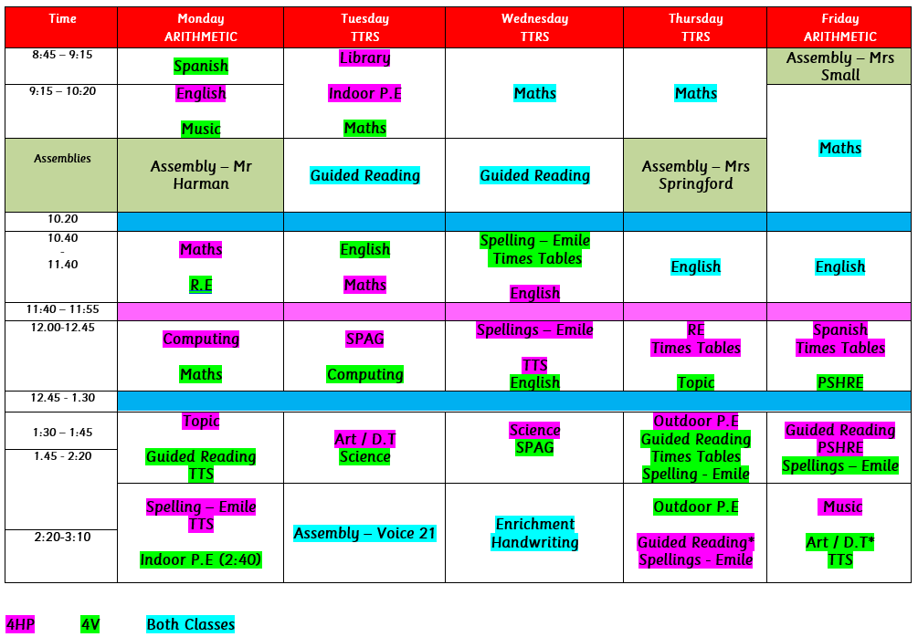
Time-
table

Slide 7
PE Kits
4HP
Tuesday (indoor PE)
Thursday (outdoor PE)
4V
Monday (indoor PE)
Thursday (outdoor PE)
When does my child need to wear their P.E kit?
Full P.E. kit is to be worn for both sessions.

Slide 8
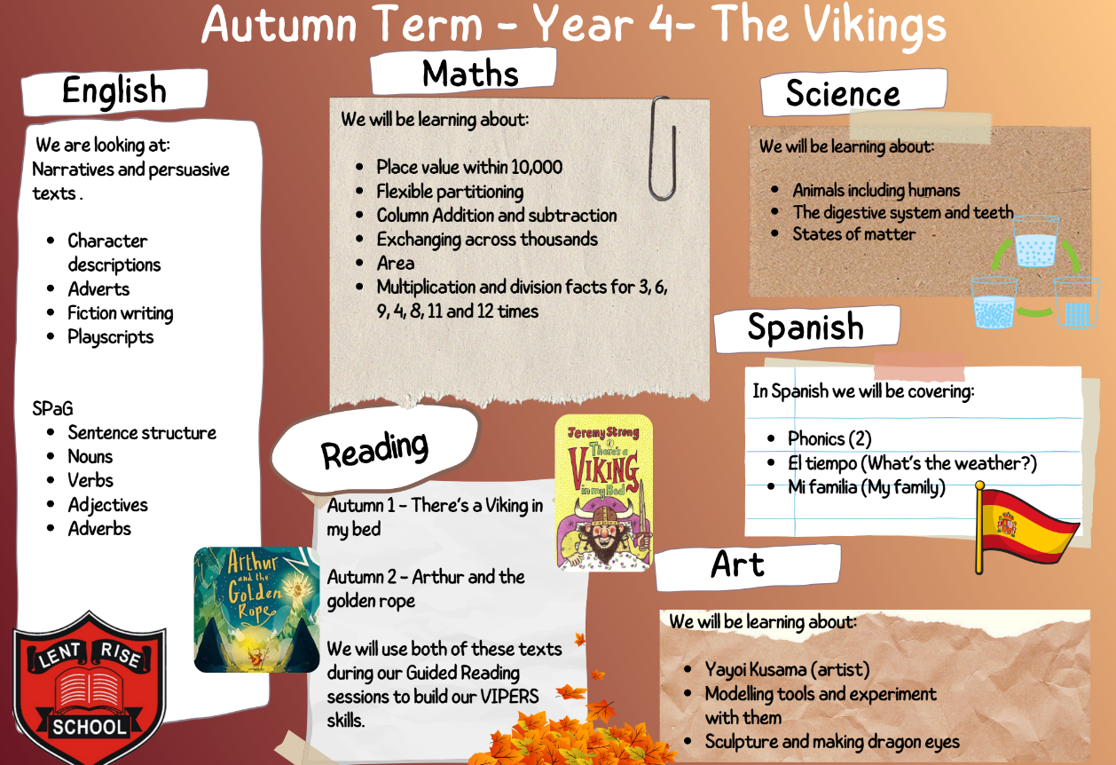
Curriculum
Overview

Slide 9
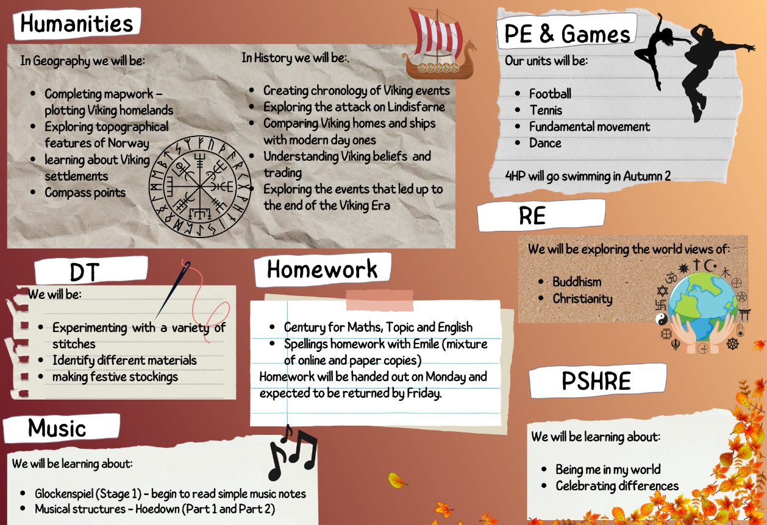
Curriculum
Overview

Slide 10
Curriculum overview
In KS2 schemes we use Magma Maths, White Rose Maths, Jigsaw RE and Jigsaw PSHRE, Teach Computing, Charanga Music, RWI Phonics, Century, Language Angels for Spanish and Emile Spellings.
We are a Voice 21 School so Oracy is embedded throughout the curriculum.
Accelerated Reader: Children on library can select AR books and complete quizzes in school to earn points.
Times Tables Rock Stars: Children have opportunities in class and at home to develop their times tables knowledge through an engaging platform.
Daily assemblies include British Values, Oracy, Citizenship, Singing and Celebration assembly.
Pre-learning and booster sessions are run weekly and range from practising key skills in maths, handwriting and spellings, to developing social skills and reading.
Gap Busting sessions are run 1-1 or in small groups on the same or following day to support children who have struggled with a concept.

Slide 11
Statutory Assessments
In year 4, the children will complete the Multiplication Tables Check.

Slide 12



The practicalities
The Check Itself.
Takes place in June
Is done on a tablet
Will take no longer than 5 minutes
There are 25 questions
Pupils have 6 seconds to answer each question
There’s no problem solving or division just simple “3 x 4 = ?” type questions
The results are for Teachers
There is no pass or fail mark
Results are not published

Slide 13
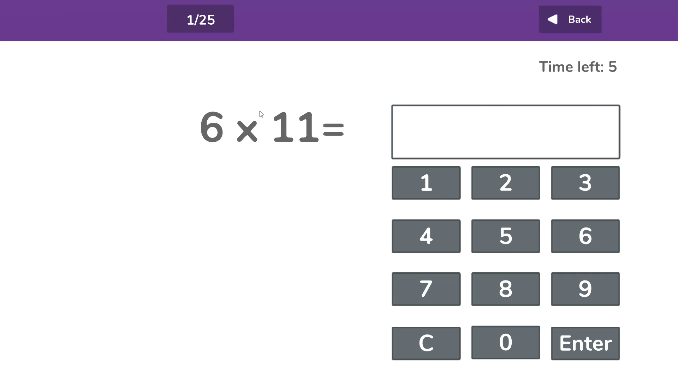

Slide 14

How You Can Help Your Child?
Practise at Home
We will of course continue to teach the full curriculum and would love your continued support to help practise the times tables with your children.
Some easy ways to do this include:
asking questions such as “What’s seven 8’s?”
Reciting times tables by Rote (4 times 1 is 4, 4 times 2 is 8, etc)
singing times tables songs (there are loads online)
Using apps and games (like Times Tables Rock Stars)

Slide 15
Assessments
Children complete termly assessments, these include:
Autumn 2: NFER Reading and NFER Arithmetic and Reasoning Papers
Spring 2: NFER Reading and NFER Arithmetic and Reasoning Papers
Summer 2: NFER Reading and NFER Arithmetic and Reasoning Papers
Science, history, geography and accelerated reader assessments every half term.
*Parents can request tests and/or test results after assessment week

Slide 16
Reporting
We are now sharing progress reports more frequently across the year, alongside opportunities for face-to-face discussions. Here’s what to expect:
Autumn 1: Face-to-Face Parent Evening: Wednesday 15th & Thursday 16th October 2025
You’ll receive a short Autumn 1 report during this meeting. It will share your child’s Age-Related Expectations (ARE) in Reading, Writing, Maths, and Science.
Autumn 2: Autumn Report sent home - Friday 15th December 2025
Parents will receive a progress report sent home, outlining:
ARE in core subjects
Progress this term
Attendance
Attitude to learning
Spring 1: Spring Reports and Face-to-Face Parent Evening
Monday 10th February 2026 - Parents will receive an ARE and Target Report sent home.
Parent Meetings:
Wednesday 11th & Thursday 12th February 2026 - These meetings will allow for discussion of your child’s targets and progress for Spring 1.
Spring 2: Spring Report sent home - Monday 23rd March 2026
This progress report will again include ARE, termly progress, attendance and learning attitude.
Summer 1: Summer Report sent home - Friday 11th May 2026
A short ARE report will be sent home to show where your child is working within the curriculum.
Summer 2: End of Year Report - Friday 10th July 2026
A full end-of-year report will be sent home, summarising your child’s learning and progress for the year.
* We have an open-door policy and additional teacher meetings can be requested throughout the year via the front office.

Slide 17
Homework
KS2 Weekly Homework:
Spellings:
  Children’s homework will be a mixture of paper copies and online tasks related to the rules we have learnt each week.
Maths:
Children will complete their maths challenges on Century Tech
Times Tables:
  All Y4 children are expected to use Times Tables Rock Stars (TTRS) regularly.
  They are encouraged to learn all the timetables up to 12s fluently.
English:
Children will complete either SPAG or reading homework on Century Tech. Children are expected to read regularly with an adult at home.

Slide 18
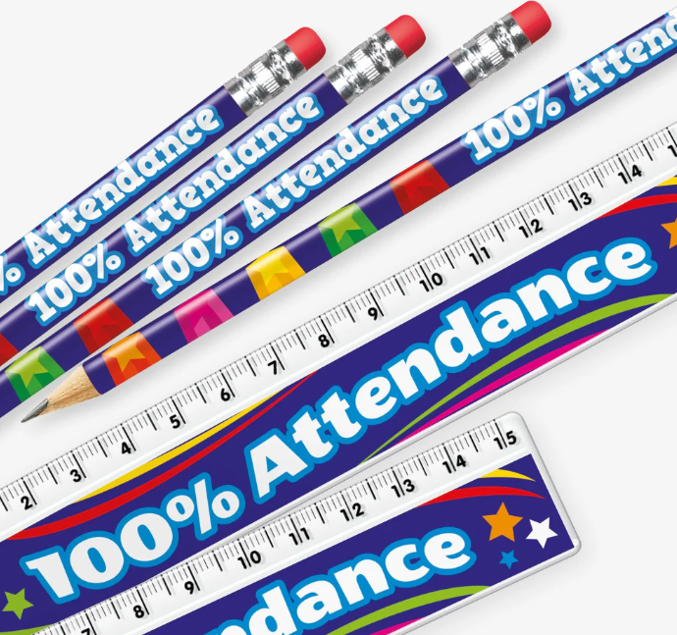
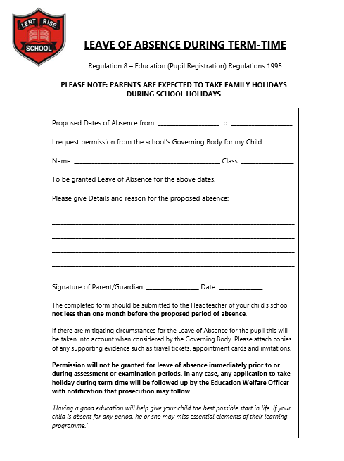
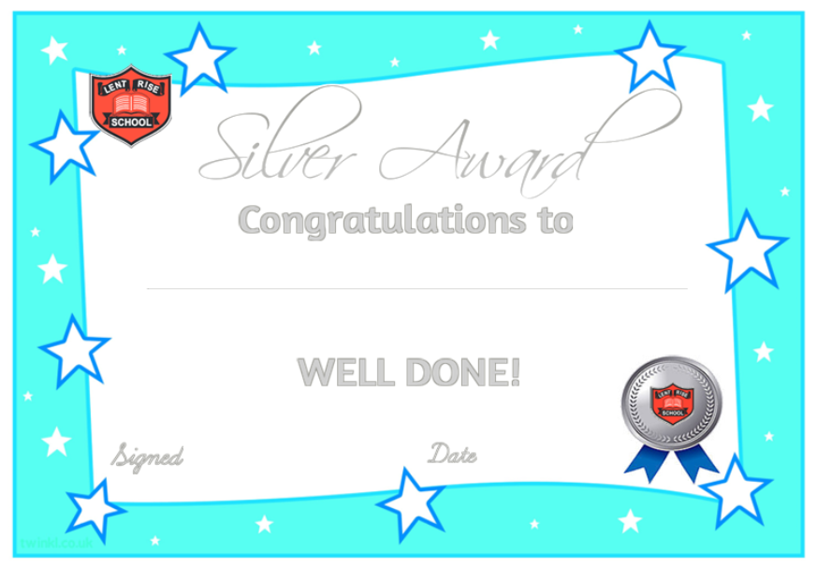
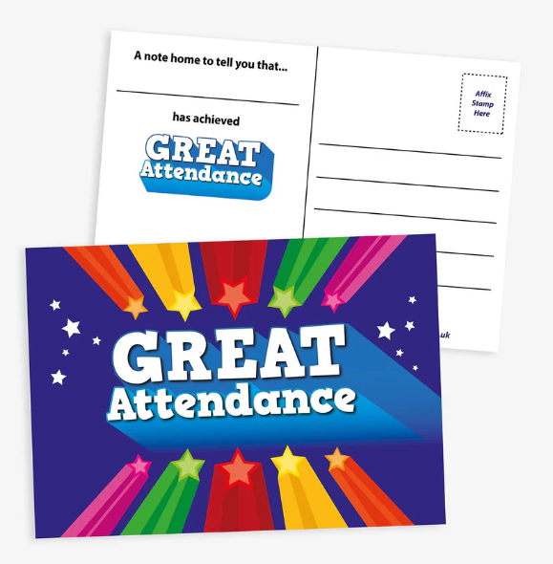

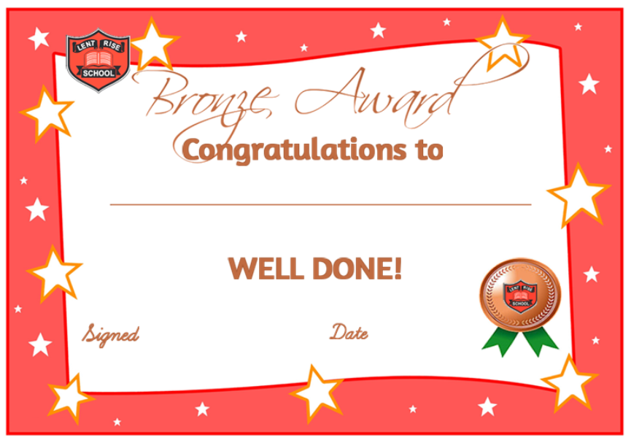
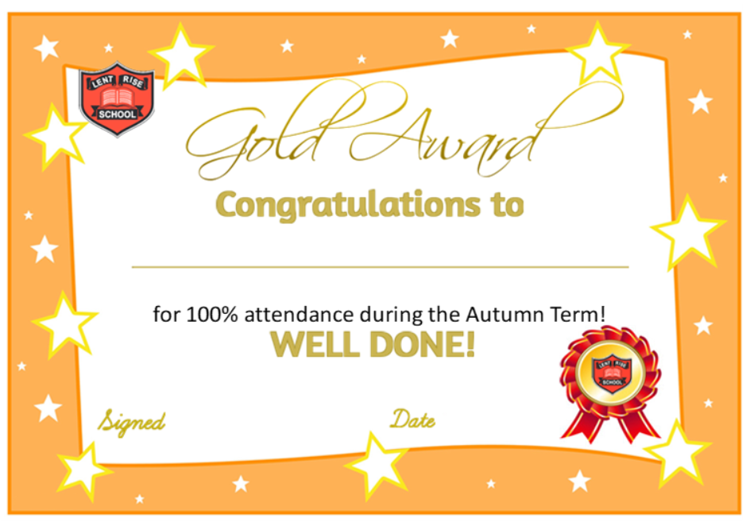
Attendance
Pupils are expected to: Attend school every day, on time.
Daily routines
The school gates open at 8:30am-8.45am.
Lates
If your child is late to school, please visit the school office to sign in.
Absence
Please log your child(s) absence via our ParentMail app using the absence section.
Planned absence
Attending a medical or dental appointment will be counted as authorised as long as you notify the school in advance of the appointment. We encourage parents/carers to make medical and dental appointments out of school hours where possible.
You can also apply for other types of term-time absence, a leave of absence form is available from the school office.
We strongly promote good attendance here at Lent Rise School and celebrate this in many different ways!
Children have the chance to receive a postcard home for great improvement of attendance and certificates in assembly for overall 100% each term. Classes get the opportunity to look after the attendance trophy for the week if they reached the highest % overall and pencils are given to any class with 100% that week. Mrs Barnard also does monthly shout outs in the school newsletter!

Slide 19
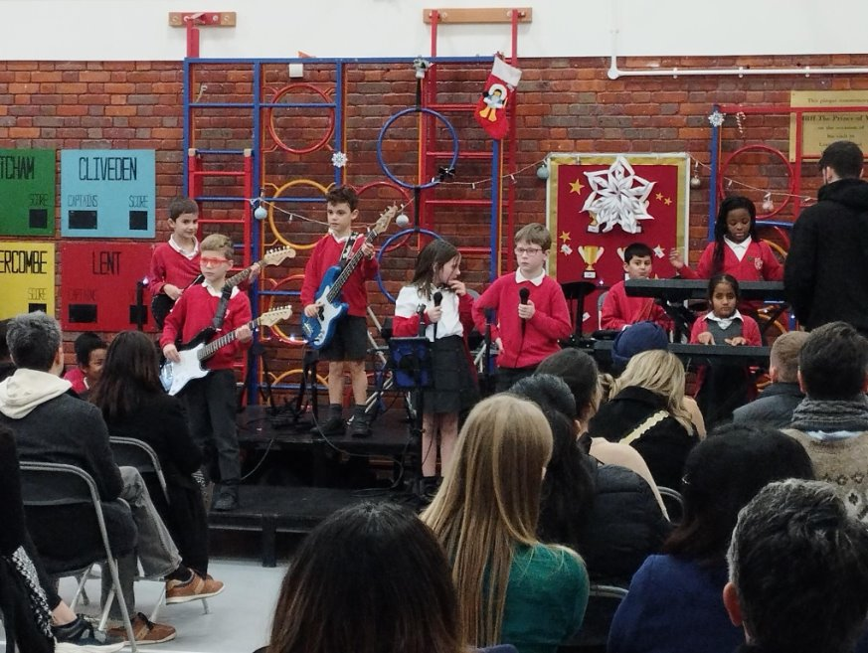




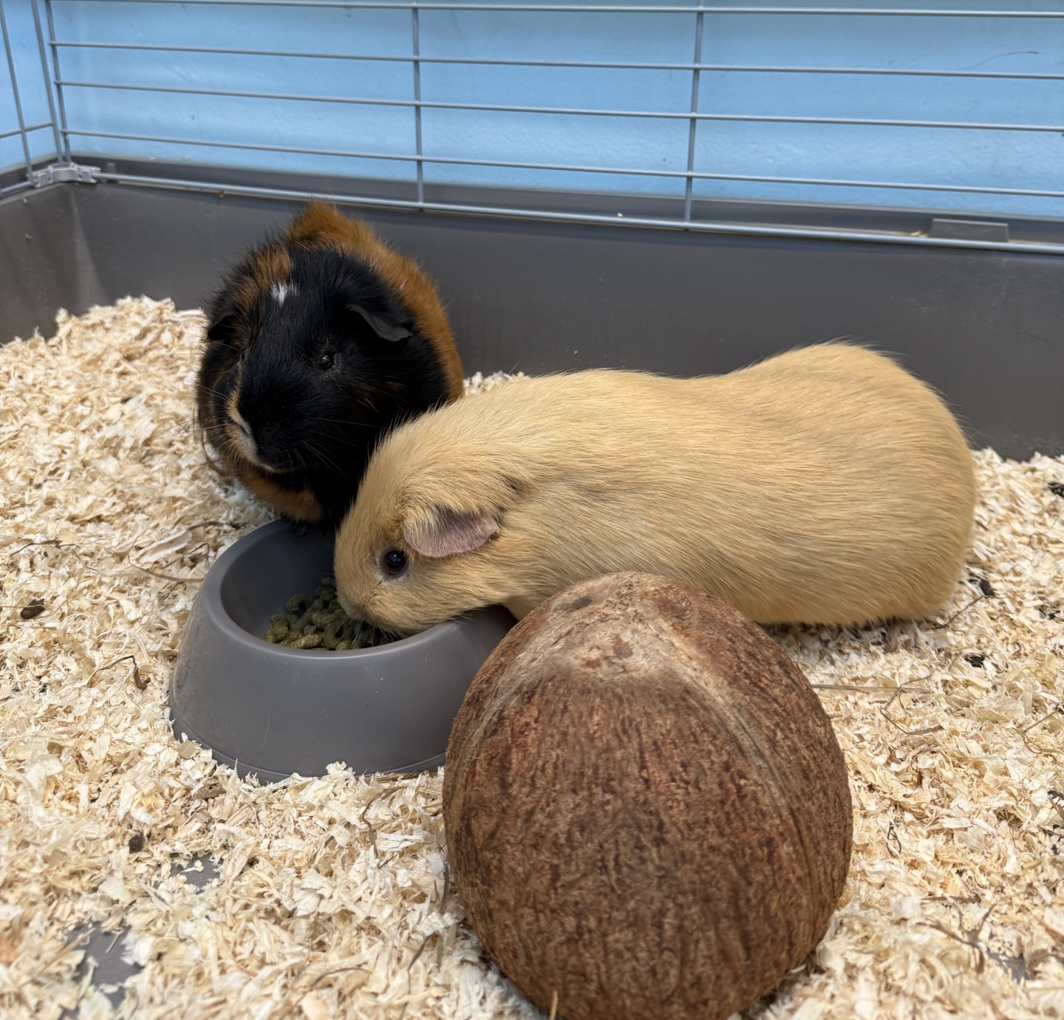

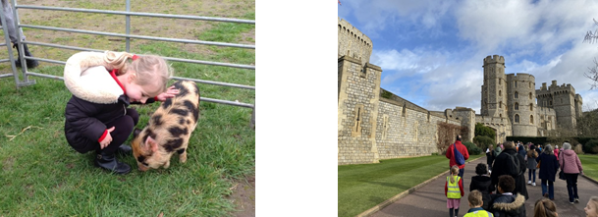
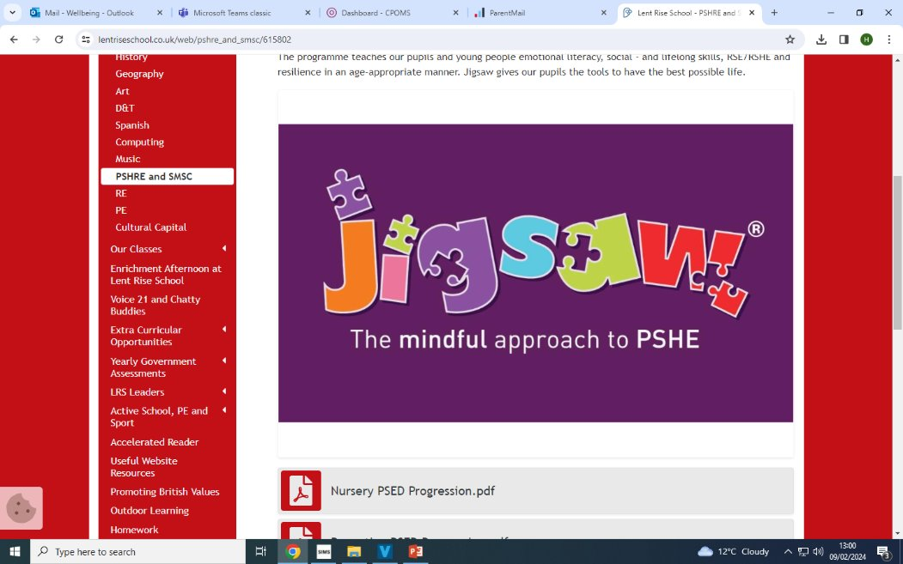
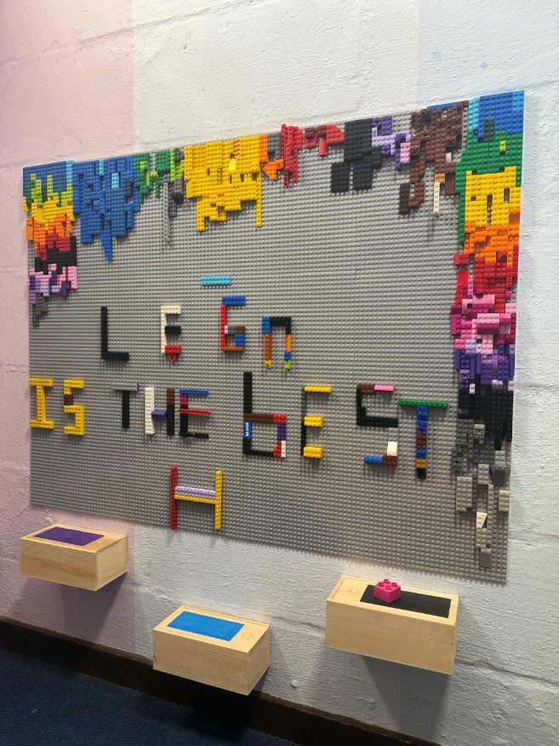
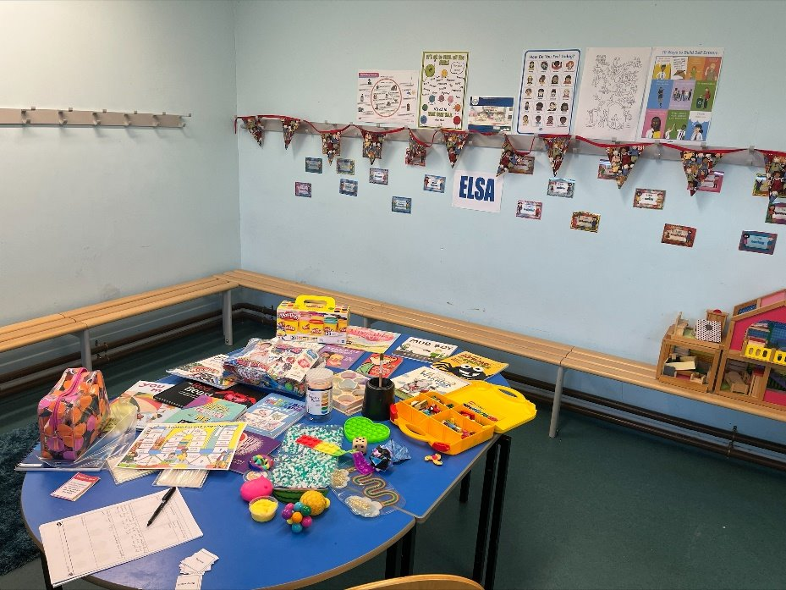
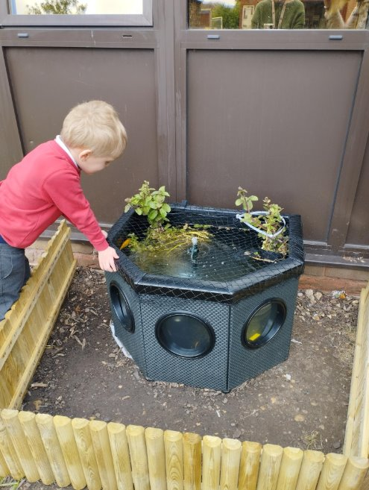
LRS Wellbeing Services
We consider our pupil’s pastoral needs, happiness and wellbeing to be of paramount importance. We make every effort to give our pupils the best start in life. We treat every child as an individual and give them every opportunity to achieve their full potential. We are committed to the development of children’s social, emotional skills, children’s self-esteem, their mental health and wellbeing.
At Lent Rise we offer many different services to support our pupils, such as...
Nurture Groups
Makaton (sign language)
ELSA
Young Carers
Play Therapy
Art Therapy
LRS Buddies supported by Bucks Mind
Wellbeing Ambassador (Miss Slade)
Mental Health First Aid
School Nursing Team
Clubs – Mindfulness & Yoga
PSHRE lessons
Chatty Buddies
Flash & Rory, our school Guinea Pigs
The Pond with our fish
Intergenerational Project
iRock
Trips & Visits
Lego Therapy
Drama sessions with Mrs Varney

Slide 20
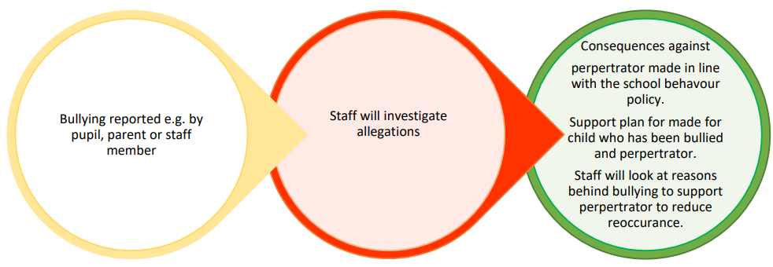
Anti-Bullying
Bullying is behaviour that hurts someone physically or mentally. It happens more than once, usually over time.
Bullying is different from teasing or ‘friendly banter’ because:
The bully wants to make the other person feel bad.
It happens over and over again
There is also cyber bullying that can be particularly traumatic for children as it can be inescapable.
Parents and children should report incidents of cyber-bullying involving children from the school in the same way as incidents of physical bullying.
All reported incidents will be taken seriously and investigated involving all parties.
We will communicate with parents of the child being bullied and the child accused of bullying
We do not disclose details relating to other individual children, including consequences given. We understand that this can be frustrating to parents who
want specific details about the actions taken against the perpetrator, Consequences against perpertrator made in line with the school behavour policy.
Staff will look at reasons behind bullying to support perpertrator to reduce reoccurance.
Staff will investigate allegations Bullying reported e.g. by pupil, parent or staff member but it is not appropriate to discuss an individual child with other parents and we ask parents to understand and respect this.

Slide 21
Online Safety
In Key Stage 1, pupils will be taught to:
Use technology safely and respectfully, keeping personal information private Identify where to go for help and support when they have concerns about content or contact on the internet or other online technologies
Pupils in Key Stage 2 will be taught to:
Use technology safely, respectfully and responsibly
Recognise acceptable and unacceptable behaviour
Identify a range of ways to report concerns about content and contact
By the end of primary school, pupils will know:
That people sometimes behave differently online, including by pretending to be someone they are not
That the same principles apply to online relationships as to face-to-face relationships, including the importance of respect for others online including when we are anonymous
The rules and principles for keeping safe online, how to recognise risks, harmful content and contact, and how to report them
How to critically consider their online friendships and sources of information including awareness of the risks associated with people they have never met How information and data is shared and used online
What sorts of boundaries are appropriate in friendships with peers and others (including in a digital context)
How to respond safely and appropriately to adults they may encounter (in all contexts, including online) whom they do not know

Slide 22
Important Dates
Autumn - 21st October 2025 – Ufton Court trips
  (The Vikings)
Spring – 27th January 2026 - Eton College
  (The Egyptians)
Summer – 5th May 2026 - VR Ocean Explorers(in school)
  (Oceans)

Slide 23
Friendly Reminders
PTA contributions over the past year have funded our music room, outdoor library and computing equipment, further enhancing your child’s learning. Thank you for your support!
Second hand uniform. We will be opening a uniform shack – parents can help themselves and make a small donation (suggested donation of £1 per item). Open on Tuesdays and Thursdays.
Website – Lots of resources are available on our website, including teaching content and progression maps.
We have an open-door policy – email office@lrschool.co.uk to arrange a call or meeting
Please check the newsletter for all upcoming non-uniform days
Any Questions?

