Slide 1

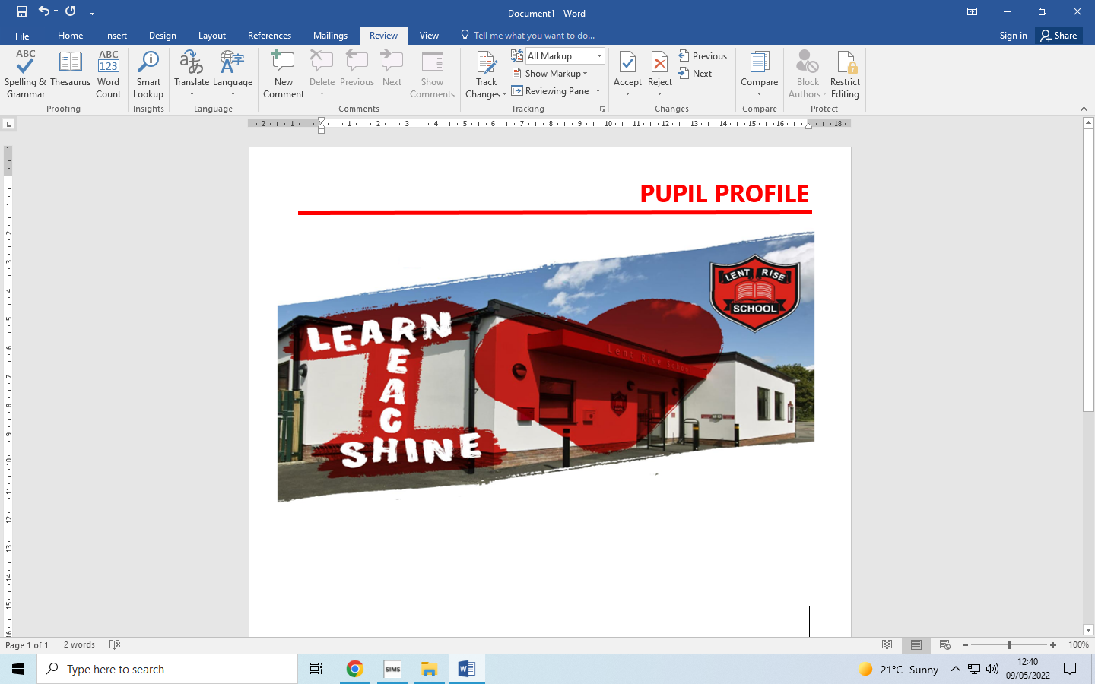
LENT RISE SCHOOL
‘Learn, Reach, Shine’
YEAR 4
PARENT PACK
Lent Rise School
Coulson Way, Burnham, Slough, SL17NP
Headteacher : Mrs J Watson
Telephone : 01628 662913
office@lrschool.co.uk
www.lentriseschool.co.uk

Slide 2
CONTENTS
Year 4 Information | 3
Curriculum | 4
Attendance and punctuality | 5
Our Open Door Policy | 6
Free School Meals and Pupil Premium Funding | 7
Safeguarding Information | 10
Term Dates | 11
USEFUL INFORMATION TO BE FOUND ON THE SCHOOL’S WEBSITE
Term Dates
Curriculum
Homework Policy
How you can Help with Writing
How to Help at Home
Teacher Assessment using Target Tracker
Registration
School Uniform
First Aid and Medication
Inhalers and Auto Injector Devices
This pack contains information only, contact and permissions information will be circulated separately.

Slide 3
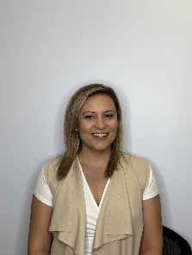
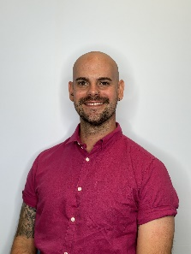
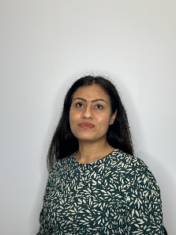
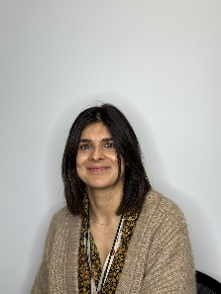
YEAR 4 INFORMATION
YEAR 4 INFORMATION
Year 4 is part of Key Stage 2 (KS2) which consists of Years 3 to 6. We will often abbreviate Year 4 to Y4 or use the class name e.g., 3B (Mrs Burniki’s class). The Phase Leader is Mr Harman.
KS2 timings
8.40 am Morning registration
8:55 am Guided Reading
9.20 am Lesson 1
10.00 am Assembly
10.20 am Morning break
10.40 am Lesson 2
11.40 am Fit in 10
11.50 am Lesson 3
12.45 pm Lunch
1.30 pm Afternoon registration + Afternoon lessons
3.15 pm Home time
PE Days:
4B: Wednesday & Thursday
4V: Wednesday & Thursday
Homework Schedule
Monday | Tuesday | Wednesday | Thursday | Friday
Comprehension (Century) | Maths (Century) | TTRS | Science (Century)
This is a suggested timetable. All homework will be set on a Monday. Homework set on a Monday is to be handed in by Thursday. Your child should be reading and practising their times tables each day too.
A Message from Year 4
Welcome! We hope that you find all of the information in this pack useful. If you have any questions after reading this Parent Pack or would like to talk to us about the year ahead, please do let us know so that we can arrange a time to meet with you. Please help us by:
Making sure that jumpers and PE kits are named.
Making sure you child has their reading record in school every day.
If you need to write a note for the teacher’s attention, please write a separate note on a piece of paper which your child can hand to their teacher.
Phase Leader Mr Harman
4V Class Teacher Mrs Verma
4B Class Teacher Mrs Burniki
HLTA Ms Masood

Slide 4
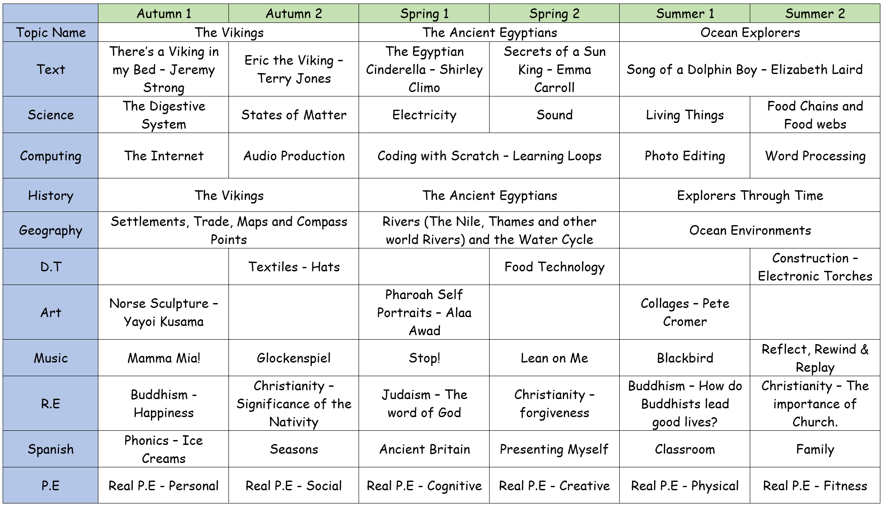
CURRICULUM
During the course of the year your child, in addition to English and Maths, will be studying the following subject areas. We hope this information will be of interest and will help you to share the work with your child by providing further reading material, or perhaps arranging a trip to a suitable museum, etc.
Each year group will take part in Educational visits designed to enhance the children's learning of the curriculum. Visits may change from year to year but in the past, Year 4 visited Oxford Natural History Museum and Ufton Court.

Slide 5
ATTENDANCE AND PUNCTUALITY
As parents you all have a legal responsibility to make sure that your child attends school every day. If your child is going to be absent from school please log the reason via the ParentMail absence portal on the first day of their absence. This is important, as we will be contacting parents if a child is not at school and no reason has been given. Parents may be asked to provide medical evidence in the form of an appointment card or prescription where there are repeated absences due to reported illness.
Regular attendance and punctuality is fundamental to enabling your child to achieve the highest levels of attainment. We ensure all children are aware of the importance of attendance and punctuality.
The attendance target set by the Governing Body for 2023-2024 is 96%. We expect ALL children to achieve this.​
If your child is unwell
If your child is too unwell to come to school, or has a medical appointment, please log the reason via our ParentMail absence portal. To help you, the NHS has compiled a list of guidelines about how long children should be kept off school when they have a common illnesses:
https://www.nhs.uk/Livewell/Yourchildatschool/Pages/Illness.aspx
Lateness
Learning begins promptly at the beginning of the day with instructions and explanations and it is vital that your child does not miss this part of the day. We monitor lateness and send letters to parents whose children regularly arrive to school late. The playground gates will open at 8:55am and close at 9:15am. Your child may come into school between these times and head straight to class. However if your child does miss the gate to go into class, please bring them to the School Office where a member of staff will sign them in.
Authorised absence
Family holidays should always be taken during the school holidays, and we will only authorise absence in very special circumstances. On these occasions permission must be sought in advance from the Headteacher. Absence request forms are available from the school office or a letter should be written to the Headteacher. Each request will be considered individually and will take into account documentary evidence and any extenuating circumstances. If the permission to take leave is not granted and the pupil is absent, the absence will be unauthorised. In such cases the school may refer the matter to the Education Welfare Service who may issues a Penalty notice.

Slide 6
OUR OPEN DOOR POLICY
Please do contact us at any time when you have a concern, even if it appears to be minor. The ‘little’ difficulties are easy to deal with; don’t let them become major concerns. The Open Door Policy is encouraged at Lent Rise School. If you wish to talk about your child please:-
1. Approach the class teacher
2. Talk to a member of the Senior Leadership Team
3. The Headteacher, Mrs Watson, is always happy to see parents, but she will go to the Class Teacher to discuss issues, therefore it makes sense for you to have spoken to the teacher first.
Contacting the Headteacher if she is not in School
When the Headteacher is out, your children are always in safe hands. If you need an immediate response, please contact the school office and a member of the Senior Leadership Team will get a response to you as soon as possible.
Complaints and Resolution Procedure
The following is the strategy that is suggested if difficulties arise – we recommend that you use this structure.
1. Talk to the Class Teacher
2. Talk to a member of the Senior Leadership Team
3. Talk to the Headteacher
4. Make Representations to the Governing Body in writing to:
Mrs Maggie Young, Chair of Governors
by e-mail: govs@lrschool.co.uk or
c/o Lent Rise School
Coulson Way
Burnham
Slough
SL1 7NP
5. If you are still not satisfied you may wish to put your complaint to the Secretary of
State for Education and Skills who can review whether the school has acted reasonably
and followed the correct procedures. The address is: Sanctuary Buildings, Great Smith
Street, London, SW1 3BT.
If you would like to read our full complaints and resolution procedure, please contact the school office for a copy or visit the school website www.lentriseschool.co.uk

Slide 7
FREE SCHOOL MEALS AND PUPIL PREMIUM FUNDING
Do you receive any of the following benefits:
Income support
Income based Job Seekers’ Allowance (IBJSA)
Income-related Employment and Support Allowance (ESA)
Support under part VI of the Immigration and Asylum Act 1999
Child tax credit, with income under the threshold set by the Treasury, (Not Working Tax Credit)
The ‘Guarantee’ element of Pension Credit
All children in Early Years, Years 1 and 2 are eligible to have a universal school meal. But we still need parents receiving the benefits listed above to sign up to the Free School Meals service. If you have a child in KS2 they will also be eligible for a free school meal, but only if you apply!
Why sign up?
For the school
We receive additional funding for children who would be eligible for Free School meals even if they were not in Early Years, Year 1 or Year 2. This funding is called Pupil Premium and we use it to support progress and achievement (you can find out how we spent this year’s Pupil Premium on our website https://www.lentriseschool.co.uk/website.
For you
If we know that your child would be eligible for Free School Meals even if they were not in Early Years, Year 1 or Year 2 we can provide additional support to them in school. We can also help with the cost of school uniform, PE kits, school trips, clubs and music lessons on a case-by-case basis.
Signing-up takes less than 5 minutes
All you need to do is complete a short form. You do not need to provide any proof of your eligibility. You only need to sign-up once and we will automatically re-check your details every term. If you are still eligible, your child will continue to receive a free school meal in Key Stage 2. The school office staff will be happy to answer your questions or help you complete the form.
All applications are dealt with in confidence.

Slide 8
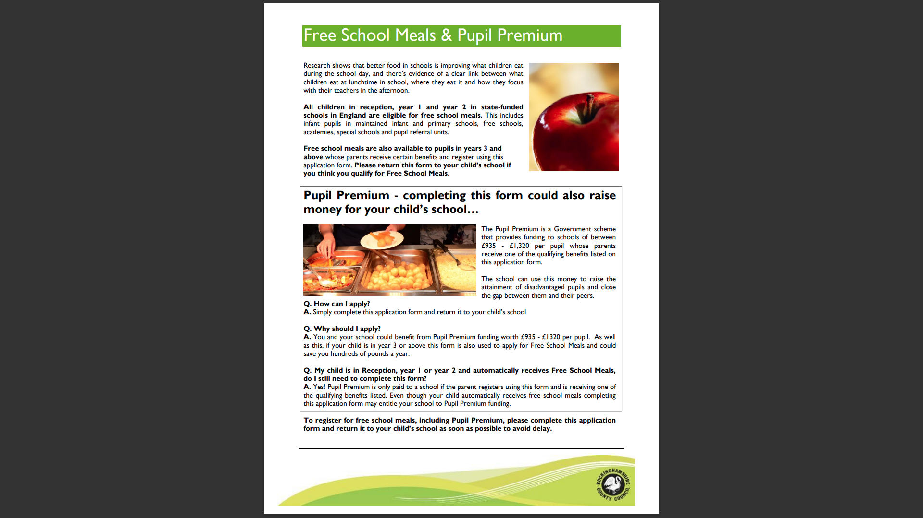

Slide 9
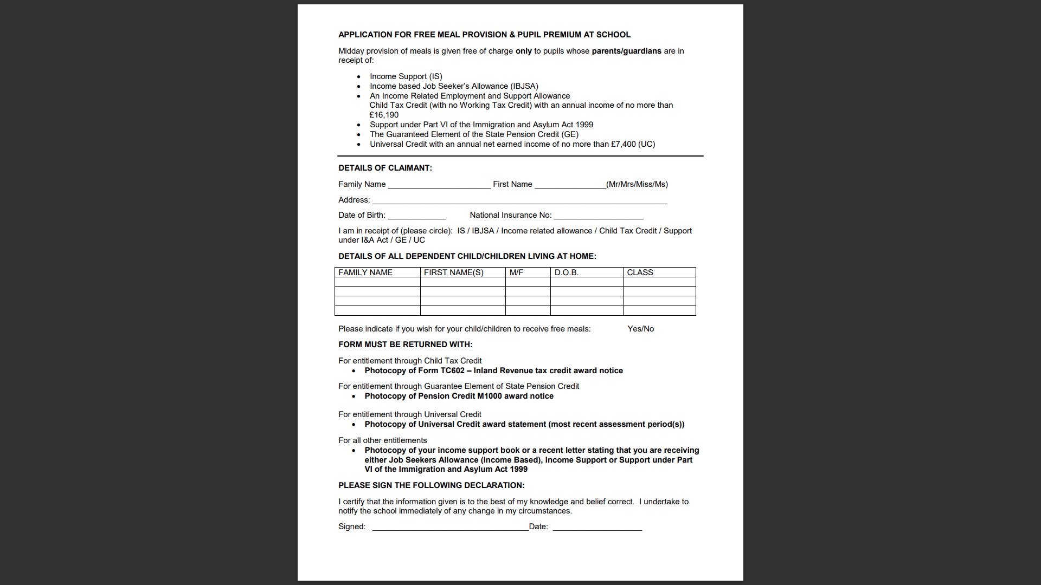

Slide 10
SAFEGUARDING
“At this school, the health, safety and well-being of every child are our paramount concern. We listen to our pupils and take seriously what they tell us. Our aim is for children to enjoy their time as pupils in this school. We want to work in partnership with you to help your child achieve their full potential and make a positive contribution.
To promote a safe environment for pupils, our selection and recruitment policy includes all checks on staff and regular volunteers’ suitability, including Criminal Records Bureau checks, as recommended by Buckinghamshire County Council in accordance with current legislation.
In accordance with our responsibilities under section 175/157 of the Education Act 2002 and “Keeping Children Safe in Education“ Sept 2023. There are four trained Designated Safeguarding Leads, the Headteacher Mrs J Watson, Deputy Headteacher Mrs R Small, and the two Assistant Headteachers Miss Boxall and Miss Johns, this ensures there is a DSL on duty at all times. It is their responsibility to ensure that all staff in contact with children receive child protection awareness training on a regular basis.
Occasions do arise when our concern about a child means we have to consult other agencies. Whilst we would always aim to work in partnership with parents there may be exceptions to this when concerns are raised for the protection of a child.
On very rare occasions Social Care, whilst undertaking an investigation under s47 of the Children Act 1989, may want to speak to a child without a parents’ knowledge. This would be a decision made in collaboration with partner agencies and would only be done in situations where a child might be at immediate risk. To gain consent at this point may increase the level of risk to the child or cause evidence of a crime to be lost.
The procedures, which we follow, have been laid down by the Local Safeguarding Children’s Board, and the school has adopted a Child Protection Policy in line with this for the safety of all. If you want to know more about our procedures, please speak to the Headteacher, Mrs J Watson or your child’s class teacher: the Policy can be found on the school’s website www.lentriseschool.co.uk

Slide 11
TERM DATES 2023-2024
Autumn Term 2023
Open on the morning of: Close at end of afternoon on:
Tuesday 5th September Friday 20th October
(*INSET: Friday 1st September, Monday 4th September)
(Half Term – Monday 23rd October – Friday 27th October)
Monday 30th October Friday 15th December
(Christmas – Tuesday 19th December – Tuesday 2nd January)
(*INSET: Monday 18th December)
Spring Term 2024
Open on the morning of: Close at end of afternoon on:
Thursday 4th January Friday 9th February
(*INSET: Wednesday 3rd January)
(Half Term – Monday 12th February – Friday 16th February)
Monday 19th February Thursday 28th March
(Easter – Friday 29th March – Friday 12th April)
Summer Term 2024
Open on the morning of: Close at end of afternoon on:
Monday 15th April Thursday 23rd May
(*INSET: Friday 24th May)
(Half Term – Monday 27th May – Friday 31st May)
Monday 3rd June Friday 19th July
(*INSET: Monday 22nd July, Tuesday 23rd July)
Early May Bank Holiday: Monday 6th May
* Inset days are for the staff only.
Whether term is starting or ending, the school start and finish times are the same.

