Slide 1

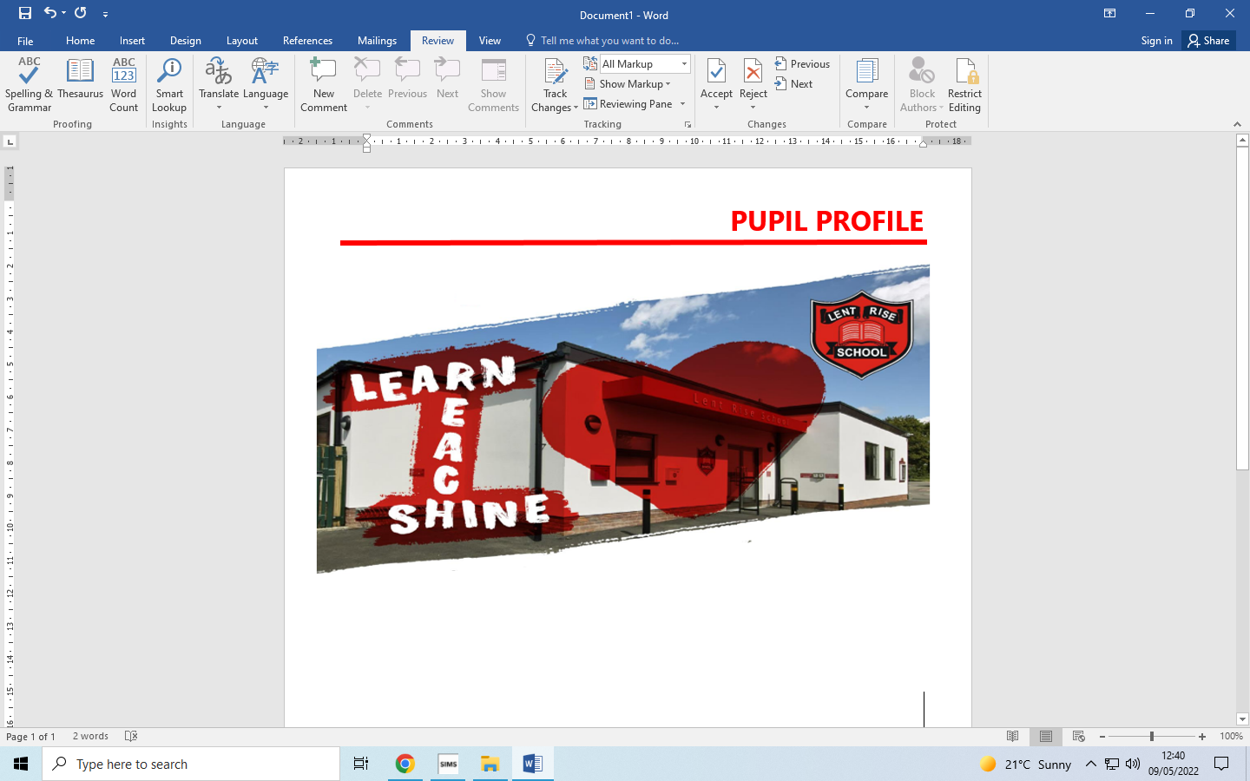
LENT RISE SCHOOL
‘Learn, Reach, Shine’
YEAR 3
PARENT PACK
Lent Rise School
Coulson Way, Burnham, Slough, SL17NP
Headteacher : Mrs J Watson
Telephone : 01628 662913
office@lrschool.co.uk
www.lentriseschool.co.uk

Slide 2
CONTENTS
Year 3 Information | 3
Curriculum | 4
Attendance and punctuality | 5
Our Open Door Policy | 6
Free School Meals and Pupil Premium Funding | 7
Safeguarding Information | 10
Privacy/ Data Protection Notice | 11
USEFUL INFORMATION TO BE FOUND ON THE SCHOOL’S WEBSITE
Term Dates
Curriculum
Homework Policy
How you can Help with Writing
How to Help at Home
Year 3 Vocabulary
Teacher Assessment using Target Tracker
Registration
School Uniform
First Aid and Medication
Inhalers and Auto Injector Devices
This pack contains information only, contact and permissions information will be circulated separately.

Slide 3
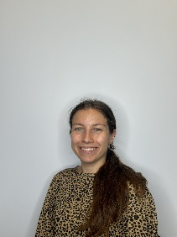
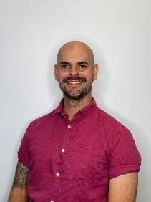
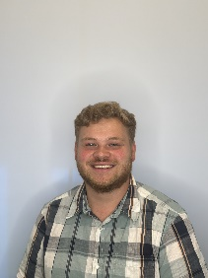
YEAR 3 INFORMATION
Year 3 is part of Key Stage 2 (KS2) which consists of Years 3 to 6. We will often abbreviate Year 3 to Y3 or use the class name e.g., 3A (Mr Anderson’s class). The Phase Leader is Mr Harman.
KS2 timings
8.40 am Morning registration
8:55 am Guided Reading
9.20 am English
10.00 am Assembly
10.20 am Morning break
10.40 am Maths
11.40 am Fit in 10
11.50 am Lesson 3
12.45 pm Lunch
1.30 pm Afternoon registration + Afternoon lessons
3.15 pm Home time
PE Days:
3A: Monday & Wednesday
3E: Monday & Wednesday
Homework Schedule
Monday | Tuesday | Wednesday | Thursday | Friday
Comprehension (Century) | Maths (Century) | TTRS | Science (Century) | Reading
Welcome! We hope that you find all of the information in this pack useful. If you have any questions after reading this Parent Pack or would like to talk to us about the year ahead, please do let us know so that we can arrange a time to meet with you. Other information:
Reading records should be signed every night, to confirm that your child has been heard reading, and they should be returned the next day to the class teacher.
Library books can be changed every day during the children’s lunchtime.
In Year 3 children are encouraged to become more independent and to understand that there are consequences for their actions. This means taking on more responsibilities at home with homework and in the classroom with strategies for learning. The children are encouraged to undertake monitor roles in class and organise themselves independently for example for PE, changing reading books and at the end of the day.
The learning day is different in Year 3. We have an extra morning session which means lunch is later and we also lose the afternoon break. Children will be advised that break and lunch time are the suitable times to go to the toilet.
At the start of Year 3, class rules are decided by the children. We encourage Year 3 children to create their own rules and expectations so that they can develop independence and responsibility.
Phase Leader
Mr Harman
3E Class Teacher | 3A Class Teacher
Miss Enright | Mr Anderson

Slide 4
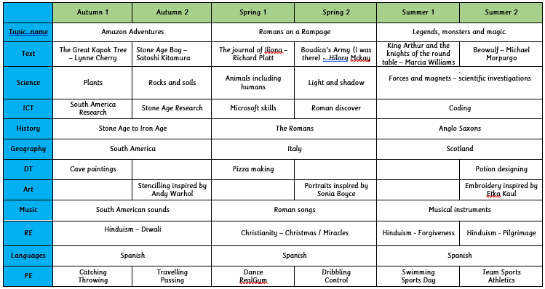
CURRICULUM
During the course of the year, your child, in addition to English and Maths, will be studying the following subject areas. We hope this information will be of interest and will help you to share the work with your child by providing further reading material, or perhaps arranging a trip to a suitable museum, etc.
The Journal of Iliona – Richard Platt
Boudica’s Army – Hilary Mckay
The Boy who Grew Dragons – Andy Shepherd
The Nothing to See Here Hotel – Steven Butler
Connecting Computers
Sequencing Sounds - Scratch
Branching Databases
Desktop Publishing
Events and Actions - Scratch
Animation
Pencil Cases
Moving Monsters
Pizza Making
Stencilling – Andy Warhol
Portraits – Sonia Boyce
Painting with Fabrics – Barbara Shaw
Each year group will take part in Educational visits designed to enhance the children's learning of the curriculum. Visits may change from year to year but last year, Year 3 visited the Living Rainforest and St. Albans.

Slide 5
ATTENDANCE AND PUNCTUALITY
As parents you all have a legal responsibility to make sure that your child attends school every day. If your child is going to be absent from school, please contact the school office on the first day of their absence. This is important, as we will be contacting parents if a child is not at school and no reason has been given.
Regular attendance and punctuality is fundamental to enabling your child to achieve the highest levels of attainment. We ensure all children are aware of the importance of attendance and punctuality.
The attendance target set by the Governing Body for 2023-2024 is 96%. We expect ALL children to achieve this.​
If your child is unwell
If your child is too unwell to come to school, or has a medical appointment, please contact the school office as soon as possible. To help you, the NHS has compiled a list of guidelines about how long children should be kept off school when they have a common illness.
https://www.nhs.uk/Livewell/Yourchildatschool/Pages/Illness.aspx
Lateness
Learning begins promptly at the beginning of the day with instructions and explanations and it is vital that your child does not miss this part of the day. We monitor lateness and send letters to parents whose children regularly arrive to school late.
Authorised absence
Family holidays should always be taken during the school holidays, and we will only authorise absence in very special circumstances. On these occasions permission must be sought in advance from the head teacher. Absence request forms are available from the school office or a letter should be written to the head teacher.

Slide 6
OUR OPEN DOOR POLICY
Please do contact us at any time when you have a concern, even if it appears to be minor. The ‘little’ difficulties are easy to deal with; don’t let them become major concerns. The Open Door Policy is encouraged at Lent Rise School. If you wish to talk about your child please:
Approach the class teacher
Talk to a member of the middle management team (KS1 or KS2 Phase Leaders)
Talk to a member of the senior leadership team
The Headteacher, Mrs Watson, is always happy to see parents but clearly she will go to the Class Teacher to discuss issues, therefore it makes sense for you to have spoken to the teacher first.
Contacting the Headteacher if she is not in School
When the Headteacher is out, your children are always in safe hands. If you need an immediate response, please contact the School Office and a member of the senior leadership team will get a response to you as soon as possible.
Complaints and Resolution Procedure
The following is the strategy that is suggested if difficulties arise – we recommend that you use this structure.
Talk to the Class Teacher
Talk to a member of the senior leadership team
Talk to the Headteacher
Make Representations to the Governing Body in writing to:
Mrs Maggie Young, Chair of Governors
by e-mail: govs@lentrise.bucks.sch.uk
or
c/o Lent Rise School
Coulson Way
Burnham
Slough
SL1 7NP
If you are still not satisfied you may wish to put your complaint to the Secretary of State for Education and Skills who can review whether the School has acted reasonably and followed the correct procedures. The address is Sanctuary Buildings, Great Smith Street, London, SW1 3BT.
If you would like to read our full Complaints Procedure, please contact the school office for a copy or visit the school website www.lentriseschool.co.uk

Slide 7



FREE SCHOOL MEALS AND PUPIL PREMIUM FUNDING
Do you receive any of the following benefits:
Income support
Income based Job Seekers’ Allowance (IBJSA)
Income-related Employment and Support Allowance (ESA)
Support under part VI of the Immigration and Asylum Act 1999
Child tax credit, with income under the threshold set by the Treasury, (Not Working Tax Credit)
The ‘Guarantee’ element of Pension Credit
All children in Early Years, Years 1 and 2 are eligible to have a universal school meal. But we still need parents receiving the benefits listed above to sign up to the Free School Meals service. If you have a child in KS2 they will also be eligible for a free school meal, but only if you apply!
Why sign up?
For the school
We receive additional funding for children who would be eligible for Free School meals even if they were not in Early Years, Year 1 or Year 2. This funding is called Pupil Premium and we use it to support progress and achievement (you can find out how we spent this year’s Pupil Premium on our website https://www.lentriseschool.co.uk/website.
For you
If we know that your child would be eligible for Free School Meals even if they were not in Early Years, Year 1 or Year 2 we can provide additional support to them in school. We can also help with the cost of school uniform, PE kits, school trips, clubs and music lessons on a case-by-case basis.
Signing-up takes less than 5 minutes
All you need to do is complete a short form. You do not need to provide any proof of your eligibility. You only need to sign-up once and we will automatically re-check your details every term. If you are still eligible, your child will continue to receive a free school meal in Key Stage 2. The school office staff will be happy to answer your questions or help you complete the form.
All applications are dealt with in confidence.

Slide 8


Slide 9
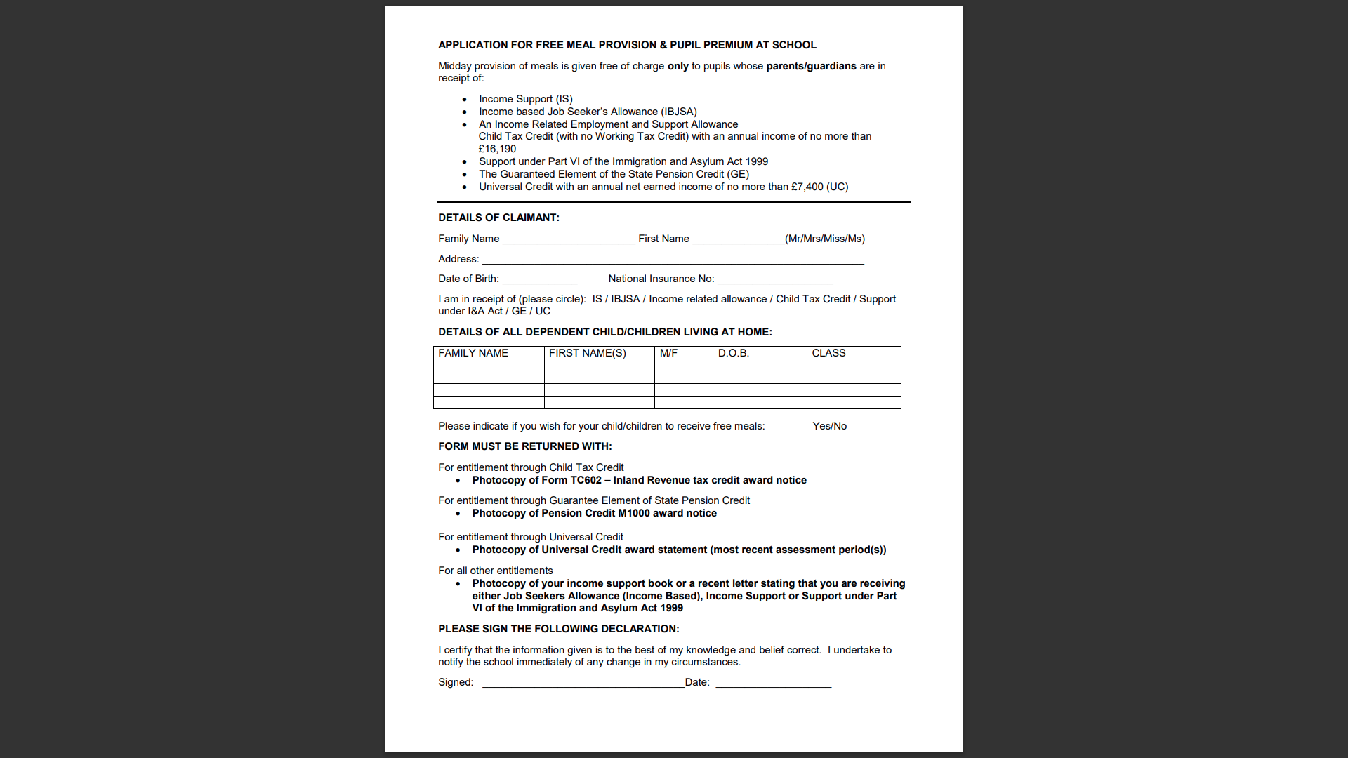

Slide 10
SAFEGUARDING
“At this school, the health, safety and well-being of every child are our paramount concern. We listen to our pupils and take seriously what they tell us. Our aim is for children to enjoy their time as pupils in this school. We want to work in partnership with you to help your child achieve their full potential and make a positive contribution.
To promote a safe environment for pupils, our selection and recruitment policy includes all checks on staff and regular volunteers’ suitability, including Criminal Records Bureau checks, as recommended by Buckinghamshire County Council in accordance with current legislation.
In accordance with our responsibilities under section 175/157 of the Education Act 2002 and “Keeping Children Safe in Education“ Sept 2023. There are four trained Designated Safeguarding Leads, the Headteacher Mrs J Watson, Deputy Headteacher Mrs R Small, and the two Assistant Headteachers Miss Boxall and Miss Johns, this ensures there is a DSL on duty at all times. It is their responsibility to ensure that all staff in contact with children receive child protection awareness training on a regular basis.
Occasions do arise when our concern about a child means we have to consult other agencies. Whilst we would always aim to work in partnership with parents there may be exceptions to this when concerns are raised for the protection of a child.
On very rare occasions Social Care, whilst undertaking an investigation under s47 of the Children Act 1989, may want to speak to a child without a parents’ knowledge. This would be a decision made in collaboration with partner agencies and would only be done in situations where a child might be at immediate risk. To gain consent at this point may increase the level of risk to the child or cause evidence of a crime to be lost.
The procedures, which we follow, have been laid down by the Local Safeguarding Children’s Board, and the school has adopted a Child Protection Policy in line with this for the safety of all. If you want to know more about our procedures, please speak to the Headteacher, Mrs J Watson or your child’s class teacher: the Policy can be found on the school’s website www.lentriseschool.co.uk

Slide 11
TERM DATES 2023-2024
Autumn Term 2023
Open on the morning of: Close at end of afternoon on:
Tuesday 5th September Friday 20th October
(*INSET: Friday 1st September, Monday 4th September)
(Half Term – Monday 23rd October – Friday 27th October)
Monday 30th October Friday 15th December
(Christmas – Tuesday 19th December – Tuesday 2nd January)
(*INSET: Monday 18th December)
Spring Term 2024
Open on the morning of: Close at end of afternoon on:
Thursday 4th January Friday 9th February
(*INSET: Wednesday 3rd January)
(Half Term – Monday 12th February – Friday 16th February)
Monday 19th February Thursday 28th March
(Easter – Friday 29th March – Friday 12th April)
Summer Term 2024
Open on the morning of: Close at end of afternoon on:
Monday 15th April Thursday 23rd May
(*INSET: Friday 24th May)
(Half Term – Monday 27th May – Friday 31st May)
Monday 3rd June Friday 19th July
(*INSET: Monday 22nd July, Tuesday 23rd July)
Early May Bank Holiday: Monday 6th May
* Inset days are for the staff only.
Whether term is starting or ending, the school start and finish times are the same.

