Slide 1

Welcome to Year 2

Slide 2
The Year 2 Team
Phase Lead: Miss Boxall & Miss Johns
2B | 2W
Miss Boxall | Mr Waldeck
Miss Lovell
Mrs Caltagirone Miss Foley Mr Pipial Mrs Lewis Miss La Placa

Slide 3
Still relevant??? Our class timetables can be found on the school website underneath our class pages.
Timetables
The school day begins at 08:30. Children need to be in class ready for the register at 08:45. Any child who arrives after the register has been completed will need to sign in at the front office.
We begin each day with a variety of tasks including Journal Writing, handwriting, reading and three Maths flashbacks to practise and strengthen arithmetic skills.

Slide 4
Timetables
Lessons that are taught 5 x a week → Maths, English, Guided Reading/Phonics
Lessons that are taught 4x a week → Maths Mastery
Lessons that are taught 3x a week → Emile Spellings
Lessons taught 1 x a week → Computing, PSHRE, R.E, Humanities, Science, Outdoor P.E and Indoor P.E, Art/Design and Technology and Music.
Classes have a weekly allocated library slot.

Slide 5
Enrichment Afternoons
Our Enrichment Afternoons cover a range of practical, hands-on activities across the Curriculum will commence in Autumn 2.
Our enrichment sessions take place on a Wednesday. These are 45 minute weekly sessions that will have a curriculum focus and be taught from Reception through to Year 6.
PE & Life Skills, Science, Computing, Outdoor Learning, Spanish, Story Telling, Oracy (through poetry) and Cooking.

Slide 6
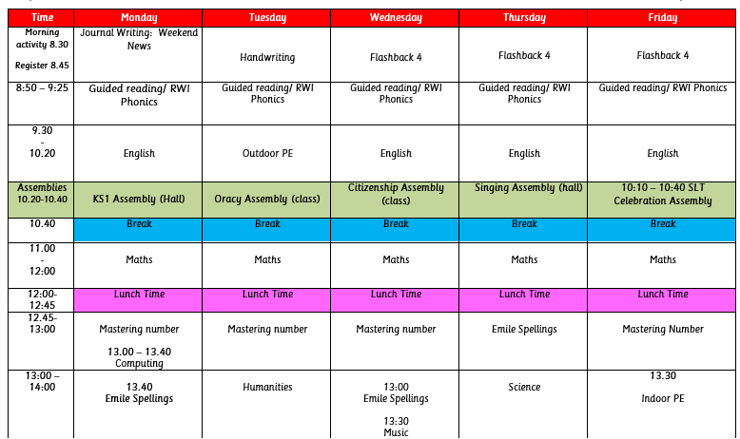
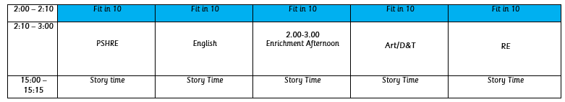
Timetables

Slide 7
PE Kits
2B and 2W
Tuesday (outdoor PE)
Friday (indoor PE)
When does my child need to wear their P.E kit?
Full P.E. kit is to be worn on a Tuesday and Friday.

Slide 8
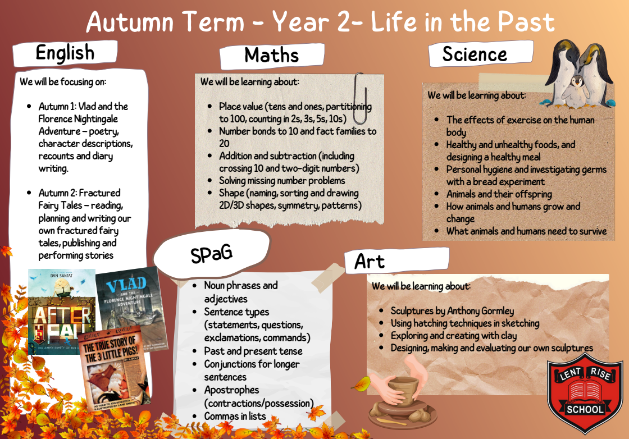
Curriculum
Overview

Slide 9
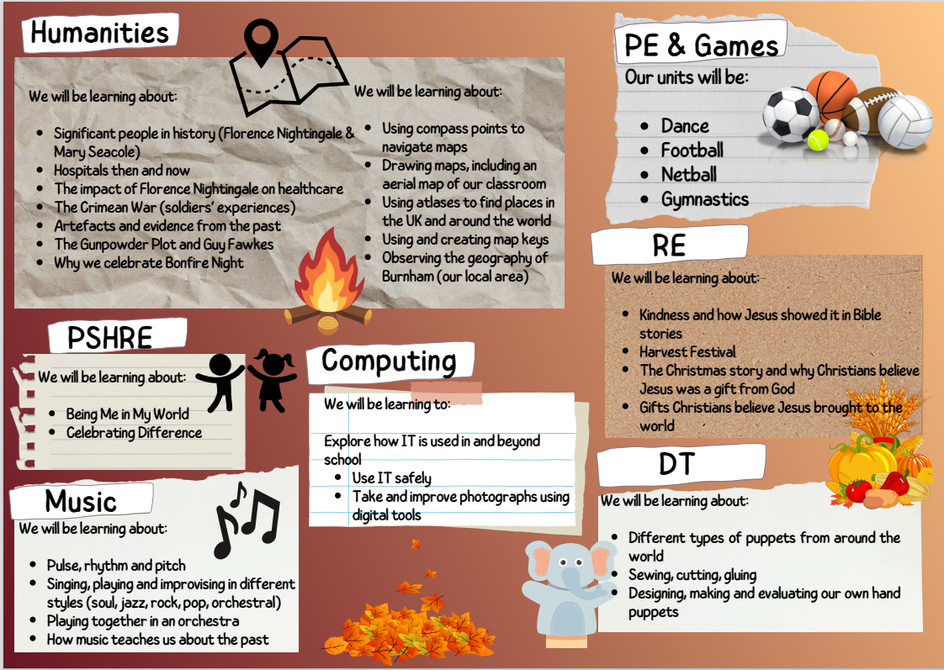
Curriculum
Overview

Slide 10
Curriculum overview
In KS1schemes we use Sumdog Maths, White Rose Maths, Mastering Number, Jigsaw RE and Jigsaw PSHRE, Teach Computing, Charanga Music, RWI Phonics and Emile Spellings.
We are a Voice 21 School so Oracy is embedded throughout the curriculum.
Accelerated Reader: Children on library can select AR books and complete quizzes in school to earn points.
Times Tables Rock Stars: Children have opportunities in class and at home to develop their times tables knowledge through an engaging platform.
Daily assemblies include British Values, Oracy, Citizenship, Singing and Celebration assembly.
Pre-learning and booster sessions are run weekly and range from practising key skills in maths, handwriting and spellings, to developing social skills, reading and phonics.
Gap Busting sessions are run 1-1 or in small groups on the same or following day to support children who have struggled with a concept.

Slide 11
Statutory Assessments
In Year 2, children who did not pass the Phonics Screening Check (PSC) in Year 1 will have the opportunity to take this again in June 2026.
Please note that KS1 SATS is no longer statutory in Year 2. We complete SATS in the summer term inline with the school's assessment week.

Slide 12
Assessments
Children complete termly assessments, these include:
Autumn 2: NFER Reading and NFER Arithmetic and Reasoning Papers
Spring 2: NFER Reading and NFER Arithmetic and Reasoning Papers
Summer 2: SATS Reading and SATS Arithmetic and Reasoning Papers
*Parents can request tests and/or test results after assessment week

Slide 13
Reporting
We are now sharing progress reports more frequently across the year, alongside opportunities for face-to-face discussions. Here’s what to expect:
Autumn 1: Face-to-Face Parent Evening: Wednesday 22nd & Thursday 23rd October 2025
You’ll receive a short Autumn 1 report during this meeting. It will share your child’s Age-Related Expectations (ARE) in Reading, Writing, Maths, and Science.
Autumn 2: Autumn Report sent home - Friday 15th December 2025
Parents will receive a progress report sent home, outlining:
ARE in core subjects
Progress this term
Attendance
Attitude to learning
Spring 1: Spring Reports and Face-to-Face Parent Evening
Monday 10th February 2026 - Parents will receive an ARE and Target Report sent home.
Parent Meetings:
Wednesday 11th & Thursday 12th February 2026 - These meetings will allow for discussion of your child’s targets and progress for Spring 1.
Spring 2: Spring Report sent home - Monday 23rd March 2026
This progress report will again include ARE, termly progress, attendance and learning attitude.
Summer 1: Summer Report sent home - Friday 11th May 2026
A short ARE report will be sent home to show where your child is working within the curriculum.
Summer 2: End of Year Report - Friday 10th July 2026
A full end-of-year report will be sent home, summarising your child’s learning and progress for the year.
* We have an open door policy and additional teacher meetings can be requested throughout the year via the front office.

Slide 14
Homework
KS1 Weekly Homework:
Phonics/Spellings:
  Children working on phonics receive a worksheet based on their current sound.
  Children who have progressed to spellings have a spelling worksheet/task set on Emile (online- introduced in Spring Term)
Maths: Classroom Secrets differentiated worksheet/ Sumdog Maths (online) - introduced in Spring Term
Times Tables:
  All KS1 children are expected to use Times Tables Rock Stars (TTRS) regularly.
  They are encouraged to learn their 2s, 3s, 5s and 10s fluently.
Reading: Reading comprehension differentiated worksheet
  Daily reading is expected and should be recorded in reading records wherever possible.

Slide 15
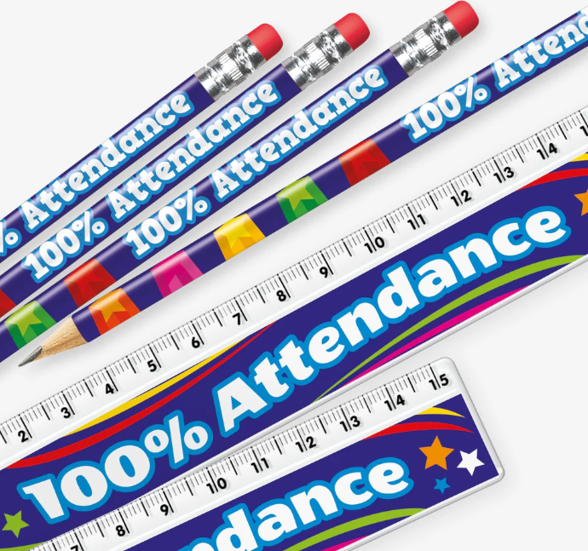
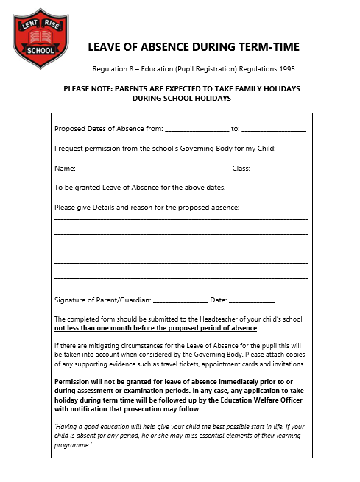
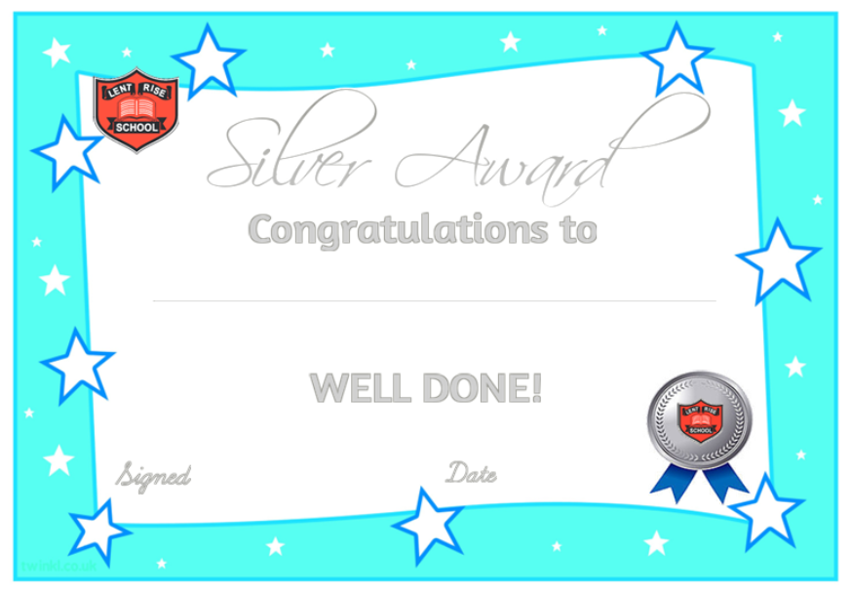
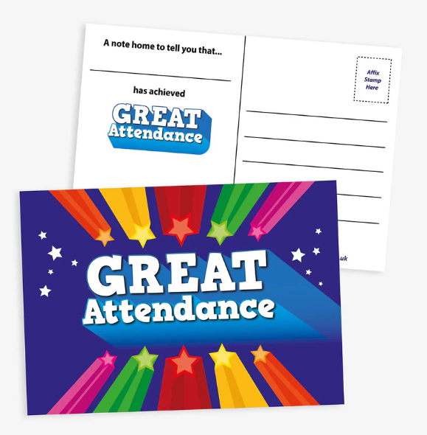

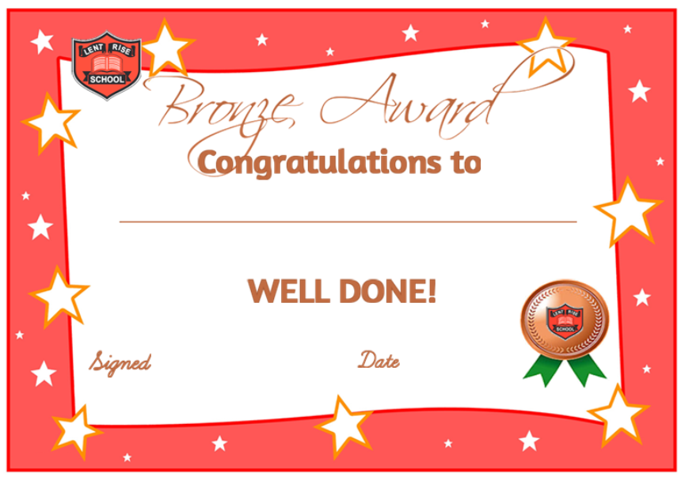
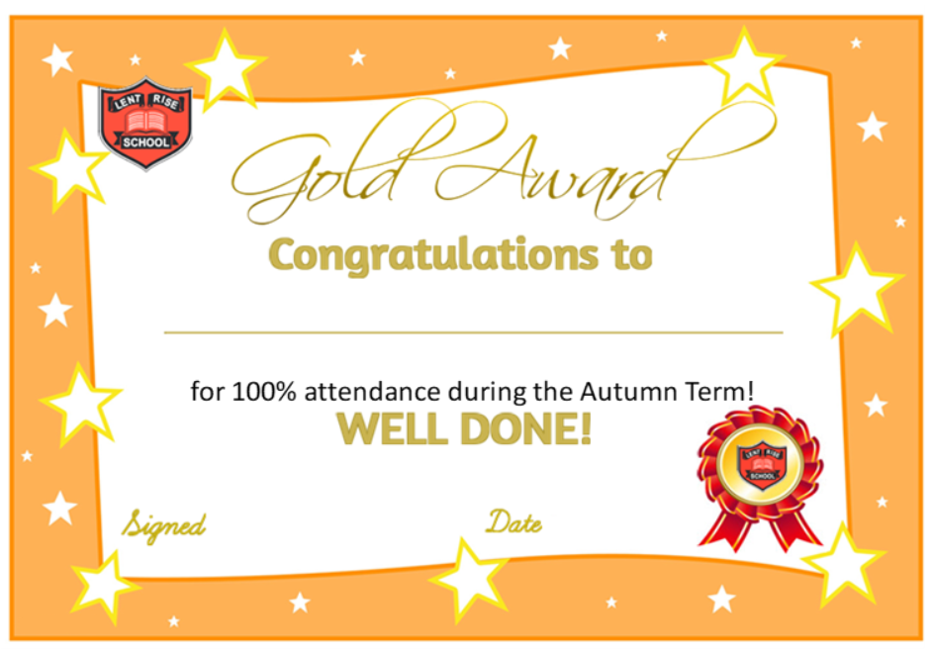
Attendance
Pupils are expected to: Attend school every day, on time.
Daily routines
The school gates open at 8:30am-8.45am.
Lates
If your child is late to school please visit the school office to sign in.
Absence
Please log your child(s) absence via our ParentMail app using the absence section.
Planned absence
Attending a medical or dental appointment will be counted as authorised as long as you notify the school in advance of the appointment. We encourage parents/carers to make medical and dental appointments out of school hours where possible.
You can also apply for other types of term-time absence, a leave of absence form is available from the school office.
We strongly promote good attendance here at Lent Rise School and celebrate this in many different ways!
Children have the chance to receive a postcard home for great improvement of attendance and certificates in assembly for overall 100% each term. Classes get the opportunity to look after the attendance trophy for the week if they reached the highest % overall and pencils are given to any class with 100% that week. Mrs Barnard also does monthly shout outs in the school newsletter!

Slide 16
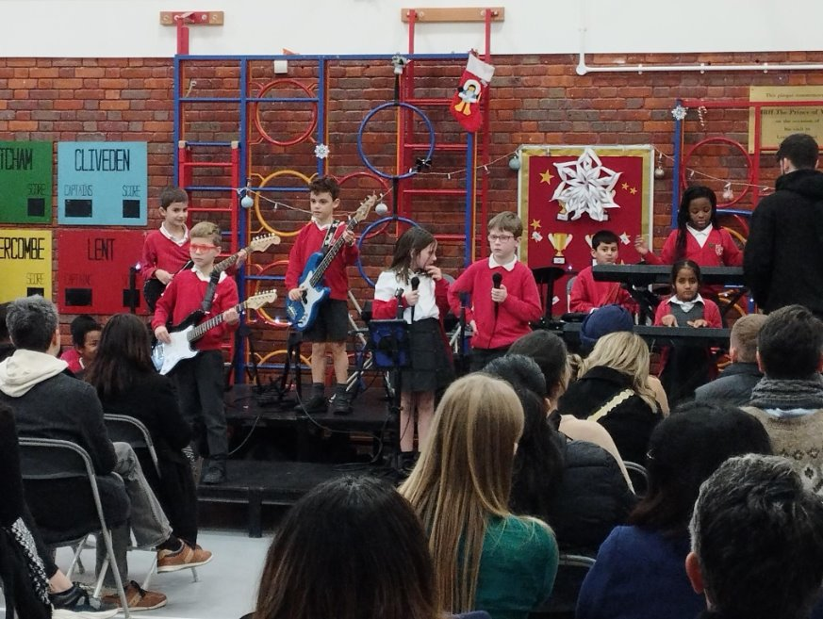




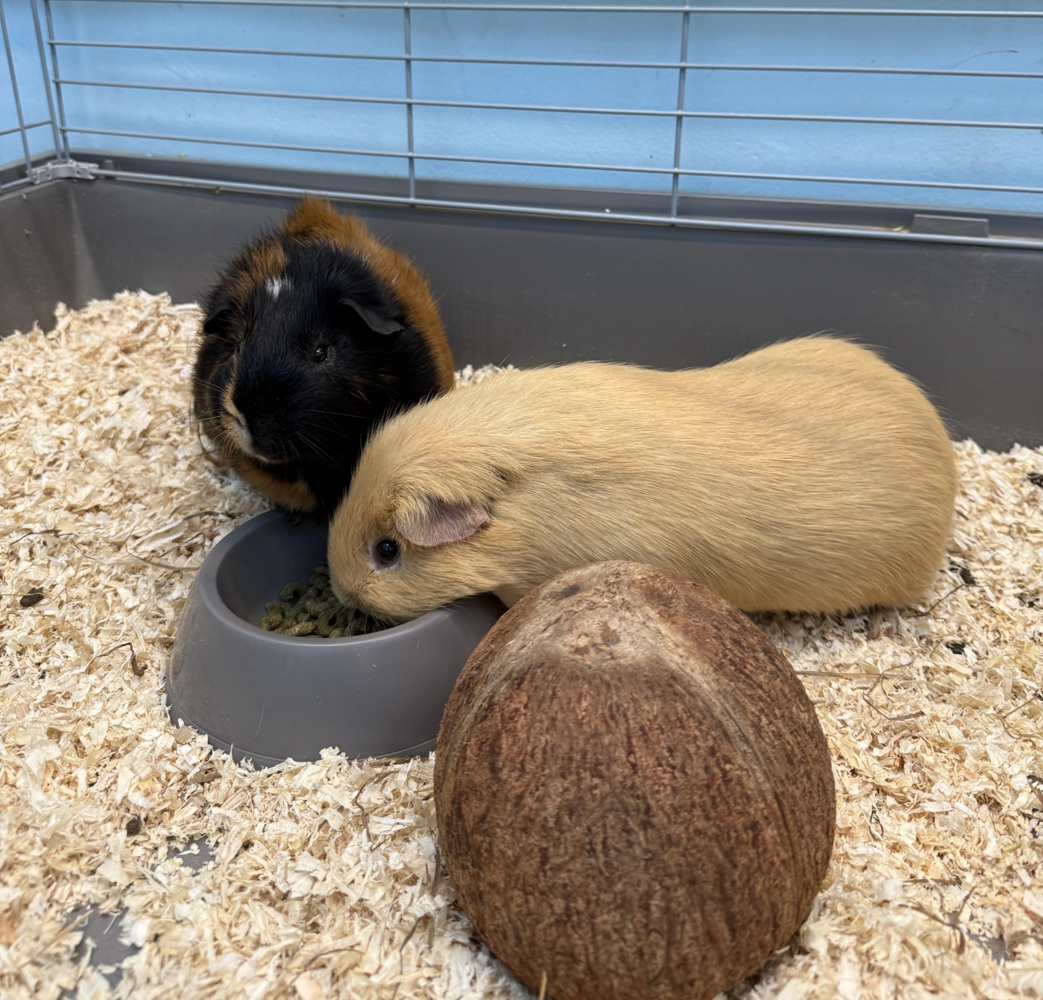

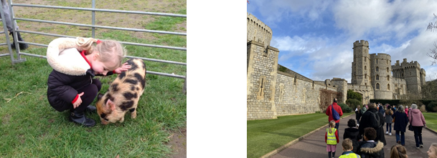
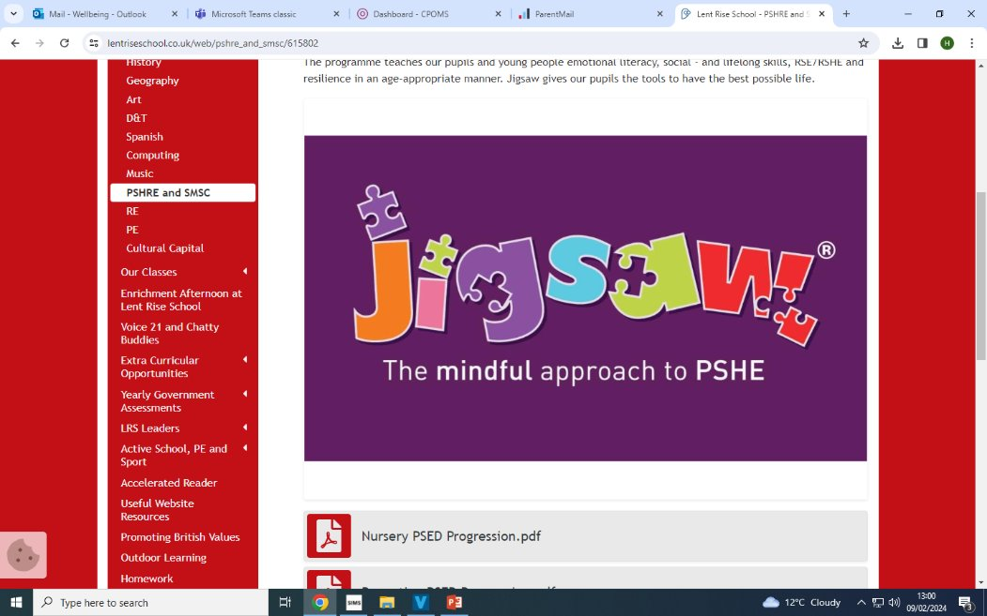
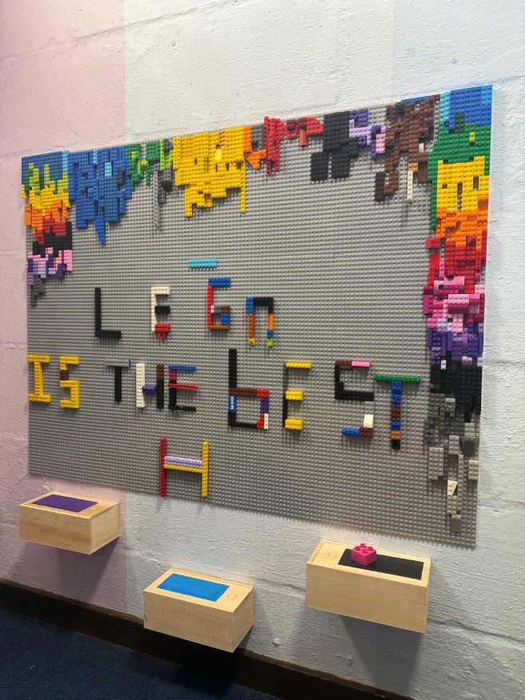
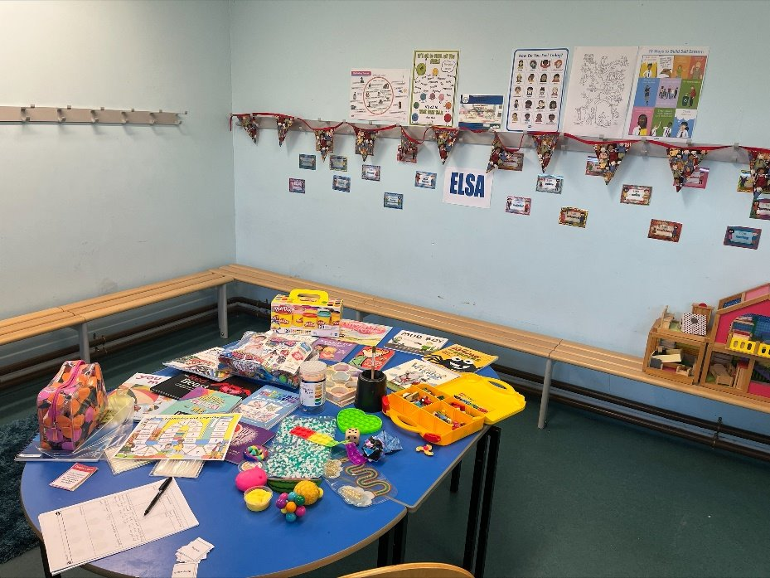
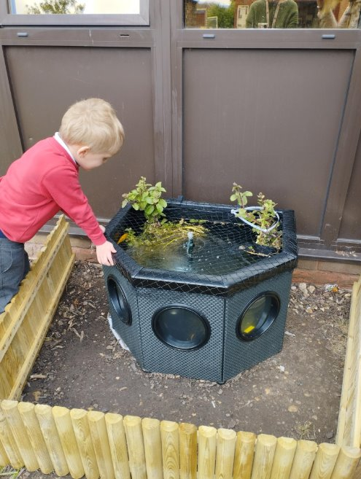
LRS Wellbeing Services
We consider our pupil’s pastoral needs, happiness and wellbeing to be of paramount importance. We make every effort to give our pupils the best start in life. We treat every child as an individual and give them every opportunity to achieve their full potential. We are committed to the development of children’s social, emotional skills, children’s self-esteem, their mental health and wellbeing.
At Lent Rise we offer many different services to support our pupils, such as...
Nurture Groups
Makaton (sign language)
ELSA
Young Carers
Play Therapy
Art Therapy
LRS Buddies supported by Bucks Mind
Wellbeing Ambassador (Miss Slade)
Mental Health First Aid
School Nursing Team
Clubs – Mindfulness & Yoga
PSHRE lessons
Chatty Buddies
Flash & Rory, our school Guinea Pigs
The Pond with our fish
Intergenerational Project
iRock
Trips & Visits
Lego Therapy
Drama sessions with Mrs Varney

Slide 17
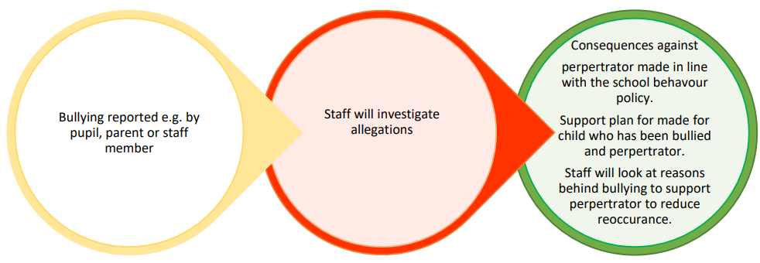
Anti-Bullying
Bullying is behaviour that hurts someone physically or mentally. It happens more than once, usually over time.
Bullying is different from teasing or ‘friendly banter’ because:
The bully wants to make the other person feel bad.
It happens over and over again
There is also cyber bullying that can be particularly traumatic for children as it can be inescapable.
Parents and children should report incidents of cyber-bullying involving children from the school in the same way as incidents of physical bullying.
All reported incidents will be taken seriously and investigated involving all parties.
We will communicate with parents of the child being bullied and the child accused of bullying
We do not disclose details relating to other individual children, including consequences given. We understand that this can be frustrating to parents who
want specific details about the actions taken against the perpetrator, Consequences against perpertrator made in line with the school behavour policy.
Staff will look at reasons behind bullying to support perpertrator to reduce reoccurance.
Staff will investigate allegations Bullying reported e.g. by pupil, parent or staff member but it is not appropriate to discuss an individual child with other parents and we ask parents to understand and respect this.

Slide 18
Online Safety
In Key Stage 1, pupils will be taught to:
Use technology safely and respectfully, keeping personal information private Identify where to go for help and support when they have concerns about content or contact on the internet or other online technologies
Pupils in Key Stage 2 will be taught to:
Use technology safely, respectfully and responsibly
Recognise acceptable and unacceptable behaviour Identify a range of ways to report concerns about content and contact
By the end of primary school, pupils will know:
That people sometimes behave differently online, including by pretending to be someone they are not
That the same principles apply to online relationships as to face-to-face relationships, including the importance of respect for others online including when we are anonymous
The rules and principles for keeping safe online, how to recognise risks, harmful content and contact, and how to report them
How to critically consider their online friendships and sources of information including awareness of the risks associated with people they have never met How information and data is shared and used online
What sorts of boundaries are appropriate in friendships with peers and others (including in a digital context)
How to respond safely and appropriately to adults they may encounter (in all contexts, including online) whom they do not know

Slide 19
Important Dates
6th November – Oxford Story Telling Museum
(A Journey Through Time)
Estimated contribution: £17
March – Beale Wildlife Park
(All Around the World)
Estimated contribution: £25
June – London’s Burning Drama (in school)
(London’s Burning)
Estimated contribution: £8

Slide 20
Friendly Reminders
PTA contributions over the past year have funded our music room, outdoor library and computing equipment, further enhancing your child’s learning. Thank you for your support!
Second hand uniform. We will be opening a uniform shack – parents can help themselves and make a small donation (suggested donation of £1 per item). Open on Tuesdays and Thursdays.
Website – Lots of resources are available on our website, including teaching content and progression maps.
We have an open door policy – email office@lrschool.co.uk to arrange a call or meeting
Our class mascot goes home weekly.
Please send Reading Records to school daily.
Please return this by the following Friday at the latest.
Any Questions?

