Slide 1

Division Workshop

Slide 2

What might it mean?
Are there any other words we can use for this process?

Slide 3

How many methods of division do you know?
Can you explain them to someone else?

Slide 4

How might you solve these problems?
10 2 =
65 5 =
124 4 =
187 x 100 =
1.8 3=

Slide 5

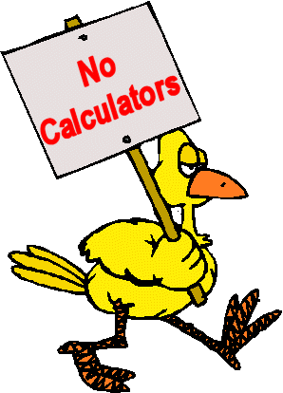

Should be quick
Can be done using jottings

Slide 6


S
T
E
P
1
Begin to know division facts for 1s, 2s, 5s and 10s

Slide 7


S
T
E
P
2

Slide 8
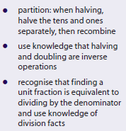


S
T
E
P
3

Slide 9
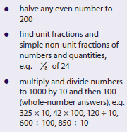

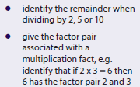
S
T
E
P
4

Slide 10


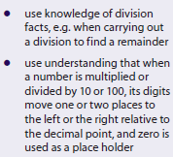


S
T
E
P
5

Slide 11
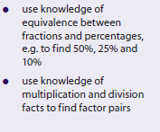
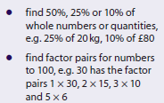
S
T
E
P
5
Continued

Slide 12
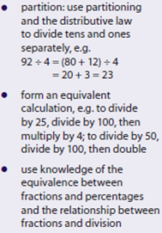

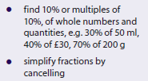
S
T
E
P
6

Slide 13
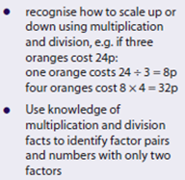

S
T
E
P
6
Continued

Slide 14
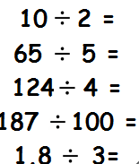

How might you solve these problems now?

Slide 15

Written Methods

Slide 16
How might you solve these problems?
15 5 =
37 3 =
129 4 =
256 7 =
1230 15 =

Slide 17

Step 1

Slide 18

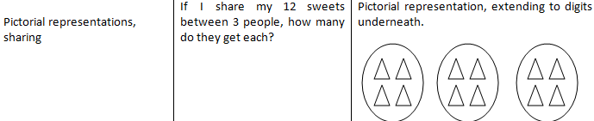
Step 2

Slide 19
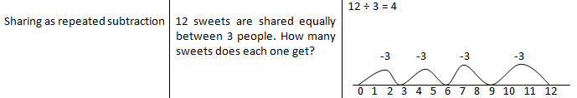
Step 3

Slide 20

Step 4

Slide 21
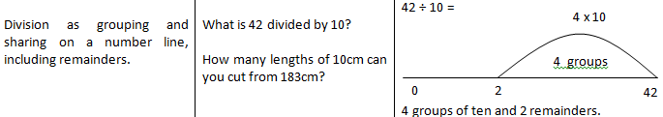
Step 5

Slide 22
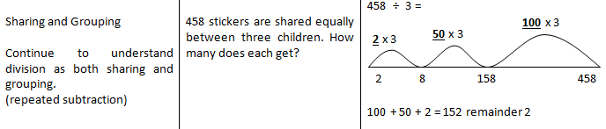
Step 6

Slide 23
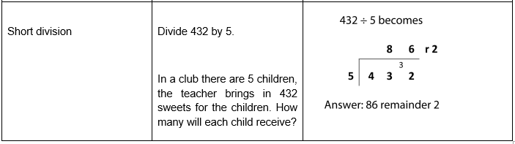
Step 7
KS2

Slide 24
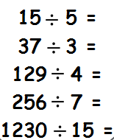
How might you solve these problems now?

Slide 25
Any questions?

