Slide 1
NURSERY PARENT PACK
Lent Rise School
Coulson Way, Burnham, Slough, SL17NP
Headteacher : Mrs J Watson
Telephone : 01628 662913
office@lrschool.co.uk or nursery@lrschool.co.uk
www.lentriseschool.co.uk

Slide 2
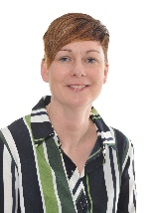
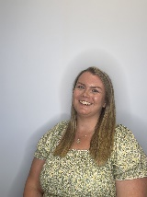
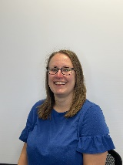
WELCOME
Welcome to Lent Rise Nursery.
All our staff are here to make the experience as easy as possible and to ensure that both you and your child settle into the nursery and are happy. This pack is to introduce you to the setting and outline where things are and how things are run in order to make your first day and settling in period as easy as possible.
We want everyone to learn, we want everyone to reach for their goals and we want everyone to shine!
Learn Reach Shine
Here at Lent Rise Nursery our team are overseen by; Mrs Watson the Headteacher and Miss Johns the Early Years Phase Leader. Leading the day-to-day team in the nursery is Mrs Ide.
Nursery staff hold a level 3 qualification or are working towards the level2/3 qualification.
Please see our staff board by the main door to find out more information about our team.
We understand the importance of having a strong and knowledgeable team and believe that continuous development is important to ensure that all staff are up to date with current legislations. We give our team opportunities to train and develop their skills to broaden their knowledge in caring and educating children.
At Lent Rise we pride ourselves on our Open Door policy. It is important that all parents and staff work together and communicate effectively in order to provide the best opportunities for your child. You will find a copy of our Open Door policy at the end of the parent pack.
There is a range of information on the Lent Rise School website. You can find nursery and school policy documents and keep abreast of news by looking at the newsletter and calendar.
The newsletter and other information letters are distributed through ParentMail. We also send text messages to you as reminders. We will always speak to you in person if there is an emergency or urgent query concerning your child.
You can view our whole school website at www.lentriseschool.co.uk.

Slide 3
Day-to-Day Information
At Lent Rise Nursery we have two sessions, a morning session and an afternoon session, with the option to stay for lunch.
Morning Session- 8:45-11:45am *example timetable of session*
8:45am | Registration, welcome and songs
9:00am | Free Flow indoors and outdoors. Snack will be provided during the session.
11.30 | Tidy up Ready for home Time.
11.45 | Home Time
Lunch Session- 11:45-12:15pm
Please note there is a charge for lunch sessions. Speak to a member of staff for more information.
Afternoon Session- 12:15-3:15pm *example timetable of session*
12:15pm | Registration, welcome and songs
12:30pm | Free Flow indoors and outdoors.
3.00pm | Tidy Up ready for home time.
3.15pm | Home Time
​
Please be prompt for pick up and drop off times to support us in preparing for the next session.

Slide 4
Day-to-Day Information
At Lent Rise Nursery, we ask that each day you bring in a named bag for your child.
In the bag we ask that you bring-
Full, spare change of clothes (please ensure these are labelled)
Spare nappies/pull ups and wipes if your child is toilet training
Nappies and wipes if your child is not yet toilet trained
Wellies
Water bottle
Coat , hat, scarf, gloves as applicable
**If your child is toilet training please provide at least 2 changes of clothes including socks · If your child is already toilet trained, or is training, please bring lots of spare pairs of underwear.
Our setting is designed to support children grow and develop through the early years of their life and part of that learning involves becoming familiar and confident with using the toilet. We are here to support your child with this so please speak to a member of the nursery team if you have any queries about this or if your child is still in nappies.
Snacks
In all sessions light snacks will be provided. These are healthy foods and will include a drink of milk or water, fruit, vegetables, bread sticks etc. Please make staff aware of any allergies/ food intolerances your child has, or special dietary requirements. ​
Voluntary Contribution
At Nursery we provide lots of fun and stimulating activities for the children these include; playdough, sensory play and messy play. These small activities are enjoyed by all but can become costly. We ask as a Nursery for a voluntary contribution that goes towards providing these experiences for the children. ​ Voluntary contributions can be made through ParentMail or put in the tin in the nursery.

Slide 5
How We Learn In Nursery
and the Curriculum
Children learn best when they are happy, safe and secure. Staff are there to guide and teach and will get to know you and your child well during your time here.
We recognise that children develop and learn in different ways and at different rates. We have a team of dedicated and professional early years teachers, early years educators and teaching assistants who plan and work closely together to provide a high-quality curriculum. We work as a team in partnership with the child, parents and carers, the wider school, other settings and external agencies to ensure the needs of each child are met physically, emotionally and academically.
Purposeful play features strongly in good nursery education and throughout our Early Years Department. We believe in the importance of play and that through play children explore and develop learning experiences, which help them make sense of the world.
Play is essential for children’s development, building their confidence as they learn to explore, to think about problems, and relate to others.
‘Statutory Framework for the Early Years Foundation Stage’. April 2017.
Play that is well planned and fun helps children to think, to increase their understanding, improve their ability to use language, build up ideas, learn self-regulation skills and understand the need for rules. It allows children to be creative, to explore and investigate materials, to experiment and to draw and test their conclusions. Children are encouraged to join in all activities, to be independent and to make choices.
We offer a rich and varied curriculum in a safe but inviting environment that gives children the opportunity to extend and develop their thinking and learning across all areas of the curriculum. Our Nursery consists of the following areas offering a different variety of learning experiences for our children.
Drawing and writing area
Book area
Fine motor skill activities
Building and Small world play
Maths area
Sand and Water (Outside)
Creative Area
Role play and dressing up

Slide 6
Key Workers
During your child’s time at Lent Rise Nursery you will be allocated a key worker. This person will be a valuable link into settling your child into nursery and for communication throughout your child’s time with us. Although all the staff in the nursery will work with all the children, their key worker will plan for and lead the group sessions for your child and give feedback about progress. Your child’s key worker will also be responsible for compiling your child’s Learning Journey.
Staff are always available at the beginning and end of sessions for you to share information with and ask questions, so please do let us know if you have any news to share, queries or concerns. If you need a longer discussion just ask to book an appointment.
Tapestry and Observations
At Lent Rise we use an online programme called ‘Tapestry’ to record, track and share your child’s learning during their time in nursery. We will be observing and recording progression of achievements throughout all areas of the Early Years Foundation Stage curriculum. This online learning journal enables staff to take photographs, videos and make written observations of the activities your child does. You will then have access to this information, so you can celebrate this learning at home too.
Attendance
Although nursery education is non statutory, there is a proven link between attendance, punctuality and children’s attainment and it is important to establish good habits of attendance so that children can take full advantage of the education offered.
Regular and full time attendance is essential if children are to benefit fully from their nursery life. It is important that children learn the importance of being punctual as part of their preparation for adult life. If your child is going to be absent please log their absence on the Parentmail app or by ringing the school office.

Slide 7
SCHOOL UNIFORM
We look to parents to work with the nursery to ensure that children come to nursery maintaining a high standard of dress.
Children should wear clothes suitable for play. Aprons are provided for messy play –but it’s surprising where paint, etc can end up, so please bear this in mind! Please ensure that all clothes are clearly labelled.
We are aware of cost of uniform and therefore do not require uniform with logos on. However, uniforms with logos on are available from School Days Direct, 20A Buckingham Avenue, Slough, Berkshire, SL1 4QA, should parents wish to purchase them.
Daily:
Polo shirt: red with or without school logo
Jumper: red – with or without logo
Bottoms: Leggings or Jogging bottoms grey or black
Shoes: trainers or black closed toe shoes
*no sandals, loose fitting slip ons, crocs or similar soft soled shoes
Hot days:
Please provide a named sun hat and apply sunscreen to your child before leaving home.
In the summer, both boys and girls may wear grey shorts. Girls can also wear summer dresses during the summer months.
Cold and Rainy days:
Please provide a warm coat, hat, and gloves. Named welly boots can also be brought to school as we do try to go outside to play in all weathers!
Hair must be neat and tidy with no extremes of colour or style, or shaved patterns on the head and must not be beneath collar length for boys. We ask that no jewellery is to be worn.

Slide 8
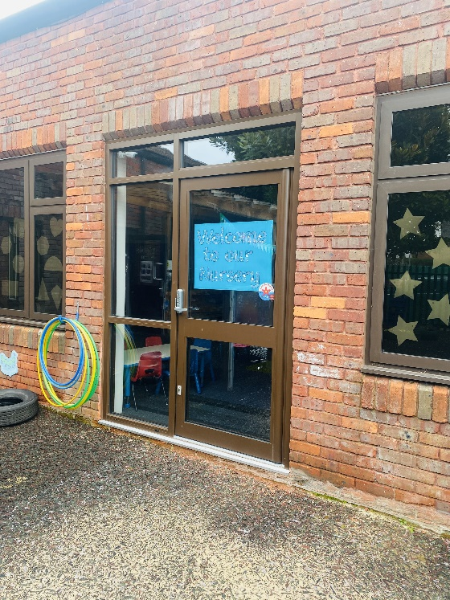
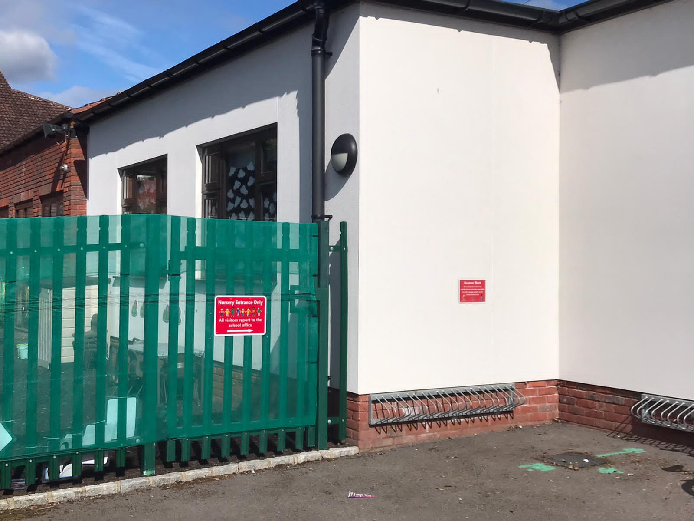
Dropping off and Picking up
Nursery children will arrive and exit through the Nursery/Reception outdoor play area.
Please ensure when dropping off and pick up that you are prompt.
Drop Off
A member of staff will open up the gate in the morning just before 8.45am to welcome you in. We ask that adults walk your child over to the door and say goodbye and the children will walk in to nursery independently.
Pick Up
At pick up time a member of staff will open up the gate and we ask that parents make a socially distanced line so we can dismiss the group safely to the correct adult. Staff will be on hand if parents do have any queries or questions but we would ask that you wait to one side until the whole group has been dismissed.
If any adults other than those listed in your child’s profile are to collect your child from nursery you must inform their teacher of the name of the person and relationship they hold to the child. We cannot allow a ‘friend’ or anyone else to collect your child without your specific permission and we will request a password so please fill this out in you pupil profile pack. Anybody that is not a nominated person must provide the password.

Slide 9
Term Dates – 2023/2024
Autumn Term 2023
Open on the morning of: Close at end of afternoon on:
Tuesday 5th September Friday 20th October
(*INSET: Friday 1st September, Monday 4th September)
(Half Term – Monday 23rd October – Friday 27th October)
Monday 30th October Friday 15th December
(Christmas – Tuesday 19th December – Tuesday 2nd January)
(*INSET: Monday 18th December)
Spring Term 2024
Open on the morning of: Close at end of afternoon on:
Thursday 4th January Friday 9th February
(*INSET: Wednesday 3rd January)
(Half Term – Monday 12th February – Friday 16th February)
Monday 19th February Thursday 28th March
(Easter – Friday 29th March – Friday 12th April)
Summer Term 2024
Open on the morning of: Close at end of afternoon on:
Monday 15th April Thursday 23rd May
(*INSET: Friday 24th May)
(Half Term – Monday 27th May – Friday 31st May)
Monday 3rd June Friday 19th July
(*INSET: Monday 22nd July, Tuesday 23rd July)
Early May Bank Holiday: Monday 6th May
* Inset days are for the staff only. Whether term is starting or ending, the school start and finish times are the same.

Slide 10
Other important information
We encourage each child to learn and follow simple daily routines in order to make them independent and responsible for their own belongings. It would be an enormous help to the staff and your child if you could support this by:
Encouraging your child to enter the building independently. Please do not crowd the doors to ensure staff members can see all the children
Clearly labelling all belongings including clothes and shoes! This also really
supports name recognition
Ensuring your child has their bag with them every morning
Informing the staff through notes or a phone message if a different nominated
adult is collecting your child from school and ensuring they know the
password
We would like to take this opportunity to ask if you could refrain from bringing toys and personal belongings into nursery. We understand at times that children can become attached to toys on their journey to nursery but as you can imagine these can some time cause conflict when other children wish to look at them or show an interest. If these items do get to nursery we are unable to take any responsibility for loss or damage.

Slide 11
FIRST AID
All our members of staff are trained in Paediatric First Aid.
If your child is ill or has an accident at nursery that causes concern, the office will contact you using the contact names and numbers you have given. Please ensure that you keep the office updated with any changes in your contact details.
We will administer First Aid to minor injuries at school and you will receive a note home explaining what happened. Please check your child at home. We are not medical professionals so if you have any concerns, please take your child to your doctor or local hospital A&E department.
MEDICATION
If your child needs medication at nursery you must complete a form giving consent for the staff to administer medicines. Legally this form can only be signed by someone with parental responsibility for the child; this does not include grandparents (unless court appointed guardians) or child minders.
Please bring medication to the school office and collect it at the end of the school day. Medication should be in the original packaging and clearly labelled with your child’s name and class. Prescription medication, including inhalers and creams, must have the pharmacy dispensing label attached.
If your child has a long term health condition then we will work with you to create a healthcare plan to support them while at nursery.
If your child has asthma, their inhaler will be kept in the nursery where they can access it at any time.
All medications including inhalers will be sent home during school holidays.
Should you require further information or if you have any queries, please contact the Headteacher or School Office.

Slide 12
INHALERS
If your child has asthma, no matter how severe, and they have been prescribed a reliever inhaler please provide an inhaler to be kept in school. This should be in the original box with the dispensing label attached. The school also has emergency inhaler kits which can be used if a child has an asthma attack and their own inhaler is unavailable (for example it is empty). These kits do not replace your child’s own inhaler, which must be in school at all times. The emergency inhaler kit can only be made available to children who have already been prescribed a reliever inhaler and whose parents have signed a consent form.
AUTO-INJECTOR DEVICES
If your child has been prescribed an auto-injector device because they are at risk of anaphylaxis then we must have an in-date device in school at all times. This is kept in the school office and all staff are trained on the signs and symptoms of anaphylaxis and how to administer emergency adrenaline. If you do not provide a device your child will not be able to attend any out of school activities or trips as we cannot approximate an ambulance response time should they have a severe allergic reaction. In the case of residential trips two devices must be supplied or your child will not be able to attend.

Slide 13
OUR OPEN DOOR POLICY
Please do contact us at any time when you have a concern, even if it appears to be minor. The ‘little’ difficulties are easy to deal with; don’t let them become major concerns. The Open Door Policy is encouraged at Lent Rise School. If you wish to talk about your child please:-
1. Approach the Nursery Lead
2. Talk to a member of the Senior Leadership Team
3. The Headteacher, Mrs Watson, is always happy to see parents but clearly she will go to the Class Teacher to discuss issues, therefore it makes sense for you to have spoken to the teacher first.
Contacting the Headteacher if she is not in School
When the Headteacher is out, your children are always in safe hands. If you need an immediate response, please contact the school office and a member of the Senior Leadership Team will get a response to you as soon as possible.
Complaints and Resolution Procedure
The following is the strategy that is suggested if difficulties arise – we recommend that you use this structure.
1.Talk to the Nursery Lead
2.Talk to a member of the Senior Leadership Team
3.Talk to the Headteacher
4.Make Representations to the Governing Body in writing to:
Mrs Maggie Young, Chair of Governors
by e-mail: govs@lentrise.bucks.sch.uk or
c/o Lent Rise School
Coulson Way
Burnham
Slough SL1 7NP
5.If you are still not satisfied you may wish to put your complaint to the Secretary of
State for Education and Skills who can review whether the school has acted reasonably
and followed the correct procedures. The address is: Sanctuary Buildings, Great Smith
Street, London, SW1 3BT.
If you would like to read our full complaints and resolution procedure, please contact the school office for a copy or visit the school website www.lentriseschool.co.uk

Slide 14
SAFEGUARDING
“At this school, the health, safety and well-being of every child are our paramount concern. We listen to our pupils and take seriously what they tell us. Our aim is for children to enjoy their time as pupils in this school. We want to work in partnership with you to help your child achieve their full potential and make a positive contribution.
To promote a safe environment for pupils, our selection and recruitment policy includes all checks on staff and regular volunteers’ suitability, including Criminal Records Bureau checks, as recommended by Buckinghamshire County Council in accordance with current legislation.
In accordance with our responsibilities under section 175/157 of the Education Act 2002 and “Keeping Children Safe in Education“ Sept 2023. There are four trained Designated Safeguarding Leads, the Headteacher Mrs J Watson, Deputy Headteacher Mrs R Small, and the two Assistant Headteachers Miss Boxall and Miss Johns, this ensures there is a DSL on duty at all times. It is their responsibility to ensure that all staff in contact with children receive child protection awareness training on a regular basis.
Occasions do arise when our concern about a child means we have to consult other agencies. Whilst we would always aim to work in partnership with parents there may be exceptions to this when concerns are raised for the protection of a child.
On very rare occasions Social Care, whilst undertaking an investigation under s47 of the Children Act 1989, may want to speak to a child without a parents’ knowledge. This would be a decision made in collaboration with partner agencies and would only be done in situations where a child might be at immediate risk. To gain consent at this point may increase the level of risk to the child or cause evidence of a crime to be lost.
The procedures, which we follow, have been laid down by the Local Safeguarding Children’s Board, and the school has adopted a Child Protection Policy in line with this for the safety of all. If you want to know more about our procedures, please speak to the Headteacher, Mrs J Watson or your child’s class teacher: the Policy can be found on the school’s website www.lentriseschool.co.uk

