Slide 1


Slide 2
WELCOME TO RECEPTION
Our Early Years department at Lent Rise consists of Starfish Nursery and two Reception classes of equal number. In Reception there are four full time members of staff, two teachers and two teaching assistants.
The first year in a child’s school life is very important. All staff will provide care, support, guidance and learning opportunities throughout every day.
In Reception your child’s key worker is their named class teacher. Your child will also have daily direct contact with the class teaching assistant. Please contact the class teacher to discuss any matters concerning your child and an appointment can be made for after school.
In the mornings during “drop off time” staff will be busy ensuring that the children are safely in school, so if you have any urgent messages, please pop up to the school office where staff are always happy to assist you.
Please use the ‘reading diary’ provided in your child’s book bag to communicate non-urgent messages with staff.
At Lent Rise School we pride ourselves on our Open Door policy. It is important that all parents and staff work together and communicate effectively in order to provide the best opportunities for your child.
We incorporate many different aspects of healthy living into school life in order to encourage every child to live a healthy life. We are part of the NHS fruit scheme for 4-7 year olds and each child is provided with a daily piece of fruit. We also work alongside the Government and County Council to provide a free hot school meal for each child in Early Years for their lunch break. There is a water fountain in the Reception classroom for your child to use, and children are encouraged to bring in a water bottle to school every day. In addition to this children can have
milk each day, which is government funded until age five. After this, there is an opportunity to purchase directly from our provider the ‘Cool Milk’ company.
If any adults other than those listed in your child’s profile are to collect your child from school you must inform their teacher and the office of the name of the person and relationship they hold to the child. We cannot allow a ‘friend’ or anyone else to collect your child without your specific permission and we will request a password so please fill this out in you pupil profile pack. Anybody that is not a nominated person must provide the password.

Slide 3
If your child is not collected from school on time, the class teacher or teaching assistant will escort your child safely to the school office, where they or the office staff will contact you to arrange immediate collection. The child will then wait with a member of staff and should be collected from the school office.
As well as information in this pack, there is a range of information on the school website:
- Key Principles
- Term Dates
- Curriculum
- Homework Policy
- Phonics Information
- How you can Help with Writing
- How to Help at Home
- Subject Vocabulary
- Teacher Assessment using Target Tracker
- Registration
- School Uniform
- First Aid and Medication
- Inhalers and Auto Injector Devices
The school newsletter and other information letters are distributed either through email or through your child’s bookbag. We also send emails and text messages to you as reminders. We will always speak to you in person if there is an emergency or urgent query concerning your child.
You can view our whole school website at:
www.lentriseschool.co.uk

Slide 4
ATTENDANCE AND PUNCTUALITY
As parents you all have a legal responsibility to make sure that your child attends school every day. If your child is going to be absent from school, please contact the school office on the first day of their absence. This is important, as we will be contacting parents if a child is not at school and no reason has been given.
Regular attendance and punctuality is fundamental to enabling your child to achieve the highest levels of attainment. We ensure all children are aware of the importance of attendance and punctuality.
If your child is unwell
If your child is too unwell to come to school, or has a medical appointment, please contact the school office as soon as possible. To help you, the NHS has compiled a list of guidelines about how long children should be kept off school when they have a common illness.
https://www.nhs.uk/Livewell/Yourchildatschool/Pages/Illness.aspx
Lateness
Learning begins promptly at the beginning of the day with instructions and explanations and it is vital that your child does not miss this part of the day. We monitor lateness and send letters to parents whose children regularly arrive to school late.
Authorised absence
Family holidays should always be taken during the school holidays, and we will only authorise absence in very special circumstances. On these occasions permission must be sought in advance from the head teacher. Absence request forms are available from the school office, or a letter should be written to the head teacher.

Slide 5
OUR OPEN DOOR POLICY
Please do contact us at any time when you have a concern, even if it appears to be minor. The ‘little’ difficulties are easy to deal with; don’t let them become major concerns. The Open Door Policy is encouraged at Lent Rise School. If you wish to talk about your child please:-
Approach the class teacher
2. Talk to a member of the Senior Leadership Team
3. The Headteacher, Mrs Watson, is always happy to see parents but she will go to the Class Teacher to discuss issues, therefore it makes sense for you to have spoken to the teacher first.
Contacting the Headteacher if she is not in School
When the Headteacher is out, your children are always in safe hands. If you need an immediate response, please contact the school office and a member of the Senior Leadership Team will get a response to you as soon as possible.
Complaints and Resolution Procedure
The following is the strategy that is suggested if difficulties arise – we recommend that you use this structure.
1.Talk to the Class Teacher
2.Talk to a member of the Senior Leadership Team
3.Talk to the Headteacher
4.Make Representations to the Governing Body in writing to:
Mrs Maggie Young, Chair of Governors
by e-mail: govs@lrschool.co.uk or
c/o Lent Rise School
Coulson Way
Burnham
Slough SL1 7NP
5.If you are still not satisfied you may wish to put your complaint to the Secretary of
State for Education and Skills who can review whether the school has acted reasonably
and followed the correct procedures. The address is: Sanctuary Buildings, Great Smith
Street, London, SW1 3BT.
If you would like to read our full complaints and resolution procedure, please contact the school office for a copy or visit the school website www.lentriseschool.co.uk

Slide 6
TERM DATES 2025-2026
Autumn Term 2025
Open on the morning of: Close at end of afternoon on:
Thursday 4th September Friday 24th October
(Half Term – Monday 27th October – Friday 31st October)
Monday 3rd November Friday 19th December
(Christmas – Monday 22nd December – Friday 2nd January)
(*Inset day – Wednesday 3rd September)
Spring Term 2026
Open on the morning of: Close at end of afternoon on:
Tuesday 6th January Friday 13th February
(Half Term – Monday 16th February – Friday 20th February)
Monday 23rd February Friday 27th March
(Easter – Monday 30th March – Friday 10th April)
(*Inset day – Monday 5th January)
Summer Term 2026
Open on the morning of: Close at end of afternoon on:
Monday 13th April Wednesday 20th May
(Half Term – Monday 25th May – Friday 29th May)
Monday 1st June Friday 17th July
(*Inset day – Thursday 21st May, Friday 22nd May, Monday 20th July, Tuesday 21st July, Wednesday 22nd July)
May Bank Holiday:
Monday 4th May
* Inset days are for the staff only.
Whether term is starting or ending, the school start and finish times are the same.

Slide 7
DAILY ROUTINES
We encourage each child to learn and follow simple daily routines in order to make them independent and responsible for their own belongings. It would be an enormous help to the staff and your child if you could support this by:
Being positive about school!
Encouraging your child to enter the building independently. Please do not crowd the doors to ensure staff members can see all the children
Clearly labelling all belongings including clothes, hats and shoes!
Ensuring your child has their book bag with them every morning
Allowing your child to be responsible for their own book bag and being involved in the communication process (tell them there is a letter etc. for class teacher in their bag)
Ensuring that you check your child’s book bag and reading record every evening for any slips or letters that may need returning
Informing the staff and office through notes or a phone message if a different nominated adult is collecting your child from school and ensuring they know the password
Ensuring you communicate with the school appropriately by sending a note, email or telephoning the school office

Slide 8
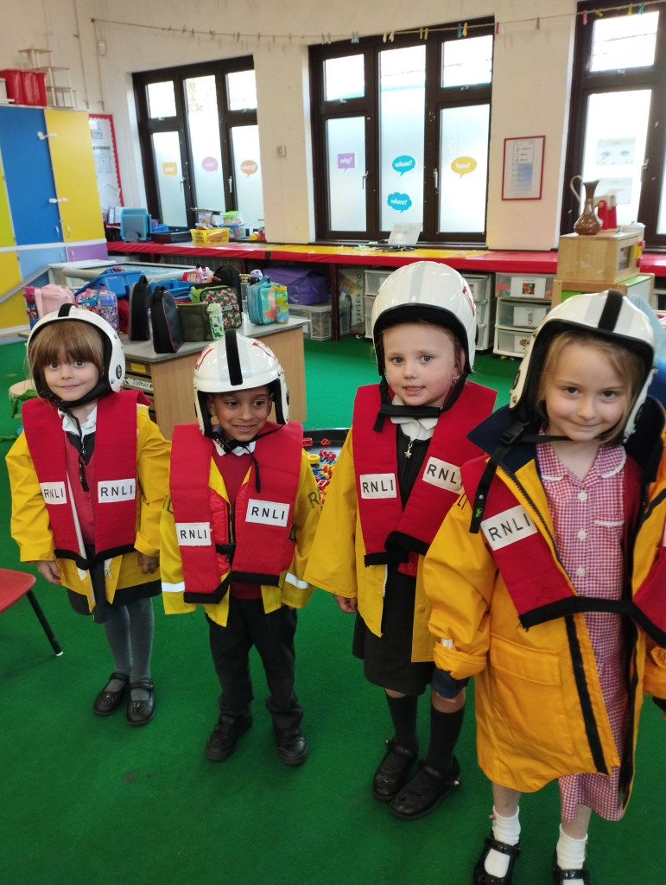
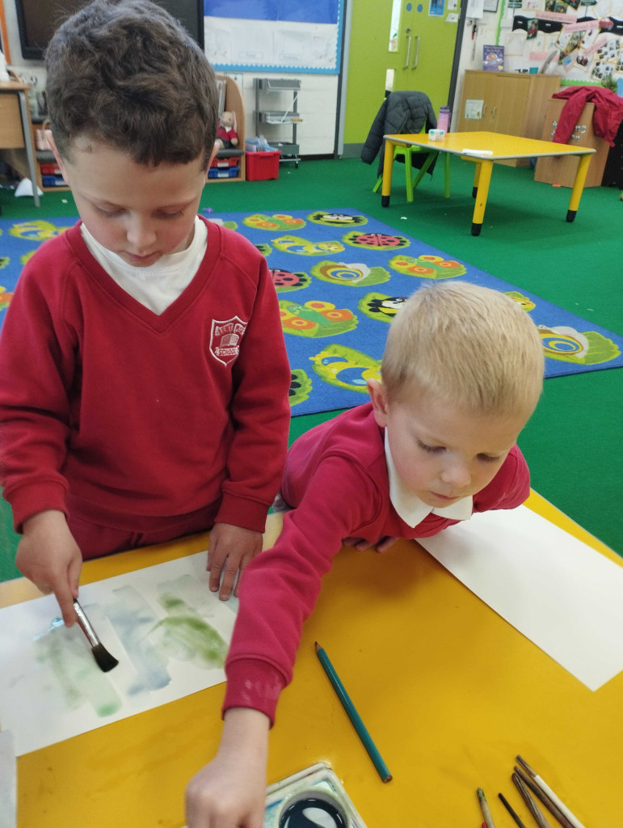
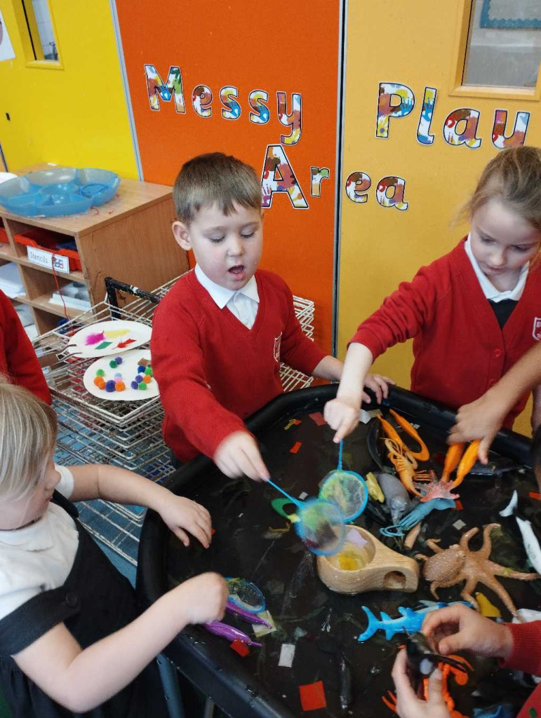
CURRICULUM
To give each Reception aged child the best learning opportunities we cover all aspects of the Early Years Foundation Stage Curriculum but extend learning opportunities into areas of the National Curriculum where appropriate. This gives all children a range of learning opportunities and allows appropriate progression.
We teach structured Phonics and Maths sessions each day and then use Child Initiated Learning for children to explore all other curriculum areas. ICT plays a very strong role in teaching and learning and is used to support many learning opportunities throughout the curriculum. We use a broad range of strategies and learning opportunities when providing access to the creative curriculum.
Our Reception classes have interactive whiteboards, digital cameras, access to programmable toys and visualisers in each classroom as well as a set of tablets.

Slide 9
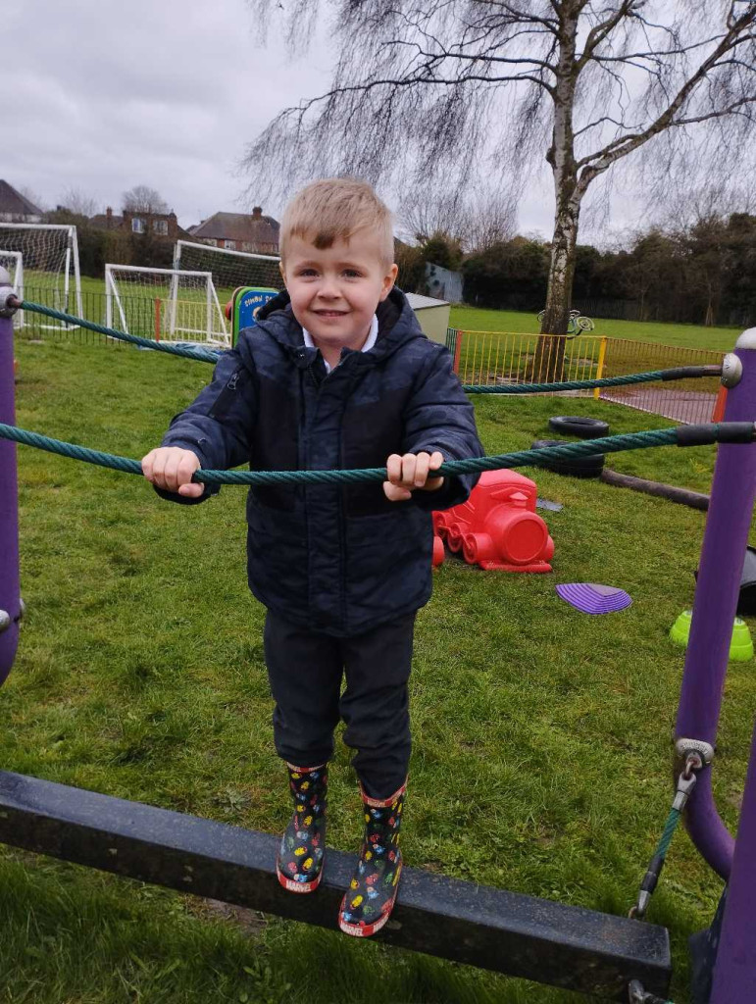
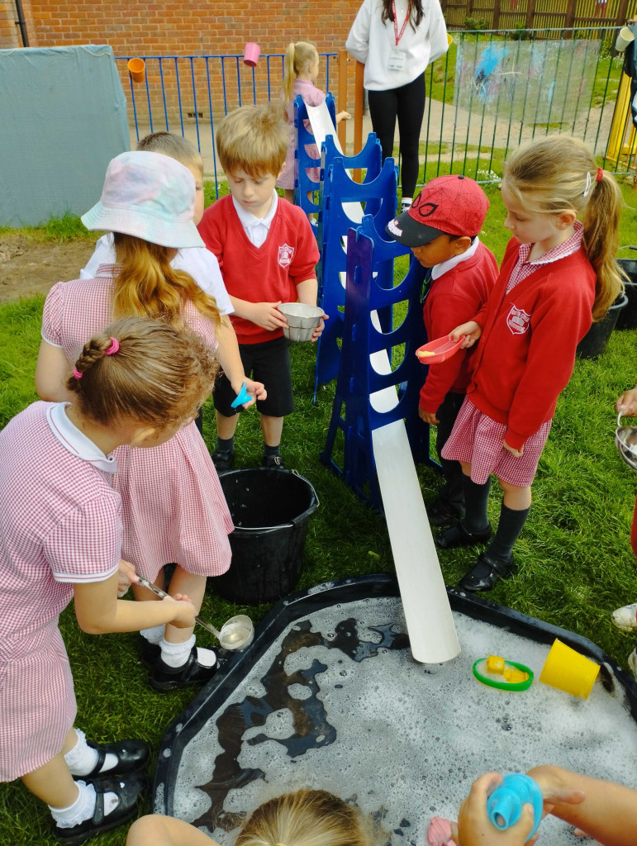
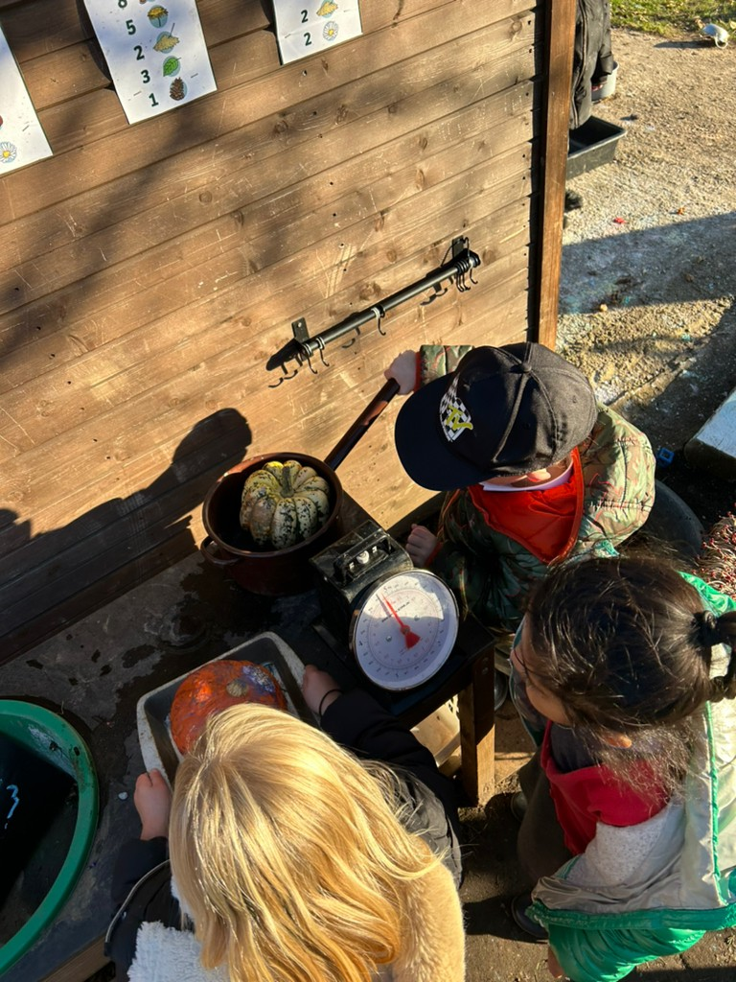
OUTDOOR PROVISION
The outdoor area is designed specifically for our Reception children. This space covers the 7 areas of learning, and children can access the different areas as they wish. We use our outdoors area daily to enhance learning within the curriculum.
Due to our outdoor area being predominantly grass, we ask that you provide your child with named welly boots. These will be stored in a rack outside the classroom. If possible, a pair that can remain in school so that your child does not need to bring them home each weekend. In addition to this, you may choose to provide your child with a spare change of clothes in their bag. Children can get messy and wet when playing with the exciting resources outside. We do not have large supplies of spare clothes, so it is helpful if the child has their own. Please also ensure your child has a raincoat or sunhat when appropriate as we go outside in most weathers.
In addition to our own outdoor area, the pupils have some formal break times on the main playground to enable them to socialise with children in Years 1 and 2.

Slide 10
ASSESSING AND REPORTING IN THE FOUNDATION STAGE
The Reception Baseline assessments is statutory in all schools and is completed in the first 6 weeks of term. Children will complete the baseline 1:1 with their class teacher, it’s a range of practical and fun activities that give us an idea of next steps for each child and the best way we can support them.
Informal assessments are carried out by class teachers through observations of daily tasks and general outcomes. Information passed on from nurseries and dialogue with parents and carers is also used to inform assessment and planning.
At Lent Rise we will be observing and recording progression of achievements throughout all areas of the Early Years Foundation Stage curriculum regularly to track progress and monitor any concerns. Parents will be informed of any concerns if and when they may arise.
During our first parent consultation meetings in the Autumn term, your child's class teacher will discuss the outcomes of initial assessments and set your child their first target to work towards both at school and home.
In the Spring Term, we will send home mini-reports which outline your child’s progress in their first six months of schooling and hold individual consultation meetings to discuss achievements made.
In the Summer Term there will be a full written report and feedback of individual Early Years Foundation Stage Profile assessments will be made at this time.

Slide 11
READING
Our main priority with regards to reading in Reception is to support each child to become an enthusiastic and confident reader.
We have a wide variety of books in four different categories: -
  Books without text (encouraging communication and imagination skills).
  Fictional stories based on familiar characters.
  Non-fiction books (based on a variety of topics familiar to children).
  Phonics and Rhyme books.
Please spend approximately 10 minutes at home each night, reading and sharing the book with your child. Please record the title in the home reading record books and write a short comment if you feel that it is necessary. We ask you to return the books daily; the record books will be checked for queries, and we will hear your child read individually ourselves. The books will be sent home for a second consecutive night for words recognition re-enforcement. Books are changed on a Monday and Thursday.
Phonics is a key component to reading and writing and as a school we follow the Read Write Inc. programme. We put great emphasis into the teaching and learning of phonics in daily phonics sessions in order to give the best start to each child’s reading and writing. We incorporate synthetic phonics strategies into these sessions to allow your child the best opportunity for learning reading and spelling cues.
At first the inexperienced reader relies on a whole word approach to reading but should learn and use the initial letter sounds of words to begin their phonics awareness.
You can help your child do this in the following ways: -
Play games like ‘I spy’ (using the sound not the alphabet letter name).
When learning words with them ask them if they can remember what sound it begins with, and if they can, sound out the other letters in the word.
Help your child to write their letters (please use the correct formation as on the sheet provided) saying the sound as they write.
Use alliteration word games e.g. I can see a – running red rabbit or a bouncing big balloon.

Slide 12
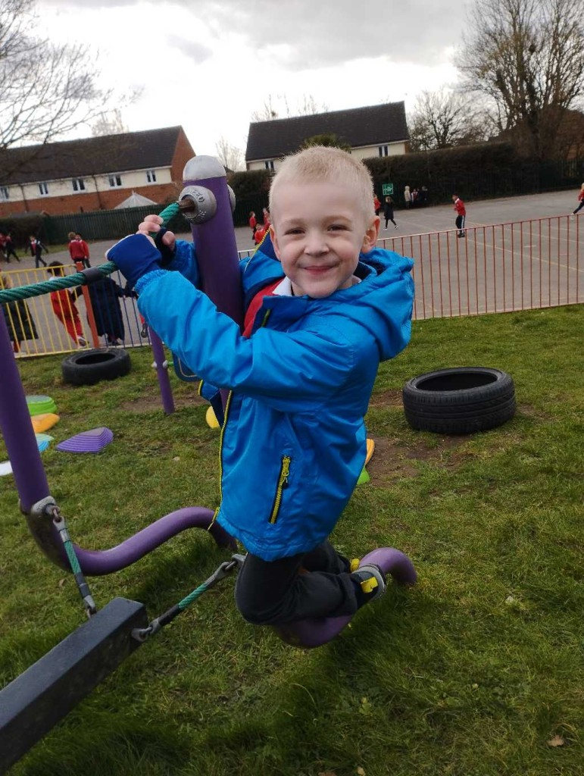
TOP TIPS FOR LENT RISE LEARNING – PREPARING YOUR CHILD FOR SCHOOL
We hope that with your support we can give your child the very best start to their education.
It would be helpful if you could prepare your child in the following ways to ensure that they settle into school life confidently and happily:
Encourage your child to ask to go to the toilet when they need to
Encourage your child to care for their own toilet hygiene including remembering to wash their hands
Encourage your child to independently put on their coat and do up the zip
Encourage your child to speak about themselves to develop their confidence around other peers and teaching staff
Try to help them to write some, if not all, of their own name
Encourage them to socialise with other children of a similar age
Play games and read as many books as possible

Slide 13
HELPING AT HOME
Hear your child read as often as possible, at least once a day.
Read to your child, to increase their vocabulary and to make books enjoyable.
Help your child to form their letters and numbers correctly.
Help your child to write their name correctly and to know their surname.
Talk to your child about school work. Encourage them to participate in topic work by taking an interest yourself.
Write letters and postcards to friends and relatives.
Help your child to learn their letter sounds and later, spellings.
Give them pocket money! (Just 10p is enough, but give it to them in change and make them count it.)
Help your child to talk about the sequence of events in the day.
Help your child to tell the time.
Get them to use puzzles and construction toys. Encourage them to play with others and make up their own stories.
When you go outside, talk about the weather and seasonal changes.
Encourage children to count shopping in the trolley, whilst in the supermarket and help to load items from the shelves.
Play counting and letter games whilst in the car.
Grow things, cook things, make things, sew, knit, colour, and paint.

Slide 14
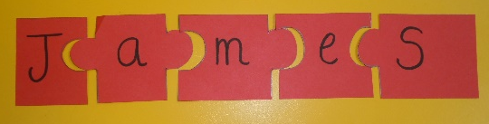


LITERACY AND NUMERACY GAMES
Below are some game ideas for you to play at home in order to help your child.
Name Jigsaws
Write your child's name on a card strip. Cut the strip up into the individual letters. Work with your child to put their name back together. One idea might be to then make this into a name tag for their bedroom door.
Pairs Game
Use pictures from magazines to play matching and finding games. This will help to develop concentration and memory skills.
Reading Area/Time
Have a special area/time for you and your child to look at books and begin to enjoy reading.
Catalogue Sounds
Pick up a free catalogue (e.g. from Argos). Decide on a letter sound to focus on (e.g. ‘a’). Work with your child to find pictures that begin with that letter. Cut them out. One idea might be to make an alphabet scrap book from these pictures.

Slide 15

Daily Counting
Count the things you see around you from the plates on the table to trees in the park. Your child will begin to enjoy counting and will soon begin to do this independently.
Patterns with pasta
Using differently coloured dry pasta, work with your child to make shapes. Use the correct words e.g. circle, square.
Counting Rhymes
Sing and learn rhymes with your child. Here are some examples to give your some ideas:
1,2,3,4,5, once I caught a fish alive
Five little speckled frogs
Five little men in a flying saucer
Five little monkeys
1,2 buckle my shoe

Slide 16
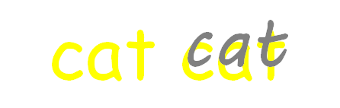
HANDWRITING
It is very important that your child learns the correct formation of handwriting from the start. This will enable them to progress confidently and easily onto joined up writing.
The following sheets are examples of how we teach letter and number formations. The sheets include simple rhymes to assist formation practice. It would be helpful if you could ensure that if your child is beginning to write their name, they are using letters formed in this way.
When doing work at home, please let your child record their ideas or simple pictures by themselves. If they need support with writing we suggest you write in yellow felt pen for them to trace over with pencil (see example below).

Slide 17
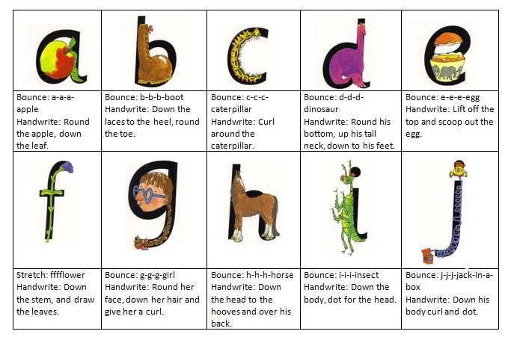
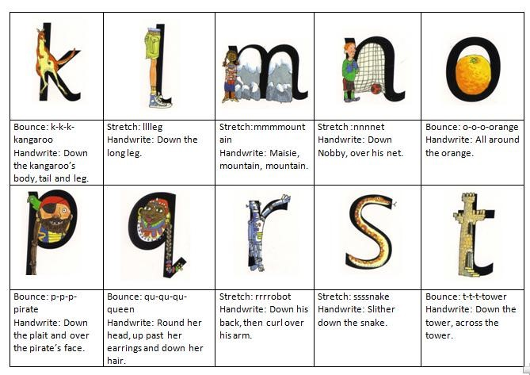

Slide 18
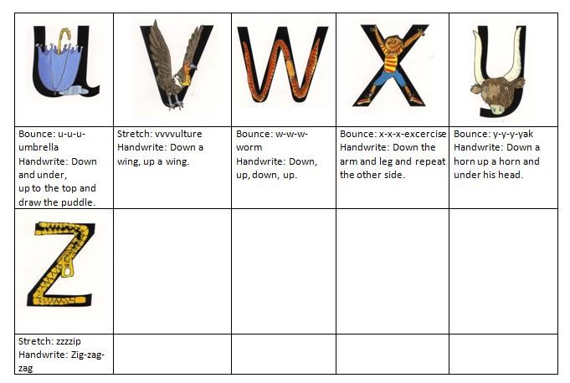

Slide 19








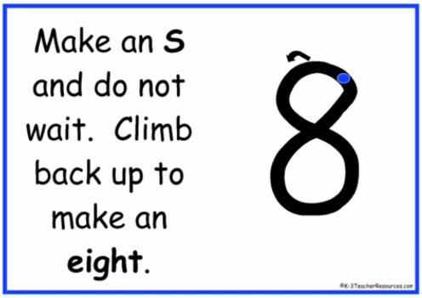

Number Formation Rhymes

Slide 20
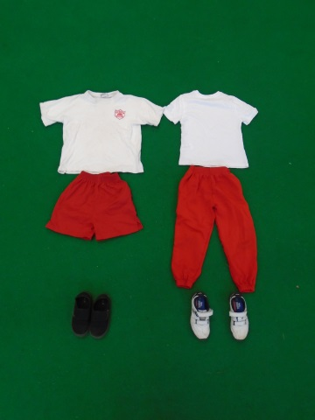
PE AND SPORT AT LENT RISE SCHOOL
‘Physical Development is the key that unlocks all learning’ (Mackintrye and Mcvitty 2004)
Children take part in a range of activities to develop their coordination, balance and team work skills.
Please ensure that your child comes prepared to take part in PE. For outdoor P.E. this will mean plain red shorts or jogging bottoms and a plain white T-shirt.
Children must not wear jewellery for any form of physical activity. This is purely a safety measure. Please support us by reiterating this with your child; it will also indicate to your child the partnership between home and school.
If there are any difficulties about the provision of suitable kit etc., please let your child's class teacher know.

Slide 21

LUNCH
Hot Lunch
Lunches can be ordered from www.kidslunch.co.uk
It is very user friendly, parents will need to:
1. Select "order lunches" on the top right corner of the Home Page,
2. Select your school... 'Lent Rise'
3. Select category ie. EYRs KS1 (no payment) or KS2
4. Select whether lunches are payable or FSM.
5. Select meal choices for the 6 weeks available. (If doing week by week please make sure you choose the correct week you require lunch)
6. You MUST order by 12pm Friday for the following weeks order or you will need to supply a packed lunch
Packed Lunch
If your child is bringing a packed lunch to school, please ensure it is healthy and balanced to support their learning and wellbeing throughout the day. As we are a nut-free school, items containing nuts should not be included, to help keep all children safe.

Slide 22
REGISTRATION
We ask parents to work with the school to make sure that children attend school regularly, as it is obviously necessary to ensure that each child achieves to their full potential.
If your child is not well enough to attend school, please log the illness on Parentmail to do this you need to go on to your parentmail app and click:
Absence,
Select child,
Add and put the reason and the duration you believe the child will be absent for, with a full explanation of the reason of absence.
If you have any queries or require further assistance please contact the school office on 01628 662913.
Parents may be asked to provide medical evidence in the form of an appointment card or prescription where there are repeated absences due to reported illness.
Please do make sure that your child is on time for school. The playground gates will open at 8:30am. Your child may come into school between 8:30- 8:45 and head straight to class. However, if your child does miss the gate to go into class, please bring them to the school office where a member of staff will sign them in.
Where possible please try to arrange medical and dental appointments outside the school day. If this is not practical, pupils should attend for part of the day and the appointment card should be brought into school to show to a member of the office staff.
Authorised absences are recorded where there is a satisfactory explanation for the absence or lateness such as illness or a medical appointment in accordance with the school’s Attendance Policy. Please see the school website for a current version of this.
Please note that we cannot authorise holidays taken during term time and parents are strongly advised not to do so. Parents wishing to take their child out of school during term time must send a written leave of absence request to the Headteacher at least one month before. All requests for leave of absence will be responded to in writing. Each request will be considered individually and will take into account documentary evidence and any extenuating circumstances. If the permission to take leave is not granted and the pupil is absent, the absence will be unauthorised. In such cases the school may refer the matter to the Education Welfare Service who may issue a Penalty Notice.
We work closely with the Education Welfare Service to monitor attendance and work with families to support attendance at school.

Slide 23

SCHOOL UNIFORM
We look to parents to work with the School to ensure that children come to school always maintaining a high standard of dress.
Boys’ Uniform :
White shirt (preferably with turn down collar and sleeves)
Grey trousers (not jeans, track suit bottoms or cords)
Red V neck pullover or sweatshirt
Black leather shoes (no suedes, trainers or boots)
Dark socks (preferably grey)
School tie (optional, but very strongly encouraged)
Girls’ Uniform :
White shirt/blouse (preferably with turn down collar and sleeves)
Grey skirt
Grey, high wasited full length trousers
Red cardigan, pullover or sweatshirt
Black leather shoes (no suedes, trainers, slingbacks, heels or boots)
Grey or white socks (or tights)
School tie (optional, but very strongly encouraged)
In the summer, both boys and girls may wear grey shorts. The girls may wear red gingham or striped dresses. Shoes may be changed to black, closed-toe, leather summer sandals.
P.E. Uniform :
White T-shirt
Red shorts
Running shoes or sports trainers for outdoor sport
Red, black or grey tracksuit bottoms
Additional items:
Wellington boots
Sun hat
Hair must be neat and tidy with no extremes of colour or style, or shaved patterns on the head and must not be beneath collar length for boys. We ask that no jewellery is to be worn.

Slide 24
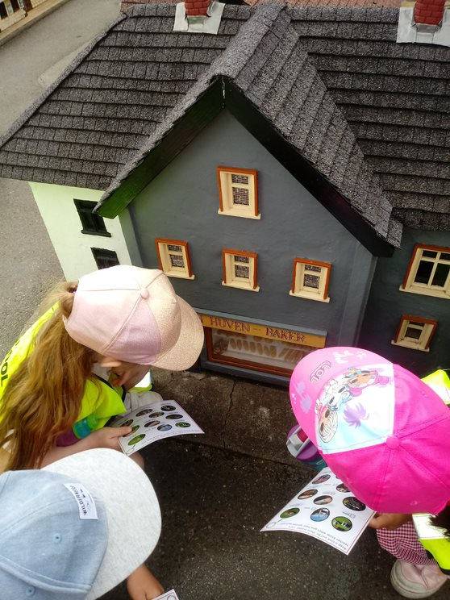
SCHOOL JOURNEYS AND ACTIVITIES
During the coming years, your child, with many others, may be taking part in school activities outside school premises and perhaps outside school hours. I hope that your child will find these events both helpful and enjoyable.
We would like to draw parents’ attention to the risks that can arise when their child takes part in out of school activities. Lent Rise School works alongside Buckinghamshire County Council to provide quality provision for school journeys and activities. The aim is that out of school activities should be properly organised and that all reasonable precautions should be taken for the safety and wellbeing of your child. Your child may, nevertheless, be exposed to additional hazards such as accidents in the course of travel or sporting activities.
An accident might occur because of negligence by the Academy or County Council, or by negligence by a teacher, another member of the County Council staff, or a voluntary helper acting in the knowledge and approval of the authority (lack of supervision). In this case, the County Council will fully accept its responsibilities and has an insurance policy which applies whenever it is legally liable to pay compensation for accidental injury to persons or accidental damage to property.
On the other hand, an accident might occur where the Academy or County council cannot be held responsible or liable. In particular an accident might be caused by the child with no fault being attributed to the teacher, the County Council or any other party or parties other than the child. In such a case the parent might thus be held responsible and in view of this, you may wish to consider your own insurance position. Many people do not insure against such risks, although some may be covered by their ordinary household policy. In the case of trips abroad and other major excursions, the teacher-in-charge may arrange group insurance and you would be advised of this at the time.

Slide 25
FIRST AID
All our staff are trained in Emergency First Aid and we have designated members of staff trained in Paediatric First Aid.
If your child is ill or has an accident at school that causes concern, the office will contact you using the contact names and numbers you have given. Please ensure that you keep the office updated with any changes in your contact details.
We will administer First Aid to minor injuries at school and you will receive a note home explaining what happened. Please check your child at home. We are not medical professionals so if you have any concerns, please take your child to your doctor or local hospital A&E department.
MEDICATION
If your child needs medication at school you must complete a form giving consent for the school to administer medicines. Legally this form can only be signed by someone with parental responsibility for the child; this does not include grandparents (unless court appointed guardians) or child minders.
Please bring medication to the school office and collect it at the end of the school day. Medication should be in the original packaging and clearly labelled with your child’s name and class. Prescription medication, including inhalers and creams, must have the pharmacy dispensing label attached.
If your child has asthma, their inhaler will be kept in their classroom where they can access it at any time.
All medications including inhalers will be sent home during school holidays.
Should you require further information or if you have any queries, please contact the Headteacher or School Office.

Slide 26

INHALERS
If your child has asthma, no matter how severe, and they have been prescribed a reliever inhaler please provide an inhaler to be kept in school. This should be in the original box with the dispensing label attached. The school also has emergency inhaler kits which can be used if a child has an asthma attack and their own inhaler is unavailable (for example it is empty). These kits do not replace your child’s own inhaler, which must be in school at all times. The emergency inhaler kit can only be made available to children who have already been prescribed a reliever inhaler and whose parents have signed a consent form.
AUTO-INJECTOR DEVICES
If your child has been prescribed an auto-injector device because they are at risk of anaphylaxis then we must have an in-date device in school at all times. This is kept in the school office and all staff are trained on the signs and symptoms of anaphylaxis and how to administer emergency adrenaline. If you do not provide a device your child will not be able to attend any out of school activities or trips as we cannot approximate an ambulance response time should they have a severe allergic reaction. In the case of residential trips two devices must be supplied or your child will not be able to attend.

Slide 27
SAFEGUARDING
“At this school, the health, safety and well-being of every child are our paramount concern. We listen to our pupils and take seriously what they tell us. Our aim is for children to enjoy their time as pupils in this school. We want to work in partnership with you to help your child achieve their full potential and make a positive contribution.
To promote a safe environment for pupils, our selection and recruitment policy includes all checks on staff and regular volunteers’ suitability, including Criminal Records Bureau checks, as recommended by Buckinghamshire County Council in accordance with current legislation.
In accordance with our responsibilities under section 175/157 of the Education Act 2002 and “Keeping Children Safe in Education“ Sept 2024. There are four trained Designated Safeguarding Leads, the Headteacher Mrs J Watson, Deputy Headteacher Mrs R Small, and the two Assistant Headteachers Miss Boxall and Miss Johns, this ensures there is a DSL on duty at all times. It is their responsibility to ensure that all staff in contact with children receive child protection awareness training on a regular basis.
Occasions do arise when our concern about a child means we have to consult other agencies. Whilst we would always aim to work in partnership with parents there may be exceptions to this when concerns are raised for the protection of a child.
On very rare occasions Social Care, whilst undertaking an investigation under s47 of the Children Act 1989, may want to speak to a child without a parents’ knowledge. This would be a decision made in collaboration with partner agencies and would only be done in situations where a child might be at immediate risk. To gain consent at this point may increase the level of risk to the child or cause evidence of a crime to be lost.
The procedures, which we follow, have been laid down by the Local Safeguarding Children’s Board, and the school has adopted a Child Protection Policy in line with this for the safety of all. If you want to know more about our procedures, please speak to the Headteacher, Mrs J Watson or your child’s class teacher: the Policy can be found on the school’s website www.lentriseschool.co.uk

Slide 28
