Slide 1

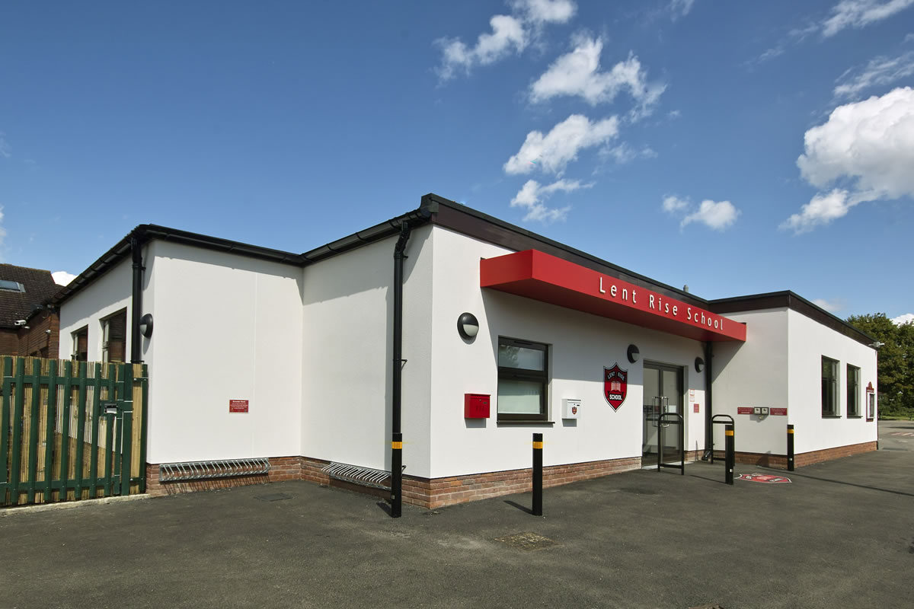
YEAR TWO PARENT PACK
Lent Rise School
Coulson Way, Burnham, Slough, SL17NP
Headteacher : Mrs J Watson
Telephone : 01628 662913
office@lentrise.bucks.sch.uk
www.lentriseschool.com

Slide 2
CONTENTS
Year 2 Information | 3
Curriculum | 4
Attendance and punctuality | 5
Our Open Door Policy | 6
Free School Meals and Pupil Premium Funding | 7
Safeguarding Information | 10
Privacy/ Data Protection Notice | 11
USEFUL INFORMATION TO BE FOUND ON THE SCHOOL’S WEBSITE
Key Principles
Term Dates
Curriculum
Homework Policy
Phonics Information
How you can Help with Writing
How to Help at Home
Year 2 Vocabulary
Teacher Assessment using Target Tracker
Registration
School Uniform
First Aid and Medication
Inhalers and Auto Injector Devices
This pack contains information only, contact and permissions information will be circulated separately.

Slide 3
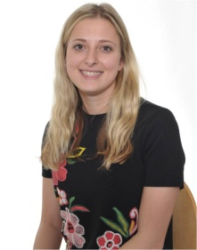
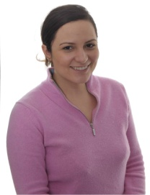
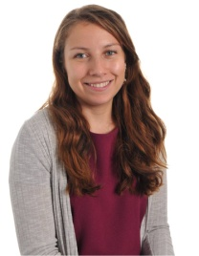
YEAR 2 INFORMATION
Year 2 is part of Key Stage 1 (KS1). We will often abbreviate Year 2 to Y2 or use the class name e.g. 2G (Miss Grella’s class). The Phase Leader is Miss Boxall who also teaches to support standards and achievement.
KS1 timings
9.10 am Morning registration
9.20 am Read Write INC / Writing
10.20 am Morning break
10.40 am Assembly
11.00 am Numeracy
12.00 noon Lunch
12.45 pm Afternoon registration
12.50 pm Handwriting
1.10 pm Afternoon session 1
2.00 pm Afternoon break
2.10 pm Afternoon session 2
3.15 pm Home time
PE Days: Indoor PE Tuesday, Outdoor PE Monday
Homework Schedule
Monday | Tuesday | Wednesday | Thursday | Friday
Reading Spelling | Reading My Maths | Phonics / comprehension | Maths | Timestable Cards
A Message from Year 2
Welcome! We hope that you find all of the information in this pack useful. If you have any questions after reading this Parent Pack or would like to talk to us about the year ahead, please do let us know so that we can arrange a time to meet with you.
Parents can leave messages for class teachers in the children’s reading record or approach teachers at the end of the day but please note it is difficult to speak to parents in the mornings as we must focus on supervising the class. Please contact the school office if you wish to make an appointment.
2G Class Teacher Miss Grella | 2BE Class Teacher Mrs Burniki | 2BE Class Teacher Miss Enright

Slide 4
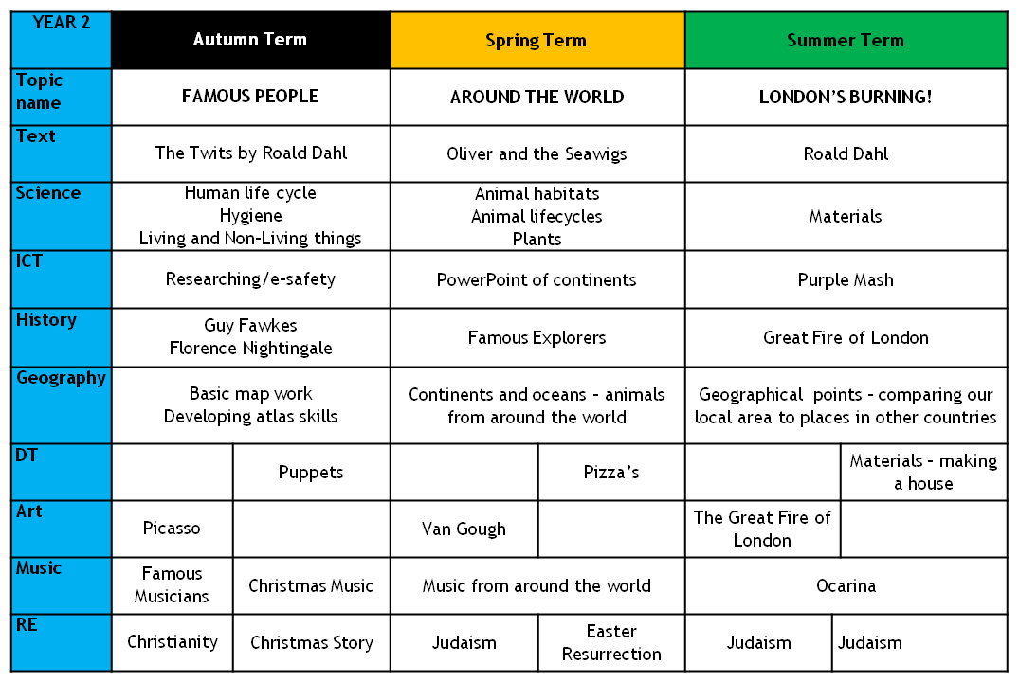
CURRICULUM
During the course of the year your child, in addition to English and Numeracy, will be studying the following subject areas. We hope this information will be of interest and will help you to share the work with your child by providing further reading material, or perhaps arranging a trip to a suitable museum, etc.
Miranda the Explorer
Caribbean dessert
Pop-Up Cards
Materials – Making a house
Each year group will take part in Educational visits designed to enhance the children's learning of the curriculum. Visits may change from year to year but last year, Year 2 visited the Roald Dahl Story Centre, Eton Natural History Museum and 2 workshops from Dramahub (Florence Nightingale and Explorers).

Slide 5
ATTENDANCE AND PUNCTUALITY
As parents you all have a legal responsibility to make sure that your child attends school every day. If your child is going to be absent from school please contact the school office on the first day of their absence. This is important, as we will be contacting parents if a child is not at school and no reason has been given.
Regular attendance and punctuality is fundamental to enabling your child to achieve the highest levels of attainment. We ensure all children are aware of the importance of attendance and punctuality.
The attendance target sent by the Governing Body for 2019-2020 is 96%. We expect ALL children to achieve this.
If your child is unwell
If your child is too unwell to come to school, or has a medical appointment, please contact the school office as soon as possible. To help you, the NHS has compiled a list of guidelines about how long children should be kept off school when they have a common illness.
https://www.nhs.uk/Livewell/Yourchildatschool/Pages/Illness.aspx
Lateness
Learning begins promptly at the beginning of the day with instructions and explanations and it is vital that your child does not miss this part of the day. We monitor lateness and send letters to parents whose children regularly arrive to school late.
Authorised absence
Family holidays should always be taken during the school holidays, and we will only authorise absence in very special circumstances. On these occasions permission must be sought in advance from the head teacher. Absence request forms are available from the school office or a letter should be written to the head teacher.

Slide 6
OUR OPEN DOOR POLICY
Please do contact us at any time when you have a concern, even if it appears to be minor. The ‘little’ difficulties are easy to deal with; don’t let them become major concerns. The Open Door Policy is encouraged at Lent Rise School. If you wish to talk about your child please:
Approach the class teacher
Talk to a member of the middle management team (KS1 or KS2 Phase Leaders)
Talk to a member of the senior leadership team
The Headteacher, Mrs Watson, is always happy to see parents but clearly she will go to the Class Teacher to discuss issues, therefore it makes sense for you to have spoken to the teacher first.
Contacting the Headteacher if she is not in School
When the Headteacher is out, your children are always in safe hands. If you need an immediate response, please contact the School Office and a member of the senior leadership team will get a response to you as soon as possible.
Complaints and Resolution Procedure
The following is the strategy that is suggested if difficulties arise – we recommend that you use this structure.
Talk to the Class Teacher
Talk to a member of the senior leadership team
Talk to the Headteacher
Make Representations to the Governing Body in writing to:
Mrs Maggie Young, Chair of Governors
by e-mail: govs@lentrise.bucks.sch.uk
or
c/o Lent Rise School
Coulson Way
Burnham
Slough
SL1 7NP
If you are still not satisfied you may wish to put your complaint to the Secretary of State for Education and Skills who can review whether the School has acted reasonably and followed the correct procedures. The address is Sanctuary Buildings, Great Smith Street, London, SW1 3BT.
If you would like to read our full Complaints Procedure, please contact the school office for a copy or visit the school website www.lentrise.bucks.sch.uk.

Slide 7



FREE SCHOOL MEALS AND PUPIL PREMIUM FUNDING
Do you receive any of the following benefits:
Income support
Income based Job Seekers’ Allowance (IBJSA)
Income-related Employment and Support Allowance (ESA)
Support under part VI of the Immigration and Asylum Act 1999
Child tax credit, with income under the threshold set by the Treasury, (Not Working Tax Credit)
The ‘Guarantee’ element of Pension Credit
All children in Early Years, Years 1 and 2 are eligible to have a universal school meal. But we still need parents receiving the benefits listed above to sign up to the Free School Meals service. If you have a child in KS2 they will also be eligible for a free school meal, but only if you apply!
Why sign up?
For the school
We receive additional funding for children who would be eligible for Free School meals even if they were not in Early Years, Year 1 or Year 2. This funding is called Pupil Premium and we use it to support progress and achievement (you can find out how we spent this year’s Pupil Premium on our website https://www.lentriseschool.co.uk/website.
For you
If we know that your child would be eligible for Free School Meals even if they were not in Early Years, Year 1 or Year 2 we can provide additional support to them in school. We can also help with the cost of school uniform, PE kits, school trips, clubs and music lessons on a case-by-case basis.
Signing-up takes less than 5 minutes
All you need to do is complete a short form. You do not need to provide any proof of your eligibility. You only need to sign-up once and we will automatically re-check your details every term. If you are still eligible, your child will continue to receive a free school meal in Key Stage 2. The school office staff will be happy to answer your questions or help you complete the form.
All applications are dealt with in confidence.

Slide 8
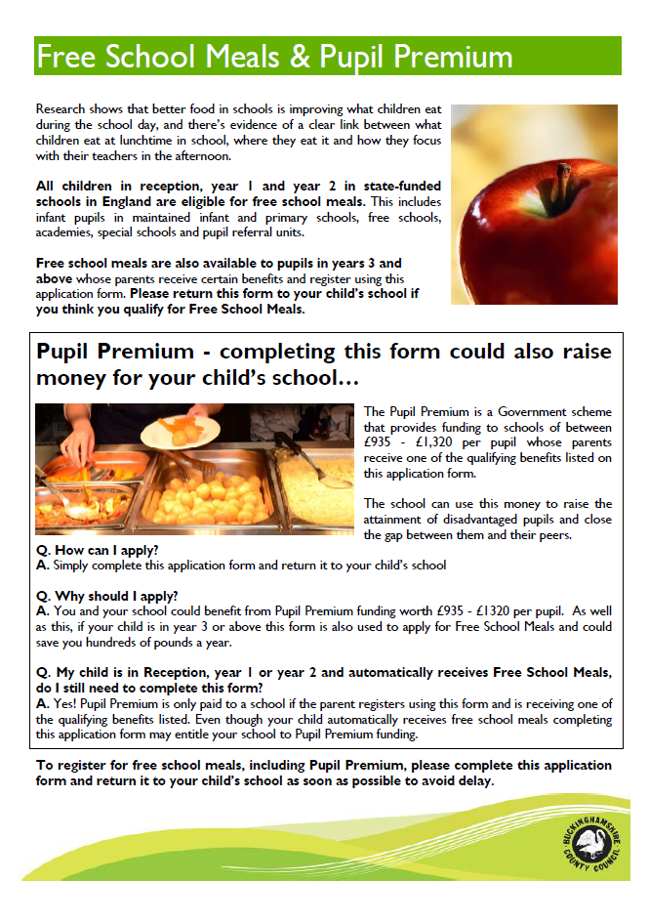

Slide 9
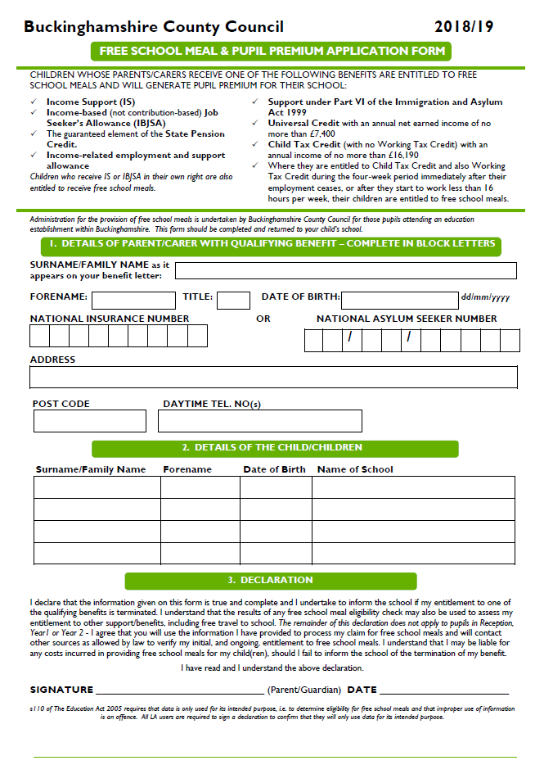

Slide 10
SAFEGUARDING
“At this school, the health, safety and well-being of every child are our paramount concern. We listen to our pupils and take seriously what they tell us. Our aim is for children to enjoy their time as pupils in this school. We want to work in partnership with you to help your child achieve their full potential and make a positive contribution.
To promote a safe environment for pupils, our selection and recruitment policy includes all checks on staff and regular volunteers’ suitability, including Criminal Records Bureau checks, as recommended by Buckinghamshire County Council in accordance with current legislation.
In accordance with our responsibilities under section 175/157 of the Education Act 2002 and “Keeping Children Safe in Education“ Sept 2019. There are two trained Designated Safeguarding Leads, the Headteacher Mrs J Watson and the Deputy Headteacher Mrs R Small, this ensures there is a DSL on duty at all times. It is their responsibility to ensure that all staff in contact with children receive child protection awareness training on a regular basis.
Occasions do arise when our concern about a child means we have to consult other agencies. Whilst we would always aim to work in partnership with parents there may be exceptions to this when concerns are raised for the protection of a child.
On very rare occasions Social Care, whilst undertaking an investigation under s47 of the Children Act 1989, may want to speak to a child without a parents’ knowledge. This would be a decision made in collaboration with partner agencies and would only be done in situations where a child might be at immediate risk. To gain consent at this point may increase the level of risk to the child or cause evidence of a crime to be lost.
The procedures, which we follow, have been laid down by the Local Safeguarding Children’s Board, and the school has adopted a Child Protection Policy in line with this for the safety of all. If you want to know more about our procedures, please speak to the Headteacher, Mrs J Watson or your child’s class teacher: the Policy can be found on the school’s website www.lentrise.bucks.sch.uk

Slide 11
PRIVACY POLICY/NOTICE PUPILS AND PARENTS MAY 2018
Privacy Notice (How we use pupil information)
The categories of pupil information that we collect, hold and share include:
Personal information (such as name, unique pupil number and address)
Characteristics (such as ethnicity, language, nationality, country of birth and free school meal eligibility)
Attendance information (such as sessions attended, number of absences and absence reasons)
Assessment information
Relevant medical information
Special educational needs information
Exclusion and behavioural information
Why we collect and use this information
We use the pupil data:
to support pupil learning
to monitor and report on pupil progress
to provide appropriate pastoral care
to assess the quality of our services
for safeguarding and child protection
to comply with the law regarding data sharing
The lawful basis on which we use this information
We collect and use pupil information under departmental censuses and the Education Act 1996, for more information on the school census process and requirements see:
https://www.gov.uk/education/data-collection-and-censuses-for-schools
We collect and process data under the following legal basis for processing:
Article 6 (GDPR)
1. the data subject has given consent to the processing of his or her personal data for one or more specific purposes;
2. processing is necessary for compliance with a legal obligation to which the controller is subject;
Article 9 (GDPR)

Slide 12
the data subject has given explicit consent to the processing of their personal data for one or more specified purposes, except where Union or Member State law provide that the prohibition referred to in paragraph 1 may not be lifted by the data subject
Collecting pupil information
Whilst the majority of pupil information you provide to us is mandatory, some of it is provided to us on a voluntary basis. In order to comply with the General Data Protection Regulation, we will inform you whether you are required to provide certain pupil information to us or if you have a choice in this.
Storing pupil data
We hold pupil data in line with IRMS (Information records management service) guidelines. Please see the following document for full details on data storage including time scales. http://irms.org.uk/page/SchoolsToolkit
Who we share pupil information with
We routinely share pupil information with:
schools that the pupil’s attend after leaving us
our local authority
the Department for Education (DfE)
agencies including the School Nurse and the NHS
academy trust if applicable
curriculum resources (all web resources are checked, and minimal details are shared with online teaching resources)
Why we share pupil information
We do not share information about our pupils with anyone without consent unless the law and our policies allow us to do so.
We share pupils’ data with the Department for Education (DfE) on a statutory basis. This data sharing underpins school funding and educational attainment policy and monitoring.
We are required to share information about our pupils with the (DfE) under regulation 5 of The Education (Information About Individual Pupils) (England) Regulations 2013.

Slide 13
Data collection requirements:
To find out more about the data collection requirements placed on us by the Department for Education (for example; via the school census) go to https://www.gov.uk/education/data-collection-and-censuses-for-schools.
The National Pupil Database (NPD)
The NPD is owned and managed by the Department for Education and contains information about pupils in schools in England. It provides invaluable evidence on educational performance to inform independent research, as well as studies commissioned by the Department. It is held in electronic format for statistical purposes. This information is securely collected from a range of sources including schools, local authorities and awarding bodies.
We are required by law, to provide information about our pupils to the DfE as part of statutory data collections such as the school census and early years’ census. Some of this information is then stored in the NPD. The law that allows this is the Education (Information About Individual Pupils) (England) Regulations 2013.
To find out more about the NPD, go to https://www.gov.uk/government/publications/national-pupil-database-user-guide-and-supporting-information.
The department may share information about our pupils from the NPD with third parties who promote the education or well-being of children in England by:
conducting research or analysis
producing statistics
providing information, advice or guidance
The Department has robust processes in place to ensure the confidentiality of our data is maintained and there are stringent controls in place regarding access and use of the data. Decisions on whether DfE releases data to third parties are subject to a strict approval process and based on a detailed assessment of:
who is requesting the data
the purpose for which it is required
the level and sensitivity of data requested: and
the arrangements in place to store and handle the data
To be granted access to pupil information, organisations must comply with strict terms and conditions covering the confidentiality and handling of the data, security arrangements and retention and use of the data.
For more information about the department’s data sharing process, please visit: https://www.gov.uk/data-protection-how-we-collect-and-share-research-data
For information about which organisations the department has provided pupil information, (and for which project), please visit the following website: https://www.gov.uk/government/publications/national-pupil-database-requests-received

Slide 14
To contact the DfE: https://www.gov.uk/contact-dfe
Keeping your personal information secure
We have appropriate security measures in place to prevent personal information from being accidentally lost, or used or accessed in an unauthorised way. We limit access to your personal information to those who have a genuine need to know it. Those processing your information will do so only in an authorised manner and are subject to a duty of confidentiality.
We also have procedures in place to deal with any suspected data security breach. We will notify you and any applicable regulator of a suspected data security breach where we are legally required to do so.
Requesting access to your personal data
Under data protection legislation, parents and pupils have the right to request access to information about them that we hold. To make a request for your personal information or be given access to your child’s educational records. In the first instance please contact the school lead below.
You also have the right to:
object to processing of personal data that is likely to cause, or is causing, damage or distress
prevent processing for the purpose of direct marketing
object to decisions being taken by automated means
in certain circumstances, have inaccurate personal data rectified, blocked, erased or destroyed; and
claim compensation for damages caused by a breach of the Data Protection regulations
If you have a concern about the way we are collecting or using your personal data, we request that you raise your concern with us in the first instance. Alternatively, you can contact the Information Commissioner’s Office at https://ico.org.uk/concerns/
Position | Name | Email | Phone
School Lead | Jill Watson | dpo@lentrise.bucks.sch.uk | 01628 662913
Data Protection Officer | Turn IT on | dpo@turniton.co.uk | 01865 597620 (option 3 – GDPR)

Slide 15
Other policies which may reference this privacy notice
This Privacy Notice also applies in addition to the School's other relevant terms and conditions and policies, including:
any contract between the School and its staff or the parents of students;
the School's policy on taking, storing and using images of students;
the School’s policy on the use of CCTV;
the School’s retention of records policy, (IRMS template);
the School's safeguarding and pastoral policy; www.lentrise.bucks.sch.uk
the School’s Health and Safety policy, including how concerns or incidents are recorded;
the School's IT policies, including its Acceptable Use policy, On-line Safety policy;
Contact
If you would like to discuss anything in this privacy notice, in the first instance please contact the School Lead below:
Policy update information (policy number GDPR-103b)
This policy is reviewed annually and updated in line with data protection legislation.
Policy review information
Policy update information
Position | Name | Email | Phone
School Lead | Jill Watson | dpo@lentrise.bucks.sch.uk | 01628 662913
Data Protection Officer | Turn IT on | dpo@turniton.co.uk | 01865 597620 (option 3 – GDPR)
Review Date | Reviewed by
02-05-2018 | Turn IT on
Review Date | Revision | Description on change | By
02-05-2018 | 1.00 | Draft release | Turn IT on
03-05-2018 | 1.00 | Full release

