Slide 1

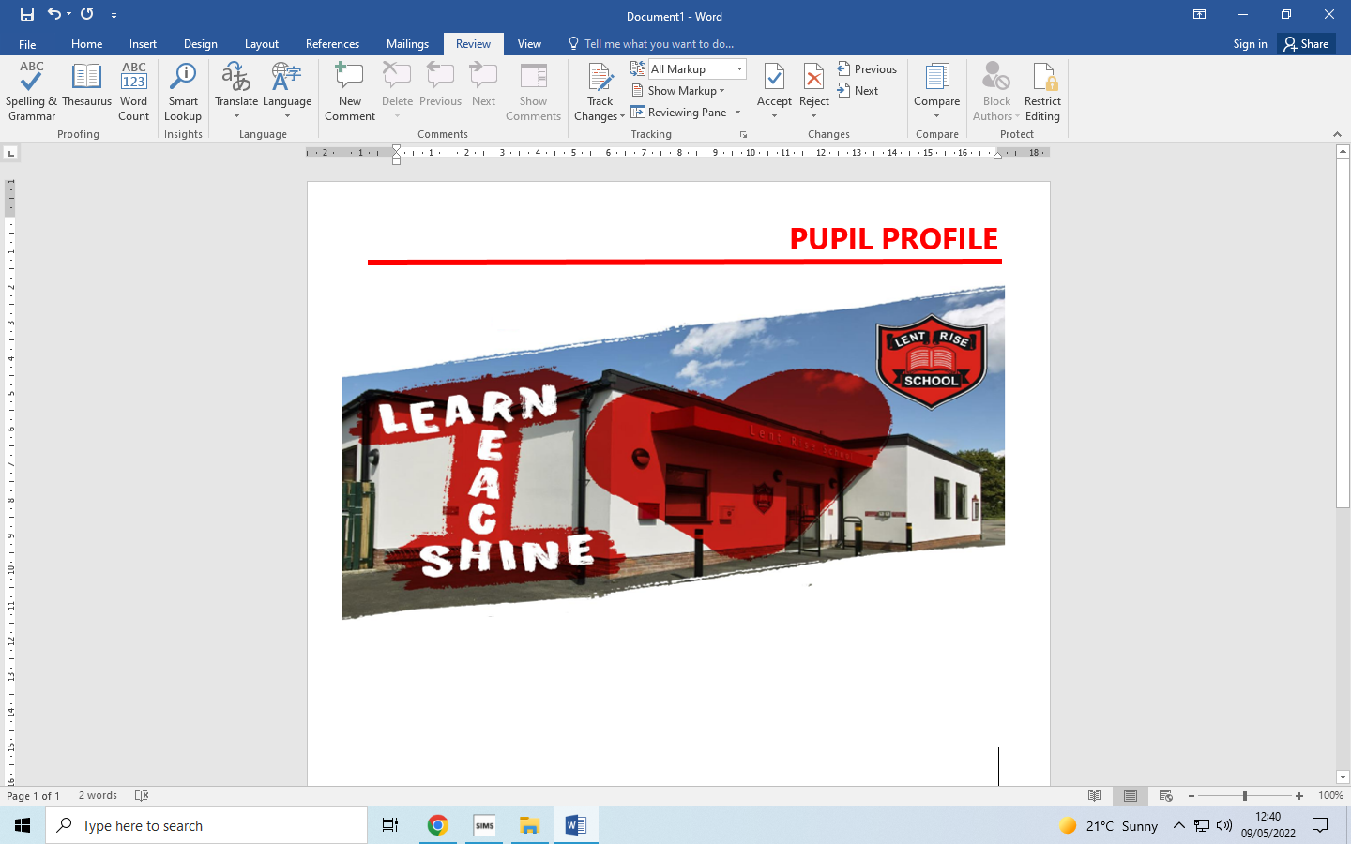
LENT RISE SCHOOL
‘Learn, Reach, Shine’
YEAR 1
PARENT PACK
Lent Rise School
Coulson Way, Burnham, Slough, SL17NP
Headteacher : Mrs J Watson
Telephone : 01628 662913
office@lrschool.co.uk
www.lentriseschool.co.uk

Slide 2
CONTENTS
Year 1 Information | 3
Curriculum | 4
Attendance and punctuality | 6
Our Open Door Policy | 7
Phonics Screening | 8
Free School Meals and Pupil Premium Funding | 9
Safeguarding Information | 12
Privacy/ Data Protection Notice | 13
USEFUL INFORMATION TO BE FOUND ON THE SCHOOL’S WEBSITE
Key Principles
Term Dates
Curriculum
Homework Policy
Phonics Information
How you can Help with Writing
How to Help at Home
Subject Vocabulary
Teacher Assessment using Target Tracker
Registration
School Uniform
First Aid and Medication
Inhalers and Auto Injector Devices
This pack contains information only, contact and permissions information will be circulated separately.

Slide 3
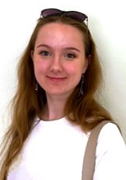
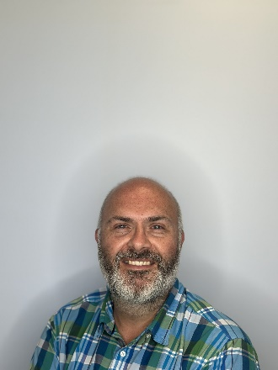
YEAR 1 INFORMATION
Year 1 is part of Key Stage 1 (KS1). We will often abbreviate Year 1 to Y1 or use the class name e.g. 1P (Miss Przybyło’s class) and 1W (Mr Waldeck’s class). The Phase Leader is Mr Harman.
KS1 timings
8.40 am Gates open
8.55am Morning Registration
9.00 am Mastering Number
9.20 am RWI Phonics
10.20 am Assembly
10.40 am Morning Break
11.00 am Maths
12.00 noon Lunch
12.45 pm Afternoon registration
12.50 pm Afternoon session 1
13.05 pm Afternoon session 2
2.00 pm Afternoon break
2.10 pm Continuous Provision
3.15 pm Home time
PE Days: Wednesday and Friday. PE Kits are to be worn on a Wednesday.
A Message from Year 1
Welcome! We hope that you find all the information in this pack useful. If you have any questions after reading this Parent Pack or would like to talk to us about the year ahead, please do let us know so that we can arrange a time to meet with you.
Parents can leave messages for class teachers in the children’s reading record or by contacting the school office to make an appointment.
1P Class Teacher | 1W Class Teacher
Miss Przybyło | Mr Waldeck

Slide 4

YEAR 1 HOMEWORK
Homework Schedule
Monday | Tuesday | Wednesday | Thursday | Friday
Reading comprehension | Reading Maths Homework | Reading Phonics/Spelling | Reading Number Bonds (Spring Term) | Times Table Rockstars
At Lent Rise, we instil a love of reading within school and encourage for this to be embedded at home.
To support your child’s reading further, please record daily readings in your child’s reading record. This can include any reading successes or challenges which we will check daily and follow up within school.
Homework is catered to your child's current learning. Answers will be sent home weekly to support you and your child.

Slide 5
CURRICULUM OPPORTUNITIES IN YEAR 1
An Introduction to Year 1
Year 1 fosters an environment of excitement, vibrancy, and enthusiasm in its teaching approach. Each lesson is meticulously planned and organised, aimed at nurturing children's innate curiosity, fostering a desire to delve deeper into subjects, and cultivating a genuine love for learning. Throughout Year 1, children acquire essential knowledge and a diverse set of skills across various disciplines.
Our curriculum is thoughtfully designed around a range of captivating themes, engaging reading materials, and diverse genres. In the initial term, Year 1 integrates child-initiated learning, facilitating a smooth transition from Early Years and laying the foundation for future whole-class instruction. Children are actively encouraged to partake in a rich array of activities, spanning creative and nonfiction writing, dramatic enactments, intricate problem-solving, and scientific exploration.
Our foremost aim is to ensure that each child realises their full potential and emerges from the year with both preparedness and confidence. The English curriculum is further enriched through interactions with school visitors and celebrations like National and International Book Day, which infuse speech and performances with the insights of guest authors. A spectrum of workshops throughout the year, including those on creative writing and related themes, culminates in a visit from a celebrated poet, making Year 1 an exhilarating educational journey.
Mathematics takes on an exciting dimension with our Mastery Approach, allowing children to develop their fluency, reasoning and problem-solving through a variety of specialised software and hands-on investigations. Weekly homework, alongside timetable Rockstars, support amplify children's use of information and communication technology (Computing), fortifying their mathematical skills.
Year 1 harnesses a range of ICT and media resources, seamlessly interwoven into the curriculum. From digital cameras to computers and iPads, students regularly engage with these tools, fostering digital literacy. Interactive whiteboards are in every classroom, and weekly scheduled ICT slots allow students valuable exposure.
Geography takes on a scientific inquiry lens as we delve into the local area, using our Eco Garden to cultivate fruits, vegetables, and sunflowers. This hands-on experience enables us to observe and investigate plant growth, yielding gratifying results.
This year is filled with hands-on exploration and practical learning. Students design and build sculptures, create fruit salads, and delve into world dance themes. Our curriculum is augmented by guest sports coaches, enhancing physical education and the overall learning experience.

Slide 6
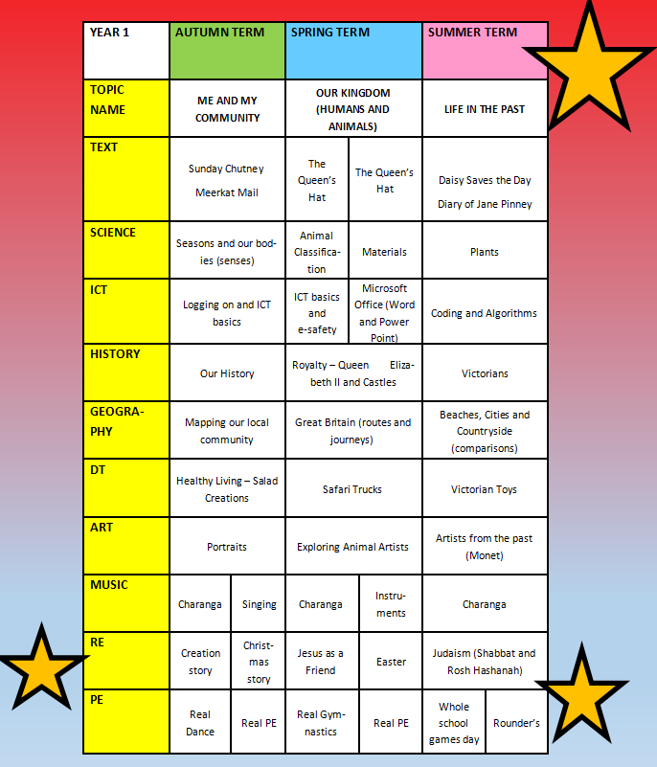
CURRICULUM
Throughout the year, your child will learn more than just English and Math. They'll explore different subjects too. This information can help you support them by finding extra reading materials or planning trips to museums, for example.
Each year group will take part in Educational visits designed to enhance the children's learning of the curriculum. Visits may change from year to year but in previous years, Year 1 visited Burnham library, Windsor castle and Shortneills for a Christmas story trip.

Slide 7
Child Initiated Learning
In Year One this year, the children will have some child-initiated learning time in the afternoons. This is to support the children with transition from Early Years.
There will be several hours a week where children will be given the opportunity to explore the room, activities and ideas independently. All of the tasks set around the room will be surrounding our current topic. They will discover and explore different aspects through a variety of child-led activities.

Slide 8
ATTENDANCE AND PUNCTUALITY
As parents you all have a legal responsibility to make sure that your child attends school every day. If your child is going to be absent from school please contact the school office on the first day of their absence. This is important, as we will be contacting parents if a child is not at school and no reason has been given.
Regular attendance and punctuality is fundamental to enabling your child to achieve the highest levels of attainment. We ensure all children are aware of the importance of attendance and punctuality.
The attendance target sent by the Governing Body for 2023-2024 is 96%. We expect ALL children to achieve this.
If your child is unwell
If your child is too unwell to come to school, or has a medical appointment, please contact the school office as soon as possible. To help you, the NHS has compiled a list of guidelines about how long children should be kept off school when they have a common illness.
https://www.nhs.uk/Livewell/Yourchildatschool/Pages/Illness.aspx
Lateness
Learning begins promptly at the beginning of the day with instructions and explanations and it is vital that your child does not miss this part of the day. We monitor lateness and send letters to parents whose children regularly arrive to school late.
Authorised absence
Family holidays should always be taken during the school holidays, and we will only authorise absence in very special circumstances. On these occasions permission must be sought in advance from the head teacher. Absence request forms are available from the school office or a letter should be written to the head teacher.

Slide 9
OUR OPEN DOOR POLICY
Please do contact us at any time when you have a concern, even if it appears to be minor. The ‘little’ difficulties are easy to deal with; don’t let them become major concerns. The Open Door Policy is encouraged at Lent Rise School. If you wish to talk about your child please:
Approach the class teacher
Talk to a member of the middle management team (KS1 or KS2 Phase Leaders)
Talk to a member of the senior leadership team
The Headteacher, Mrs Watson, is always happy to see parents but clearly she will go to the Class Teacher to discuss issues, therefore it makes sense for you to have spoken to the teacher first.
Contacting the Headteacher if she is not in School
When the Headteacher is out, your children are always in safe hands. If you need an immediate response, please contact the School Office and a member of the senior leadership team will get a response to you as soon as possible.
Complaints and Resolution Procedure
The following is the strategy that is suggested if difficulties arise – we recommend that you use this structure.
Talk to the Class Teacher
Talk to a member of the senior leadership team
Talk to the Headteacher
Make Representations to the Governing Body in writing to:
Mrs Maggie Young, Chair of Governors
by e-mail: govs@lentrise.bucks.sch.uk
or
c/o Lent Rise School
Coulson Way
Burnham
Slough
SL1 7NP
If you are still not satisfied you may wish to put your complaint to the Secretary of State for Education and Skills who can review whether the School has acted reasonably and followed the correct procedures. The address is Sanctuary Buildings, Great Smith Street, London, SW1 3BT.
If you would like to read our full Complaints Procedure, please contact the school office for a copy or visit the school website www.lentriseschool.co.uk .

Slide 10
THE PHONICS SCREENING CHECK
As you may be aware children at the end of Year 1 are assessed against their phonic reading knowledge by their teacher. The Phonics Screening Check is a quick and easy check of your child’s phonics knowledge. It helps the teachers, and the school, to identify what level the child has reached with their phonic knowledge and what support will be needed for them to reach their full reading potential.
The children are not made aware that they are completing a test; in our experience the children tend to perform better (at this age) in a class setting where they are unaware that they are completing a ‘test’. We ensure that these tests are 'stress-free' - we never refer to them as ‘tests’ and usually the children are completely unaware that they are doing them!
You will be able to discuss your child's results, their report and their teacher assessment levels with their class teacher.
What is the Phonics Screening check?
The Phonics Screening Check is a quick and easy check of your child’s phonics knowledge. It helps the school to confirm whether your child has made the expected progress.
The check consists of a total of 40 words and non-words (alien words) that your child will be asked to read one-on-one with a teacher. Non-words are a collection of letters that will follow phonics rules your child has been taught, but they do not actually mean anything – your child will need to read these with the correct sounds to show that they understand the phonics rules behind them.
The teacher administering the check with your child will give them a few practice words to read first – including some non-words – so they understand more about what they have to do.
The Phonics Screening Check is meant to show how well your child can use the phonics skills they’ve learned up to the end of Year 1, and to identify pupils who need extra phonics help. If they do not reach the expected level, your child’s teacher will support your child by using a range of strategies to ensure they are successful readers.

Slide 11



FREE SCHOOL MEALS AND PUPIL PREMIUM FUNDING
Do you receive any of the following benefits:
Income support
Income based Job Seekers’ Allowance (IBJSA)
Income-related Employment and Support Allowance (ESA)
Support under part VI of the Immigration and Asylum Act 1999
Child tax credit, with income under the threshold set by the Treasury, (Not Working Tax Credit)
The ‘Guarantee’ element of Pension Credit
All children in Early Years, Years 1 and 2 are eligible to have a universal school meal. But we still need parents receiving the benefits listed above to sign up to the Free School Meals service. If you have a child in KS2 they will also be eligible for a free school meal, but only if you apply!
Why sign up?
For the school
We receive additional funding for children who would be eligible for Free School meals even if they were not in Early Years, Year 1 or Year 2. This funding is called Pupil Premium and we use it to support progress and achievement (you can find out how we spent this year’s Pupil Premium on our website https://www.lentriseschool.co.uk/website.
For you
If we know that your child would be eligible for Free School Meals even if they were not in Early Years, Year 1 or Year 2 we can provide additional support to them in school. We can also help with the cost of school uniform, PE kits, school trips, clubs and music lessons on a case-by-case basis.
Signing-up takes less than 5 minutes
All you need to do is complete a short form. You do not need to provide any proof of your eligibility. You only need to sign-up once and we will automatically re-check your details every term. If you are still eligible, your child will continue to receive a free school meal in Key Stage 2. The school office staff will be happy to answer your questions or help you complete the form.
All applications are dealt with in confidence.

Slide 13
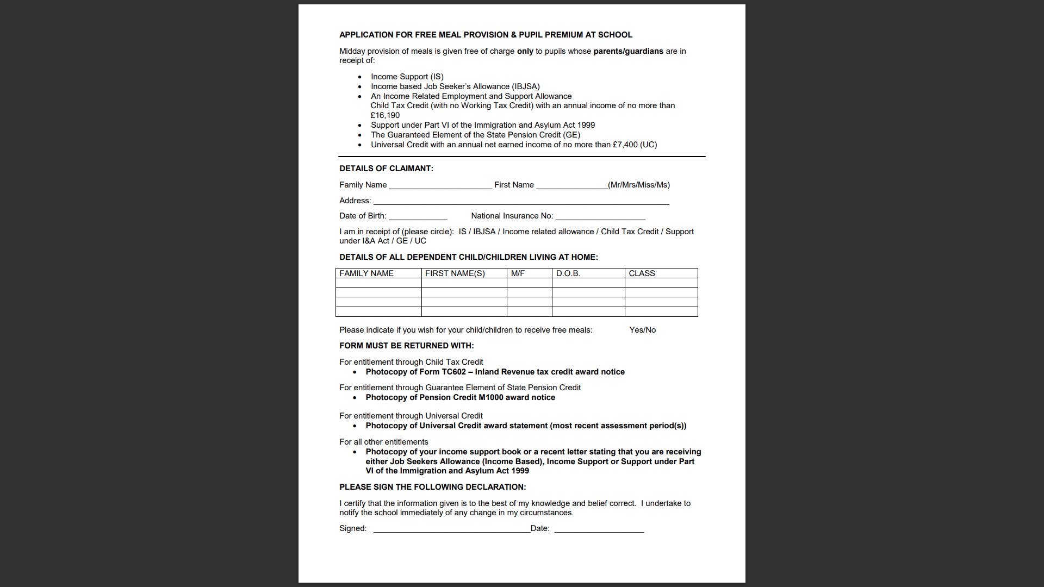

Slide 14
SAFEGUARDING
“At this school, the health, safety and well-being of every child are our paramount concern. We listen to our pupils and take seriously what they tell us. Our aim is for children to enjoy their time as pupils in this school. We want to work in partnership with you to help your child achieve their full potential and make a positive contribution.
To promote a safe environment for pupils, our selection and recruitment policy includes all checks on staff and regular volunteers’ suitability, including Criminal Records Bureau checks, as recommended by Buckinghamshire County Council in accordance with current legislation.
In accordance with our responsibilities under section 175/157 of the Education Act 2002 and “Keeping Children Safe in Education“ Sept 2023. There are four trained Designated Safeguarding Leads, the Headteacher Mrs J Watson, Deputy Headteacher Mrs R Small, and the two Assistant Headteachers Miss Boxall and Miss Johns, this ensures there is a DSL on duty at all times. It is their responsibility to ensure that all staff in contact with children receive child protection awareness training on a regular basis.
Occasions do arise when our concern about a child means we have to consult other agencies. Whilst we would always aim to work in partnership with parents there may be exceptions to this when concerns are raised for the protection of a child.
On very rare occasions Social Care, whilst undertaking an investigation under s47 of the Children Act 1989, may want to speak to a child without a parents’ knowledge. This would be a decision made in collaboration with partner agencies and would only be done in situations where a child might be at immediate risk. To gain consent at this point may increase the level of risk to the child or cause evidence of a crime to be lost.
The procedures, which we follow, have been laid down by the Local Safeguarding Children’s Board, and the school has adopted a Child Protection Policy in line with this for the safety of all. If you want to know more about our procedures, please speak to the Headteacher, Mrs J Watson or your child’s class teacher: the Policy can be found on the school’s website www.lentriseschool.co.uk

Slide 15
