Slide 1

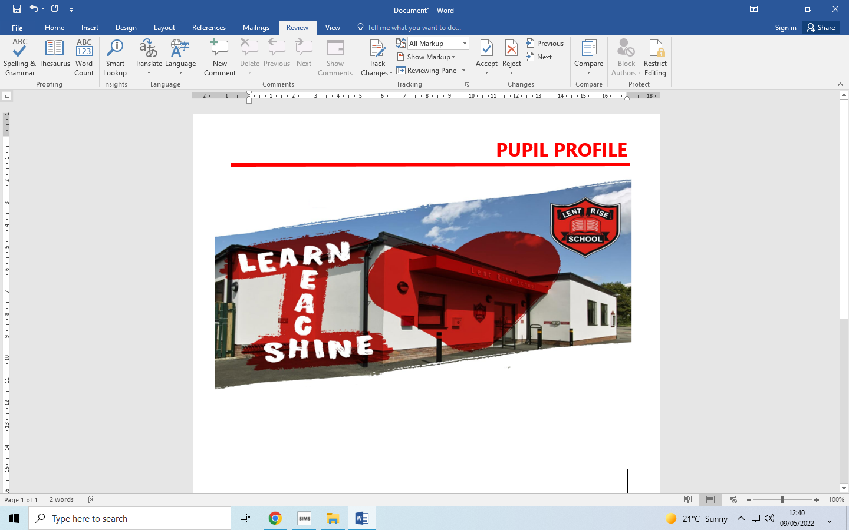
LENT RISE SCHOOL
‘Learn, Reach, Shine’
YEAR 6
PARENT PACK
Lent Rise School
Coulson Way, Burnham, Slough, SL17NP
Headteacher : Mrs J Watson
Telephone : 01628 662913
office@lrschool.co.uk
www.lentriseschool.co.uk

Slide 2
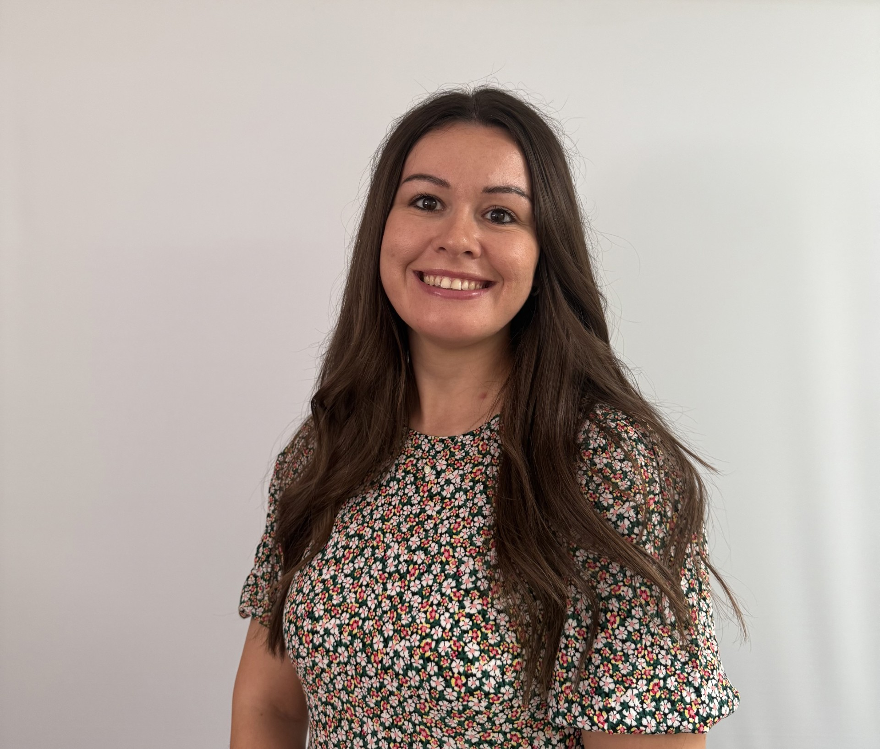
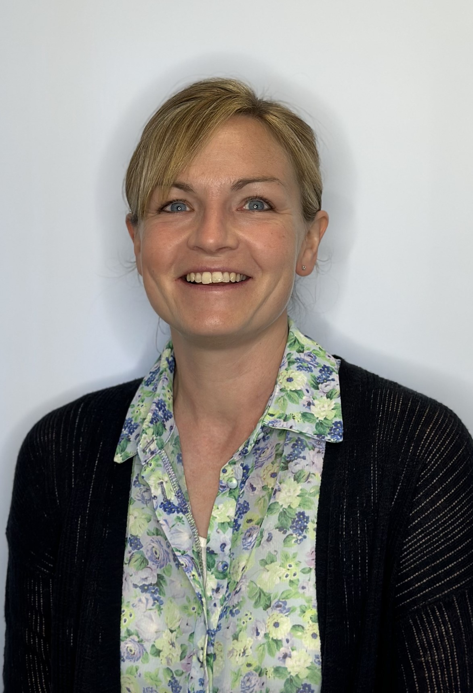
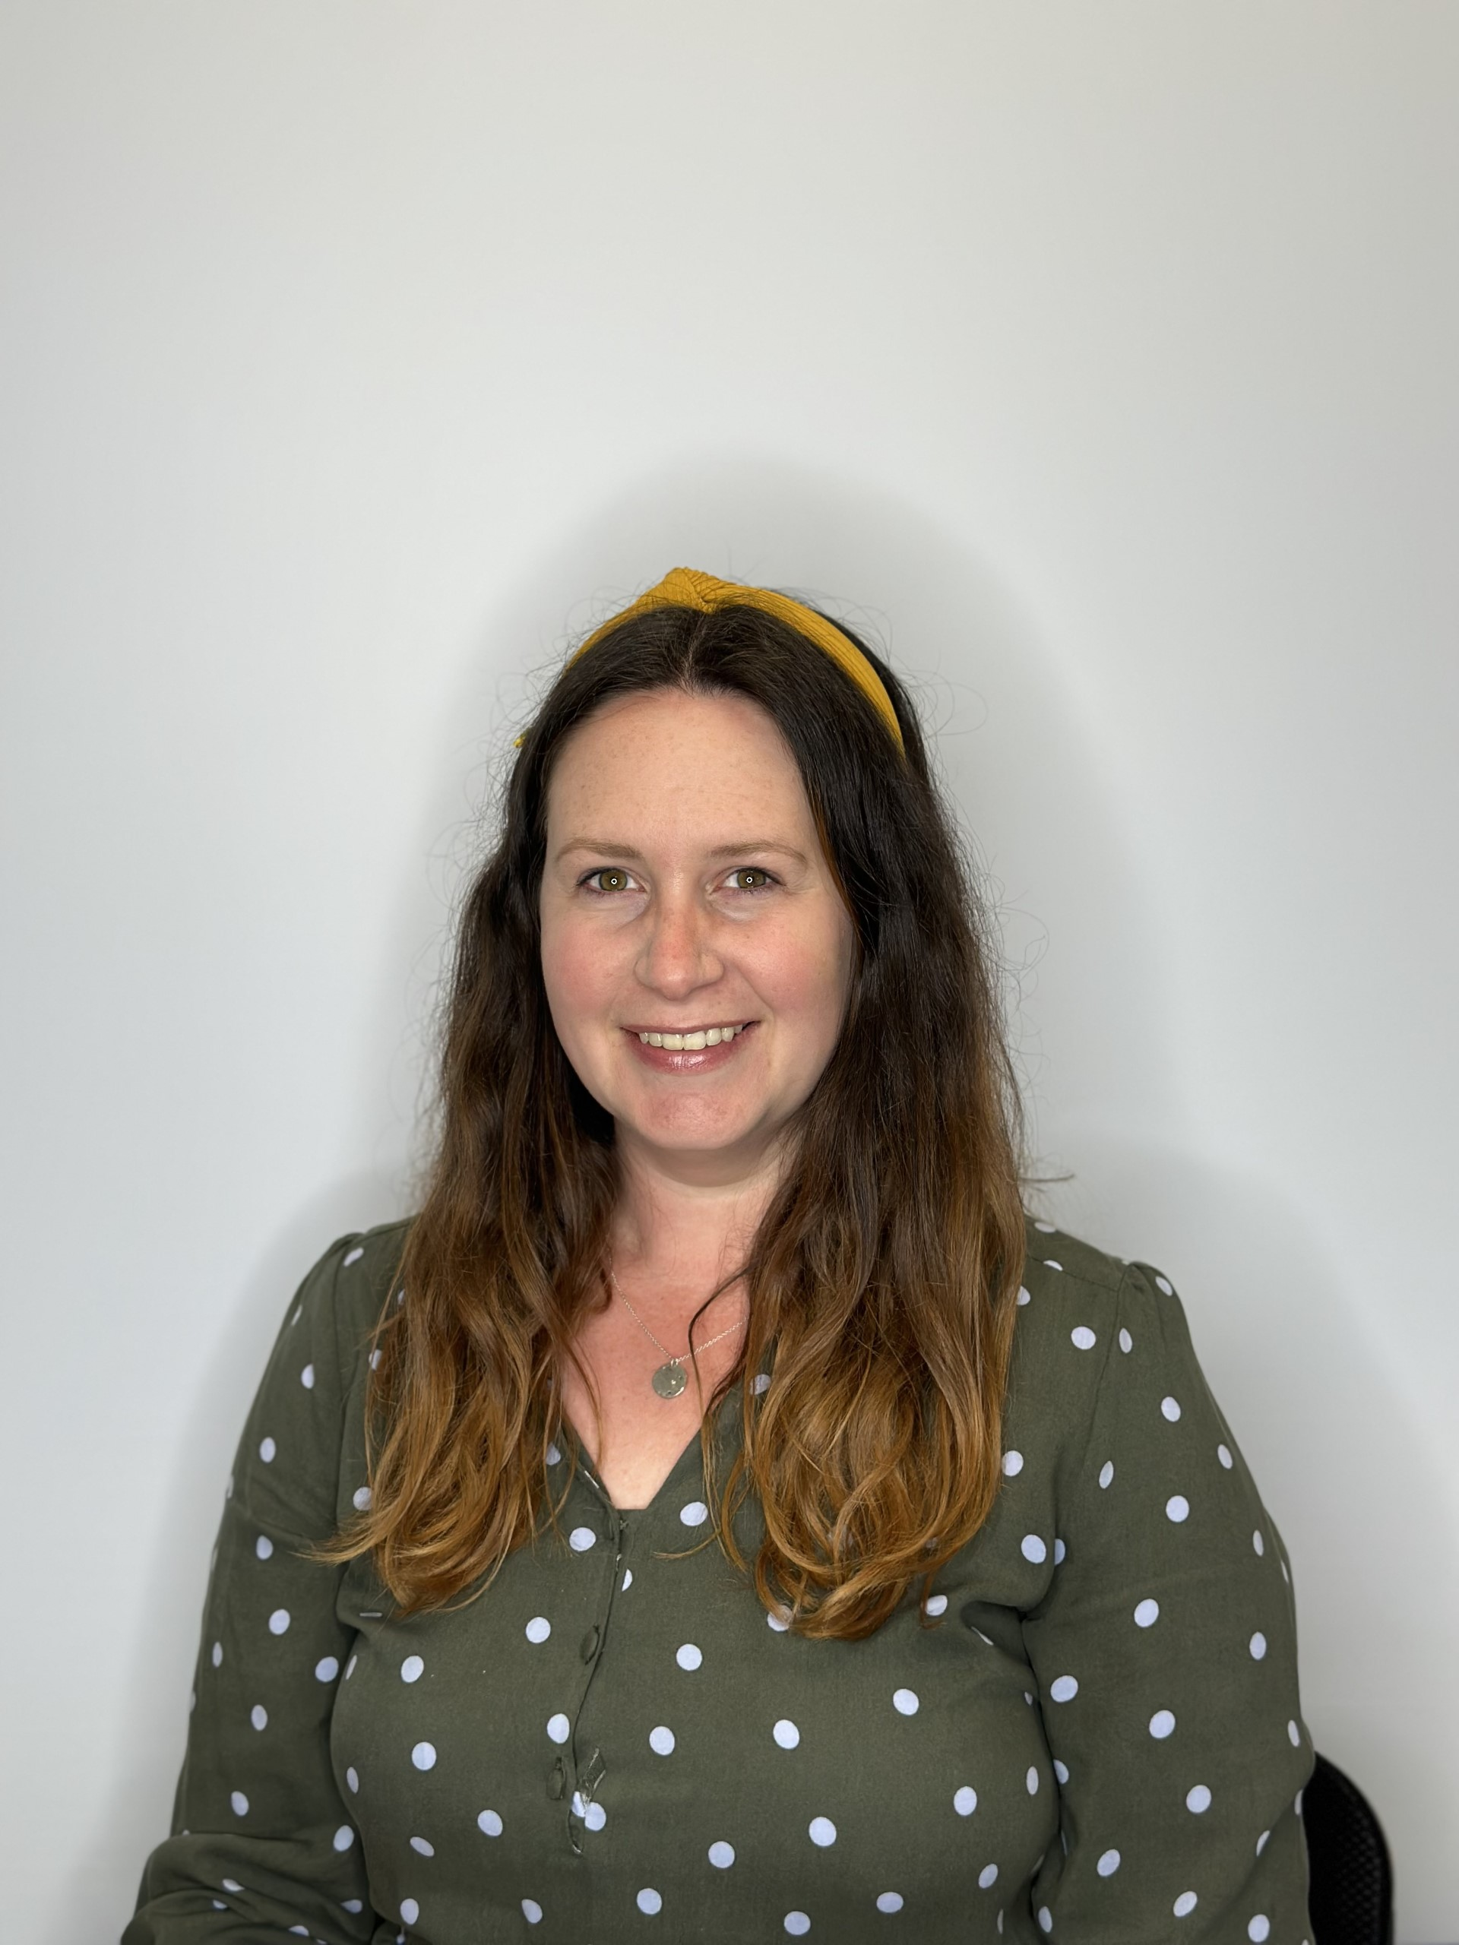
YEAR 6 INFORMATION
Year 6 is part of Key Stage 2 (KS2) which consists of Years 3 to 6. We will often abbreviate Year 6 to Y6 or use the class name. The Phase Leader is Mr North.
KS2 timings
8.30-8.45 am Morning Registration and Guided Reading
9.20 am Lesson 1
10.20 am Morning break
10:40 am Lesson 2
11:50 am Fit in 10
12:00 pm Morning lesson 3
12.45 pm Lunch
1.30 pm Afternoon registration + Afternoon lessons
3.15 pm Home time
Assemblies will be held every day; timings vary throughout the week.
PE Days
6U: Monday (outdoor) and Thursday (indoor)
6PS: Monday (outdoor) and Thursday (indoor)
A Message from Year 6
Welcome! We hope that you find all the information in this pack useful. If you have any questions after reading this Parent Pack or would like to talk to us about the year ahead, please do let us know so that we can arrange a time to meet with you. Please ensure children are equipped with their own sensible-sized pencil cases and a reading book ready for the school day. We look forward to welcoming your children into our classes!
6U Class Teacher
Mrs Uyduran
6PS Class Teacher
Mrs Paveley
6PS Class Teacher
Mrs Springford

Slide 3

YEAR 6 HOMEWORK
Suggested Homework Schedule
Monday | Tuesday | Wednesday | Thursday | Friday
 | Comprehension (Century) Spellings (Emile) | Maths (Century) | TTRS | Science (Century)
Homework is sent out weekly online (Mondays). Above is a suggested timetable only.
At Lent Rise, we instil a love of reading within school and encourage for this to be embedded at home.
To support your child’s reading further, please record daily readings in your child’s reading record. This can include any reading successes or challenges which we will check daily and follow up within school.
To support your child’s times tables further, please ensure that your child practices their times tables daily. This can be through times tables games, reciting and chanting times tables or using Times Tables Rock Stars.
Homework is catered to your child's current learning.

Slide 4
ATTENDANCE AND PUNCTUALITY
As parents you all have a legal responsibility to make sure that your child attends school every day. If your child is going to be absent from school, please log the reason via the ParentMail absence portal on the first day of their absence. This is important, as we will be contacting parents if a child is not at school and no reason has been given. Parents may be asked to provide medical evidence in the form of an appointment card or prescription where there are repeated absences due to reported illness. ​
Regular attendance and punctuality is fundamental to enabling your child to achieve the highest levels of attainment. We ensure all children are aware of the importance of attendance and punctuality. ​
​
The attendance target set by the Governing Body for 2024-2025 is 96%. We expect ALL children to achieve this.​
​
If your child is unwell​
If your child is too unwell to come to school, or has a medical appointment, please log the reason via our ParentMail absence portal. To help you, the NHS has compiled a list of guidelines about how long children should be kept off school when they have a common illnesses:​
https://www.nhs.uk/Livewell/Yourchildatschool/Pages/Illness.aspx​
​
Lateness​
Learning begins promptly at the beginning of the day with instructions and explanations, and it is vital that your child does not miss this part of the day. We monitor lateness and send letters to parents whose children regularly arrive to school late. The playground gates will open at 8:30am and close at 8:45am. Your child may come into school between these times and head straight to class. However, if your child does miss the gate to go into class, please bring them to the School Office where a member of staff will sign them in.​
​
Authorised absence​
Family holidays should always be taken during the school holidays, and we will only authorise absence in very special circumstances. On these occasions permission must be sought in advance from the Headteacher. Absence request forms are available from the school office or a letter should be written to the Headteacher. Each request will be considered individually and will take into account documentary evidence and any extenuating circumstances. If the permission to take leave is not granted and the pupil is absent, the absence will be unauthorised. In such cases the school may refer the matter to the Education Welfare Service who may issues a Penalty notice. ​
​

Slide 5
OUR OPEN DOOR POLICY
Please do contact us at any time when you have a concern, even if it appears to be minor. The ‘little’ difficulties are easy to deal with; don’t let them become major concerns. The Open Door Policy is encouraged at Lent Rise School. If you wish to talk about your child please:
Approach the class teacher
Talk to a member of the middle management team (KS1 or KS2 Phase Leaders)
Talk to a member of the senior leadership team
The Headteacher, Mrs Watson, is always happy to see parents but clearly she will go to the Class Teacher to discuss issues, therefore it makes sense for you to have spoken to the teacher first.
Contacting the Headteacher if she is not in School
When the Headteacher is out, your children are always in safe hands. If you need an immediate response, please contact the School Office and a member of the senior leadership team will get a response to you as soon as possible.
Complaints and Resolution Procedure
The following is the strategy that is suggested if difficulties arise – we recommend that you use this structure.
Talk to the Class Teacher
Talk to a member of the senior leadership team
Talk to the Headteacher
Make Representations to the Governing Body in writing to:
Mrs Maggie Young, Chair of Governors
by e-mail: govs@lrschool.co.uk
or
c/o Lent Rise School
Coulson Way
Burnham
Slough
SL1 7NP
If you are still not satisfied you may wish to put your complaint to the Secretary of State for Education and Skills who can review whether the School has acted reasonably and followed the correct procedures. The address is Sanctuary Buildings, Great Smith Street, London, SW1 3BT.
If you would like to read our full Complaints Procedure, please contact the school office for a copy or visit the school website www.lentriseschool.co.uk

Slide 6
SAFEGUARDING
“At this school, the health, safety and well-being of every child are our paramount concern. We listen to our pupils and take seriously what they tell us. Our aim is for children to enjoy their time as pupils in this school. We want to work in partnership with you to help your child achieve their full potential and make a positive contribution.
To promote a safe environment for pupils, our selection and recruitment policy includes all checks on staff and regular volunteers’ suitability, including Criminal Records Bureau checks, as recommended by Buckinghamshire County Council in accordance with current legislation.
In accordance with our responsibilities under section 175/157 of the Education Act 2002 and “Keeping Children Safe in Education“ Sept 2023. There are four trained Designated Safeguarding Leads, the Headteacher Mrs J Watson, Deputy Headteacher Mrs R Small, and the two Assistant Headteachers Miss Boxall and Miss Johns, this ensures there is a DSL on duty at all times. It is their responsibility to ensure that all staff in contact with children receive child protection awareness training on a regular basis.
Occasions do arise when our concern about a child means we have to consult other agencies. Whilst we would always aim to work in partnership with parents there may be exceptions to this when concerns are raised for the protection of a child.
On very rare occasions Social Care, whilst undertaking an investigation under s47 of the Children Act 1989, may want to speak to a child without a parents’ knowledge. This would be a decision made in collaboration with partner agencies and would only be done in situations where a child might be at immediate risk. To gain consent at this point may increase the level of risk to the child or cause evidence of a crime to be lost.
The procedures, which we follow, have been laid down by the Local Safeguarding Children’s Board, and the school has adopted a Child Protection Policy in line with this for the safety of all. If you want to know more about our procedures, please speak to the Headteacher, Mrs J Watson or your child’s class teacher: the Policy can be found on the school’s website www.lentriseschool.co.uk

Slide 7
